Slide 1
Impacts of Ocean Acidification in a wider Context:
Insights from IPCC SR15 and Current Research
Hans-O. Pörtner
IPCC Working Group II Co-Chair
Alfred Wegener Institute for Polar and Marine Research
Event: Actions on Ocean Acidification – The Other CO2 Problem
COP24, Katowice
Room Narew
8th December 2018

Slide 2
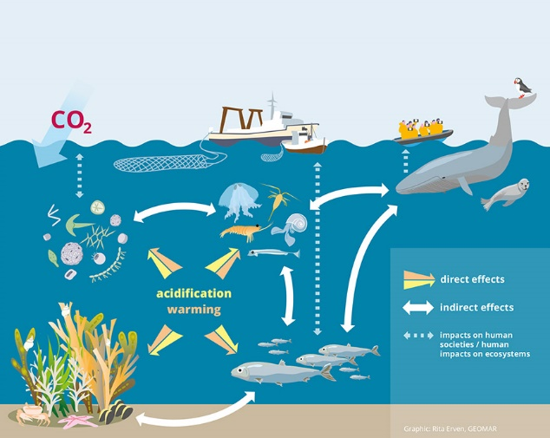
Effects of Ocean Warming and Acidification
Limited understanding of fundamental processes

Slide 3
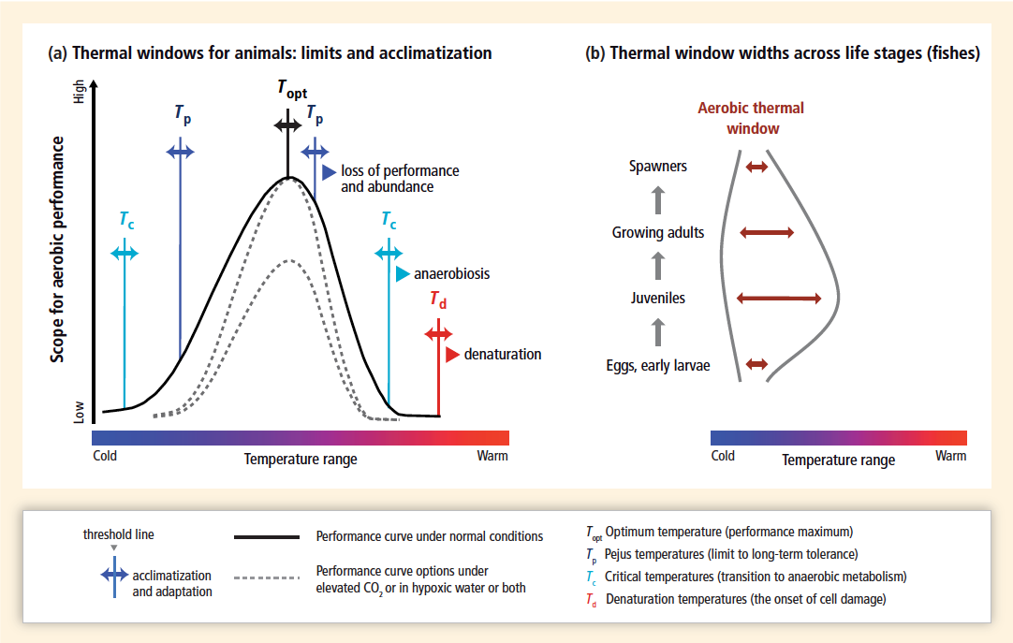
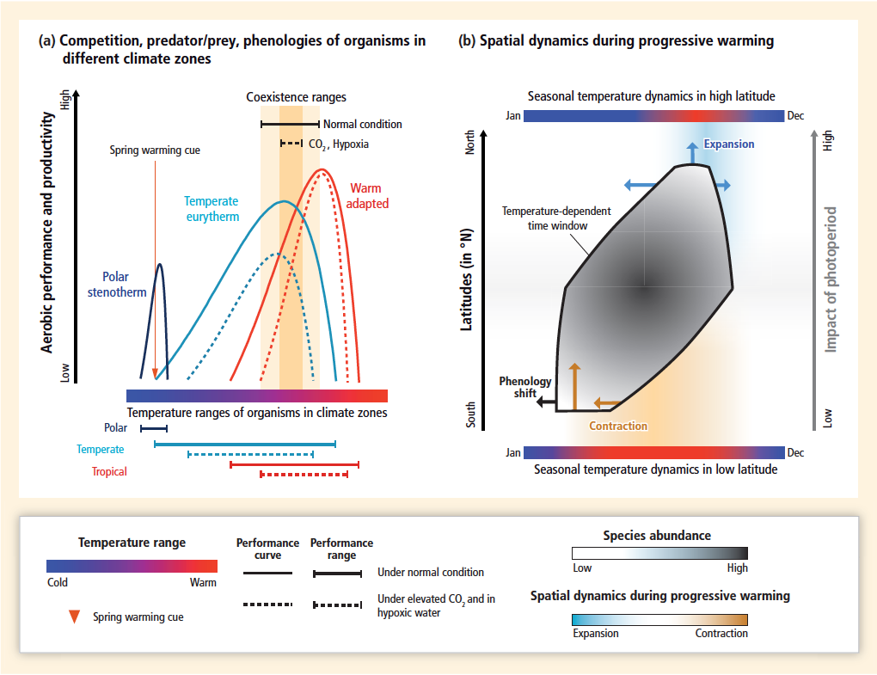
The consequences of thermal specialization,
influenced by oxygen and CO₂, .....biogeography
IPCC AR5 WGII Figure 6.5

Slide 4
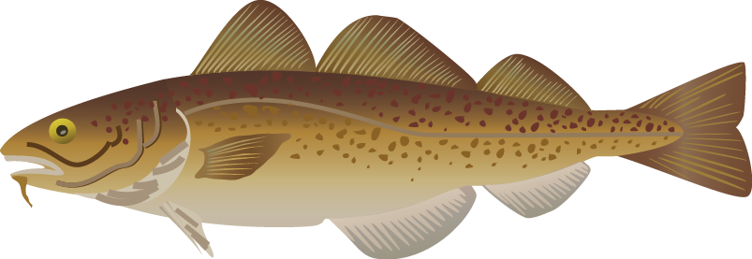
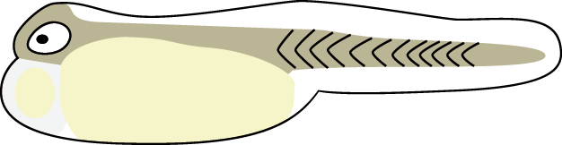
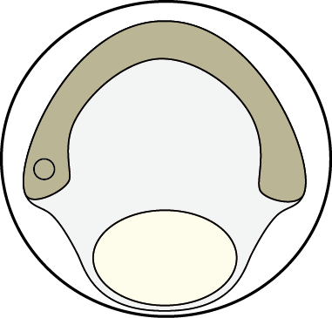
Complex Physiologies lead to variable thermal tolerance ranges across lifestages (Atlantic cod)
3.
4.
5. Spawners
4. Adults
3. Juveniles
2. Larvae
1. Eggs
5.
2.
....not yet considered in impact modelling
1.
Pörtner and Farrell, Science 2008
4.
4.
4.
4.
3.
4.
3.
4.
3.
4.
3.
4.
3.
4.
3.
3.
3.
3.
5. Spawners
5. Spawners
5. Spawners
5. Spawners
5. Spawners
5. Spawners
5. Spawners
4. Adults
5. Spawners
4. Adults
5. Spawners
4. Adults
5. Spawners
4. Adults
5. Spawners
4. Adults
5. Spawners
4. Adults
4. Adults
3. Juveniles
4. Adults
3. Juveniles
2.
4. Adults
Sequence of life stages
3. Juveniles
2.
4. Adults
Sequence of life stages
3. Juveniles
2.
4. Adults
Sequence of life stages
3. Juveniles
2.
4. Adults
2.
Sequence of life stages
3. Juveniles
5.
Sequence of life stages
3. Juveniles
2.
Sequence of life stages
2. Larvae
3. Juveniles
5.
2.
Sequence of life stages
2. Larvae
3. Juveniles
5.
2.
Sequence of life stages
2. Larvae
3. Juveniles
5.
2.
Sequence of life stages
2. Larvae
3. Juveniles
5.
Sequence of life stages
2. Larvae
3. Juveniles
5.
Sequence of life stages
2. Larvae
5.
Sequence of life stages
1. Eggs
2. Larvae
5.
1. Eggs
2. Larvae
5.
1. Eggs
2. Larvae
1. Eggs
2. Larvae
1. Eggs
2. Larvae
1. Eggs
2. Larvae
1. Eggs
1. Eggs
Thermal tolerance range
1. Eggs
Thermal tolerance range
1. Eggs
Thermal tolerance range
1. Eggs
Thermal tolerance range
1. Eggs
Thermal tolerance range
Thermal tolerance range
Thermal tolerance range
Thermal tolerance range
Thermal tolerance range
Thermal tolerance range
Thermal tolerance range
Thermal tolerance range
1.
1.
1.
1.
1.
1.
1.
1.
1.

Slide 5
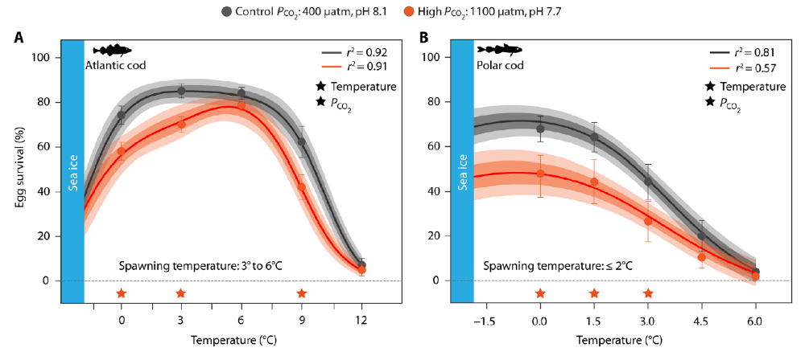
Narrowing Thermal Range =
Narrowing Spawning Habitat
Ocean Acidification causes narrowing of embryonic thermal ranges, thereby affecting suitable spawning habitat
Source: Dahlke et al. Sci. Adv. 2018; 4 : eaas8821

Slide 6
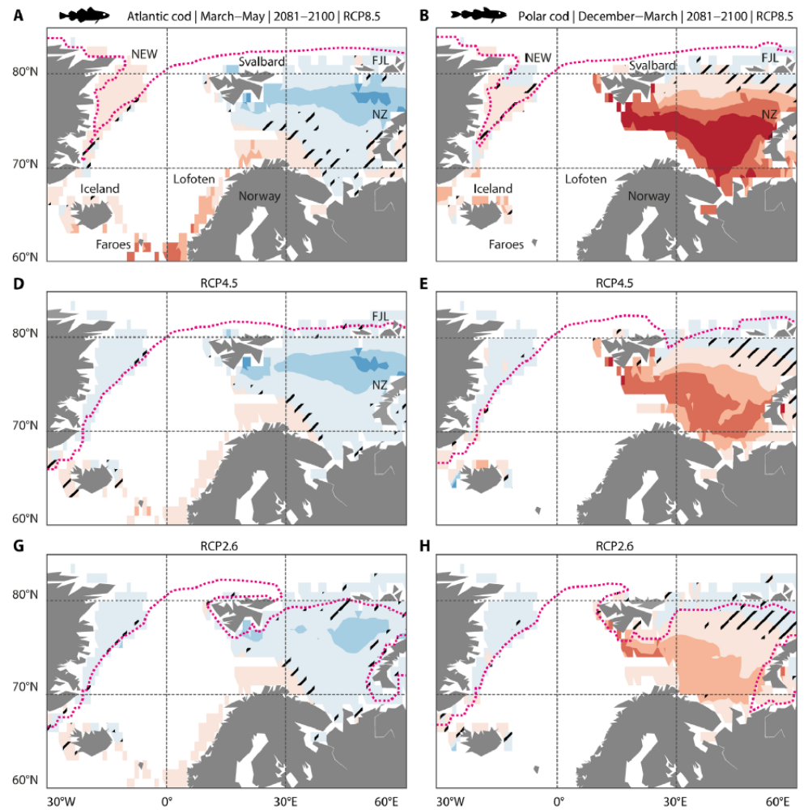
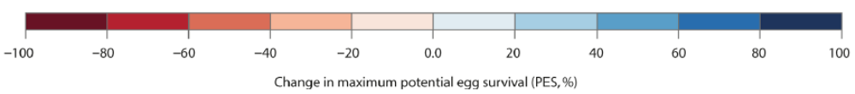
Shift in thermally suitable spawning habitat
Atlantic cod
Polar cod
≈4°C
≈2°C
Source: Dahlke et al. Sci. Adv. 2018; 4 : eaas8821
Change in maximum potential egg survival (PES, %)
≈1.5°C

Slide 7
Assessing Risks
LTGG
2 °C
1.5°C
Updated from IPCC AR5

Slide 8
IPCC SR15 Summary for Policy Makers
“Fisheries and aquaculture are important to global food security but are already facing increasing risks from ocean warming and acidification (medium confidence), which will increase at 1.5°C global warming. Risks are increasing for marine aquaculture and many fisheries at warming and acidification at 1.5°C (e.g., many bivalves such as oysters, and fin fish; medium confidence), especially at low latitudes (medium confidence). Small-scale fisheries in tropical regions, which are very dependent on habitat provided by coastal ecosystems such as coral reefs, mangroves, seagrass and kelp forests, are at a high risk at 1.5°C due to loss of habitat (medium confidence). Risks of impacts and decreasing food security become greater as warming and acidification increase, with substantial losses likely for coastal livelihoods and industries (e.g. fisheries, aquaculture) as temperatures increase beyond 1.5°C (medium to high confidence). {3.4.4, 3.4.5, 3.4.6, Box 3.1, Box 3.4, Box 3.5, Cross-Chapter Box 6 in this Chapter} “

Slide 9
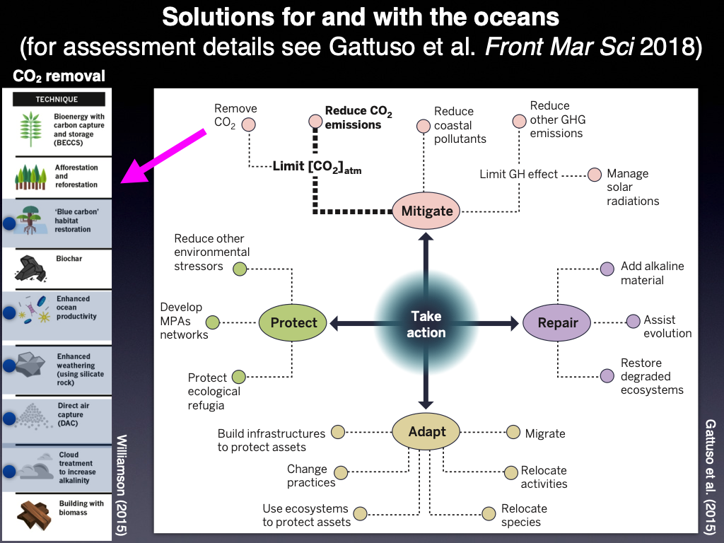


Slide 10
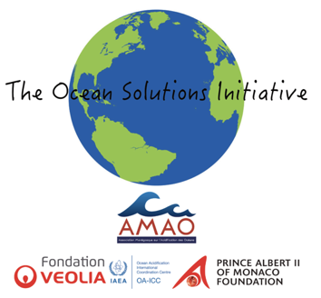
Thank you for your attention
Contact IPCC WGII:
tsu@ipcc-wg2.awi.de
Working Group II Technical Support Unit
Intergovernmental Panel on Climate Change
c/o Alfred Wegener Institute, Germany
Further info IPCC:
http://www.ipcc.ch
Instagram IPCC_Climate_Change
Twitter @IPCC_CH
Facebook @IPCC News

