Slide 1
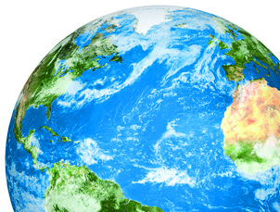
Ocean acidification: another reason for reducing CO₂ emissions, for ocean inclusion in the Paris Agreement and for increasing global observations
Dr Carol Turley OBE, Plymouth Marine Laboratory
UN Side Event, on Ocean Acidification, part of the COP24 UN Oceans Action Event, 8th December 2018

Slide 2
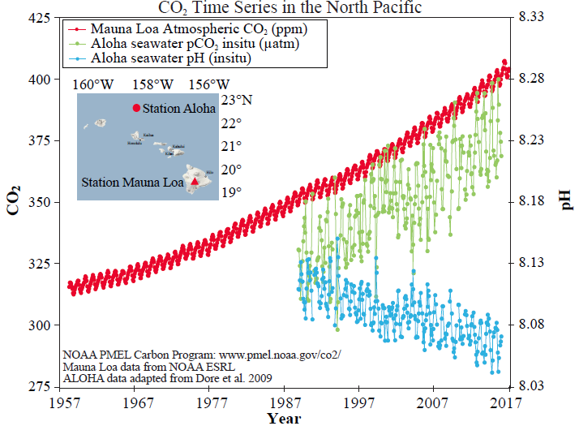

Ocean acidification is happening now and is measurable
Atmospheric CO₂
Seawater pCO₂
Seawater pH
The ocean has already taken up 27% of CO₂ emissions causing ocean acidification

Slide 3
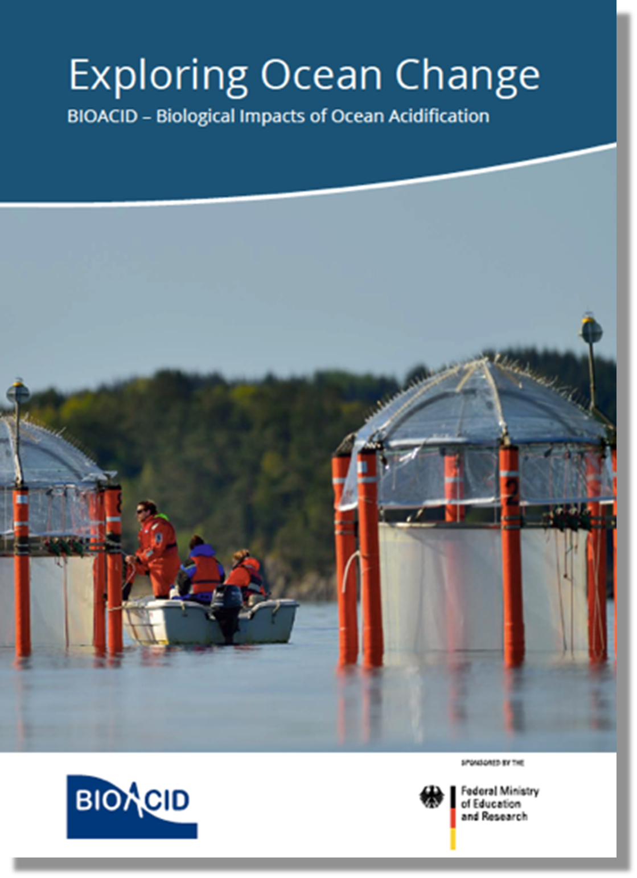

Where are we now?
Since pre-industrial times, human activities have caused approximately:
30% increase in ocean acidity
Impacts already detectable
Where could we be by 2100?
150% increase in ocean acidity
~50% of all species tested negatively affected by ocean acidification

Slide 4

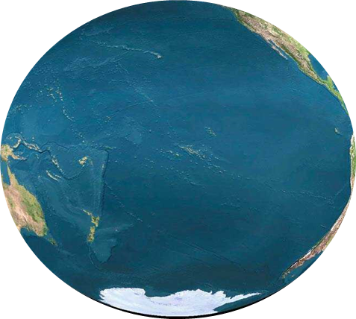
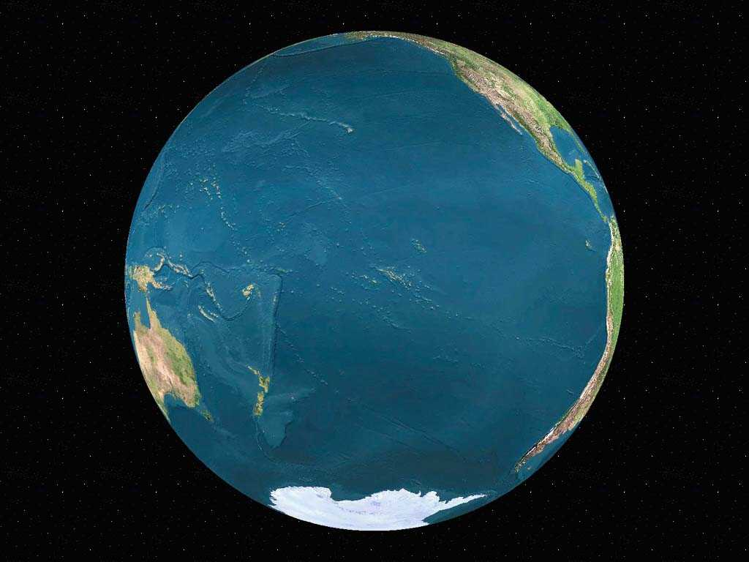
The ocean is at the frontline of climate change
… multiple stressors often occurring at the same time and place
+
+
+
+
+
Acidification
Warming
Oxygen loss
Sea Level Rise
Marine heat waves
Storms

Slide 5
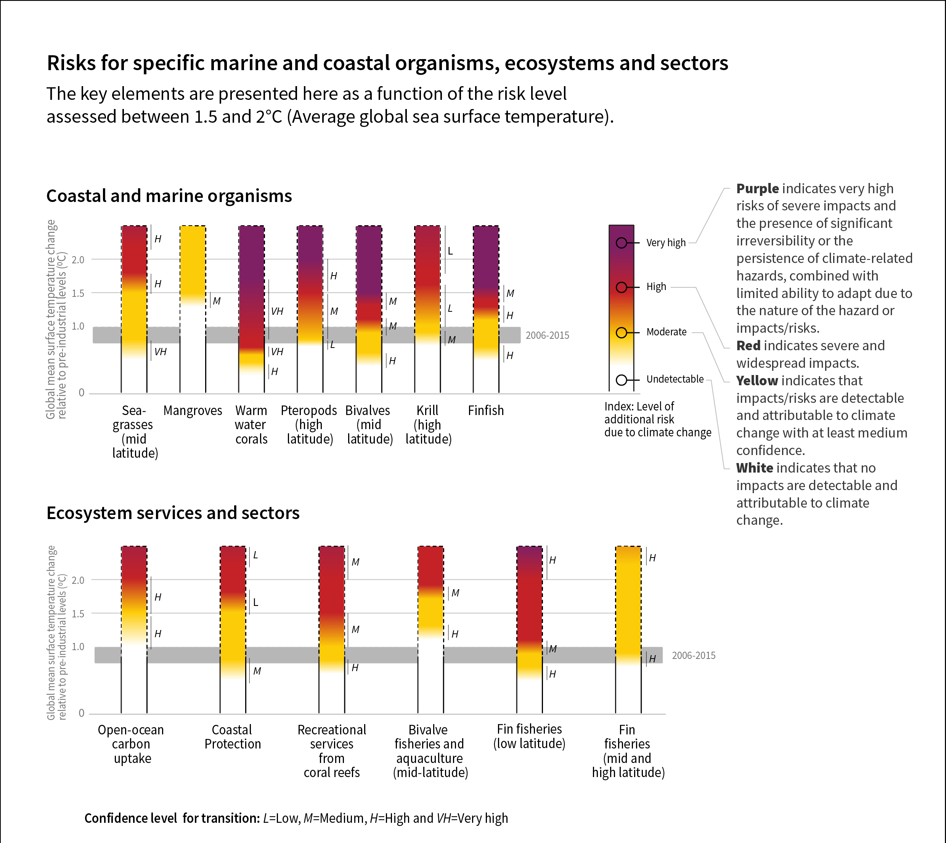
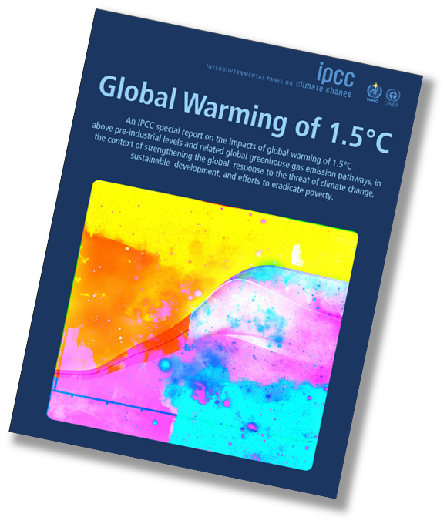
IPCC SR1.5: Risk level assessed between 1.5 and 2℃
Level of additional risk due to climate change

Slide 6
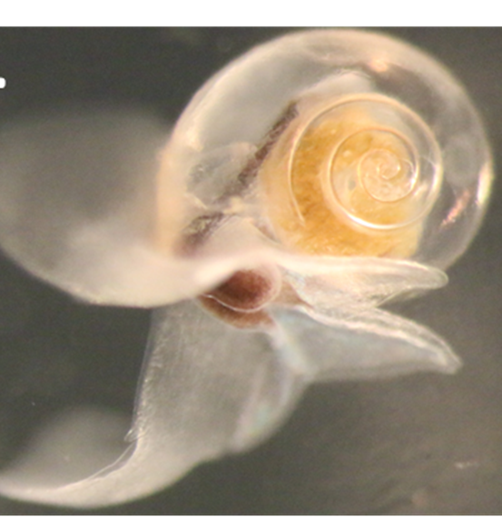
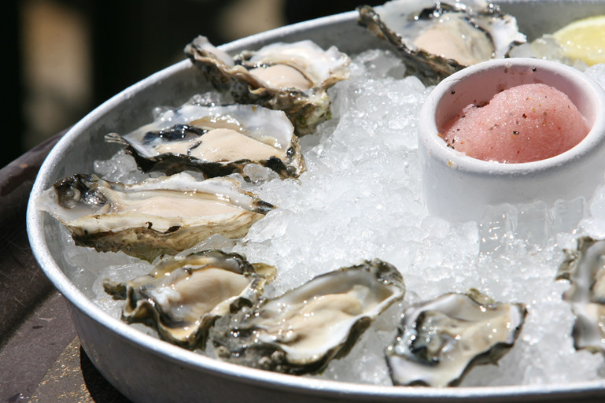
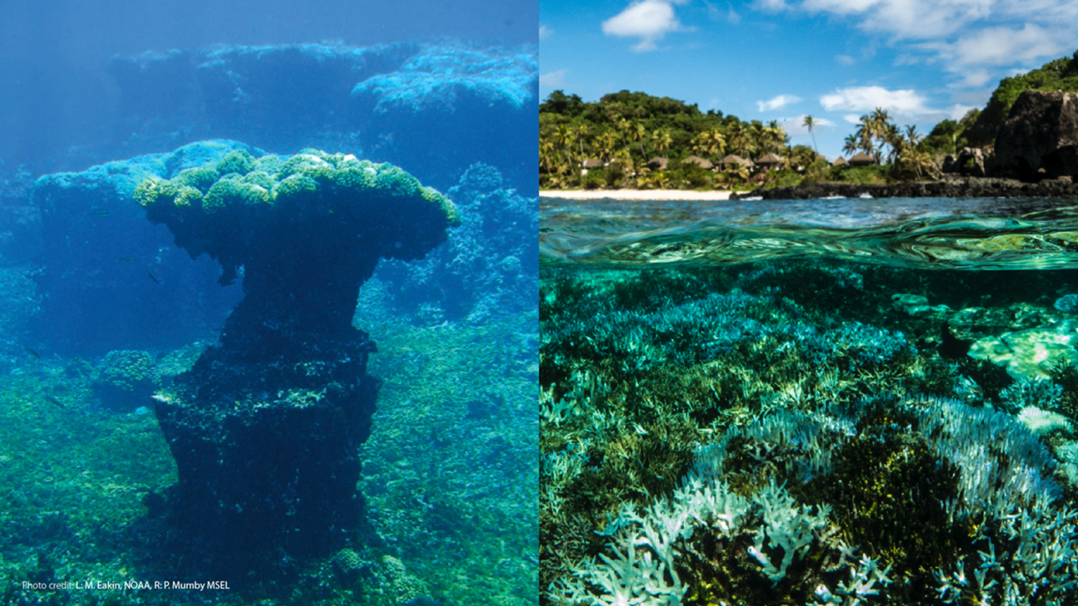
IPCC SR1.5: Risk level assessed between 1.5 and 2℃
Image: Clara Manno
Image: Seb Hennige
70-90% of the warmer water coral reefs that exist today will disappear when global warming exceeds 1.5°C (very high confidence)

Slide 7
IPCC SR1.5: Risk level assessed between 1.5 and 2℃
Current NDCs deliver over 3ºC
3.0
Image: Clara Manno
Image: Seb Hennige
70-90% of the warmer water coral reefs that exist today will disappear when global warming exceeds 1.5°C (very high confidence)

Slide 8

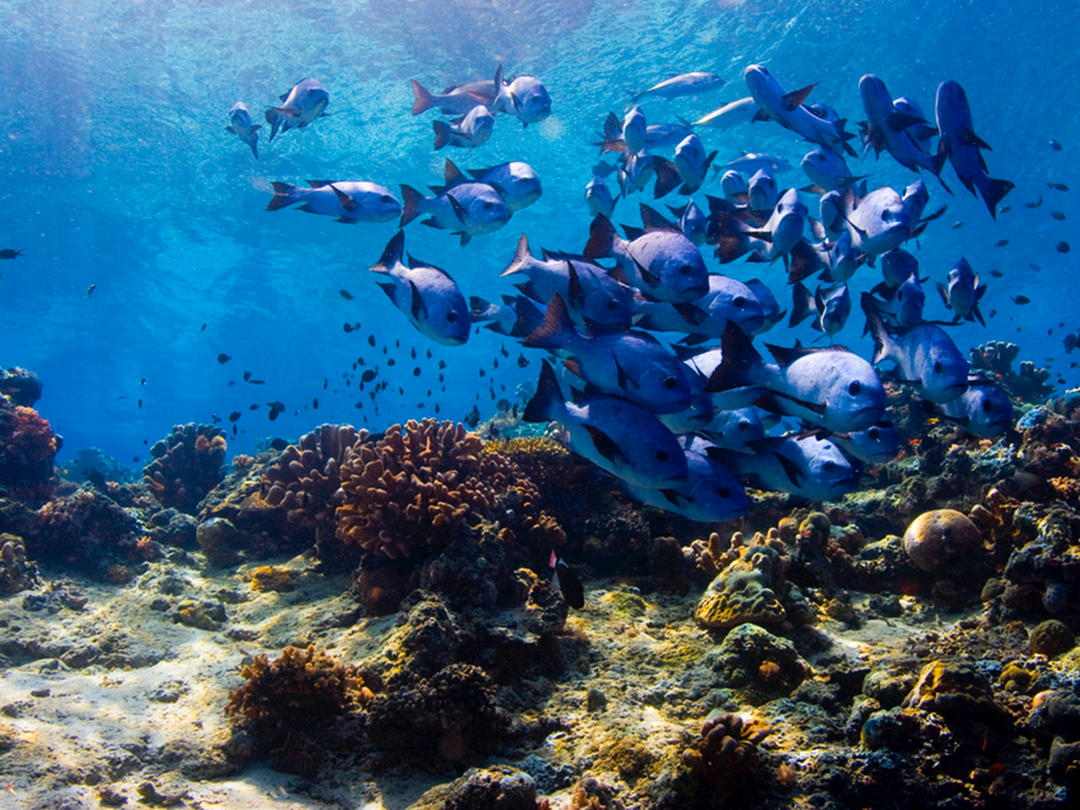
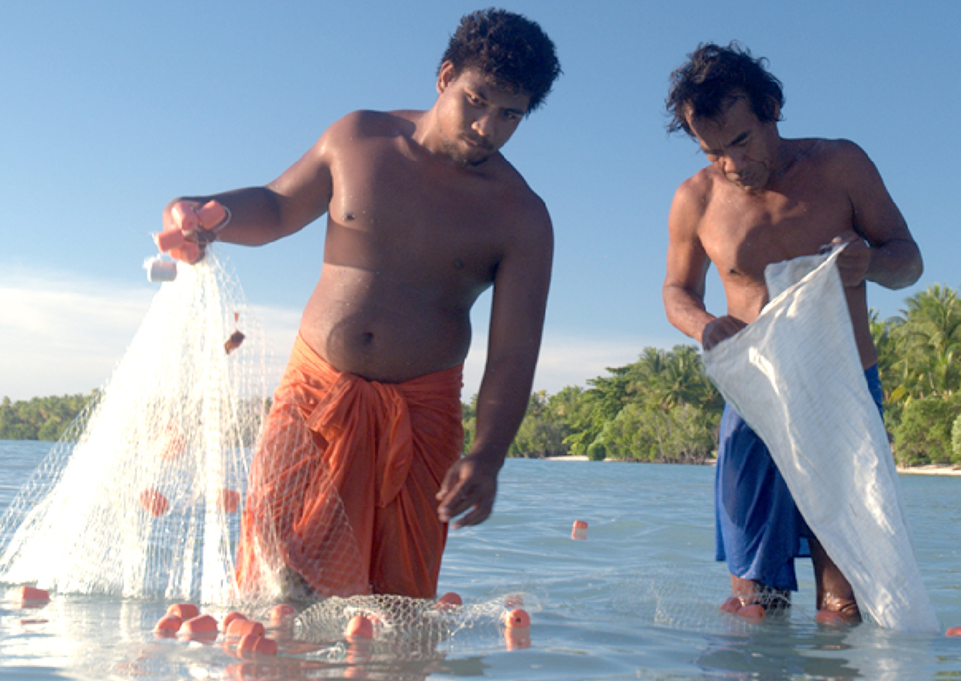

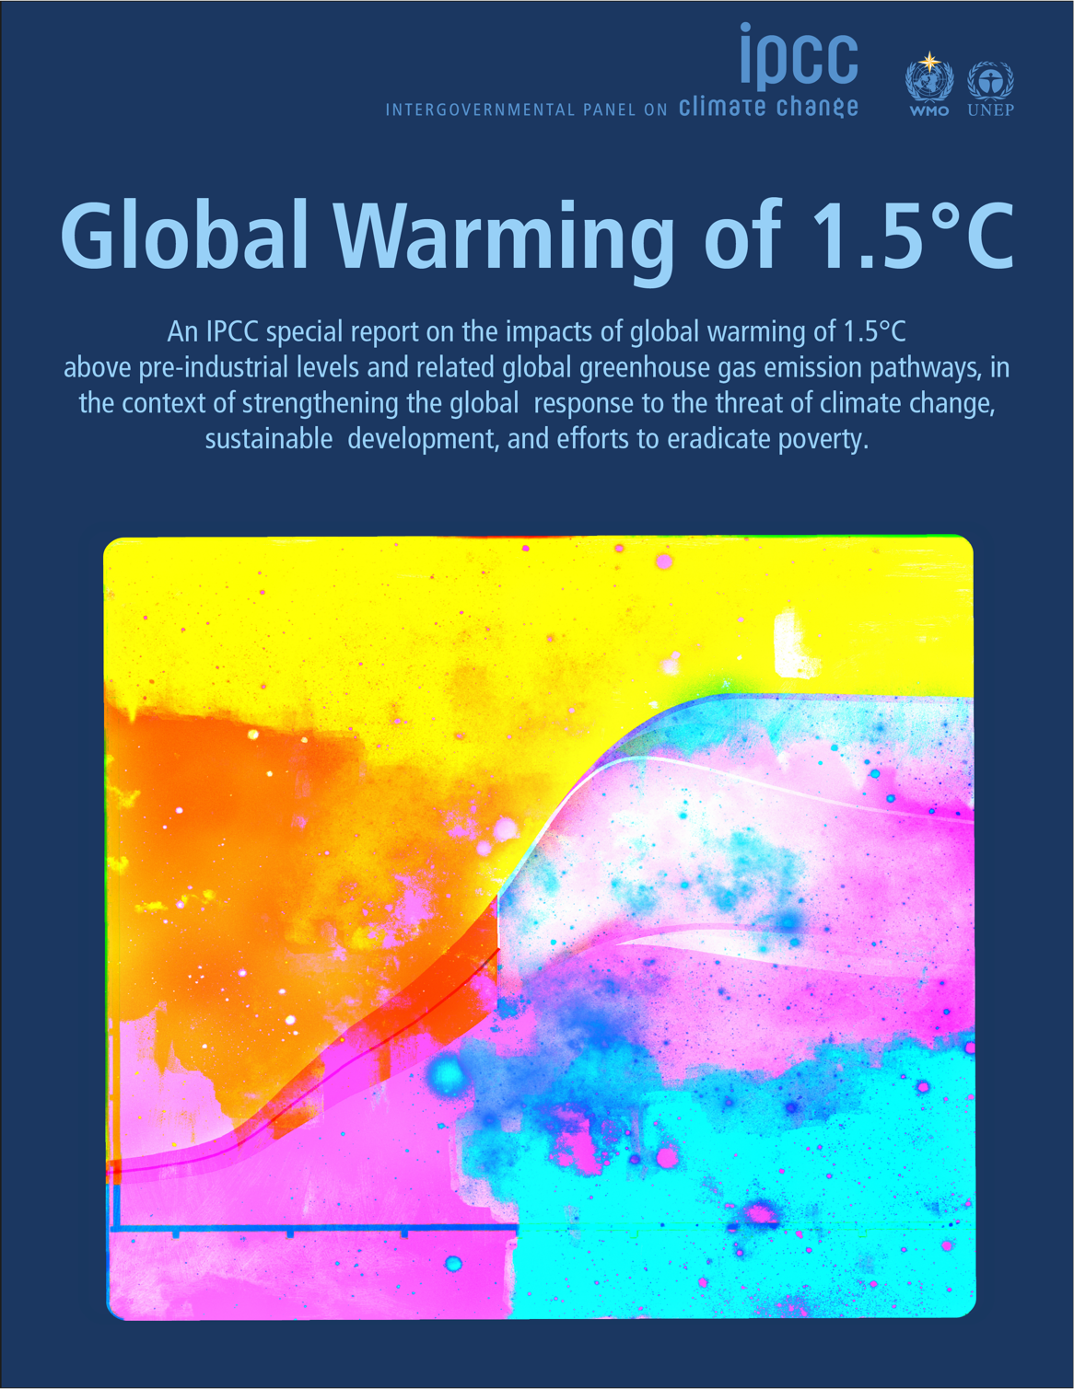
Risk level assessed between 1.5 and 2℃?
Current NDCs deliver over 3ºC
3.0
Image: Dan Exton
Limiting global warming to 1.5°C compared to 2ºC is projected to:
Reduce risks to marine biodiversity, fisheries, and ecosystems, and their functions and services to humans (high confidence)

Slide 9

The ocean and the UNFCCC – why it should be included
Directly relevant to CO₂ emissions and the UNFCCC [Article 2, UNFCCC]
+
+
+
+
+
Acidification
Warming
Oxygen loss
Sea Level Rise
Marine heat waves
Storms
The objective of UNFCCC is: “to achieve stabilization of greenhouse gas concentrations in the atmosphere at a level that would prevent dangerous anthropogenic interference with the climate system” [Article 2, UNFCCC Convention]
The ocean is clearly part of the “climate system”
The UNFCCC therefore has responsibility for GHG impacts on the ocean

Slide 10

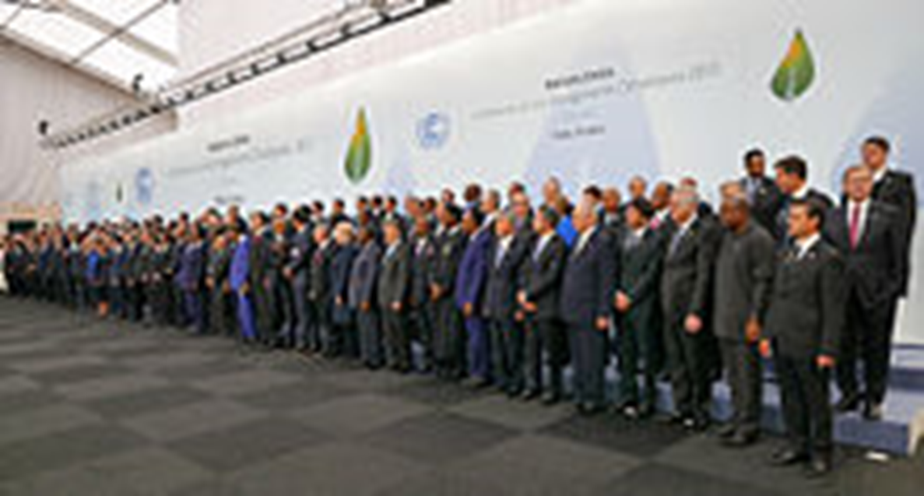
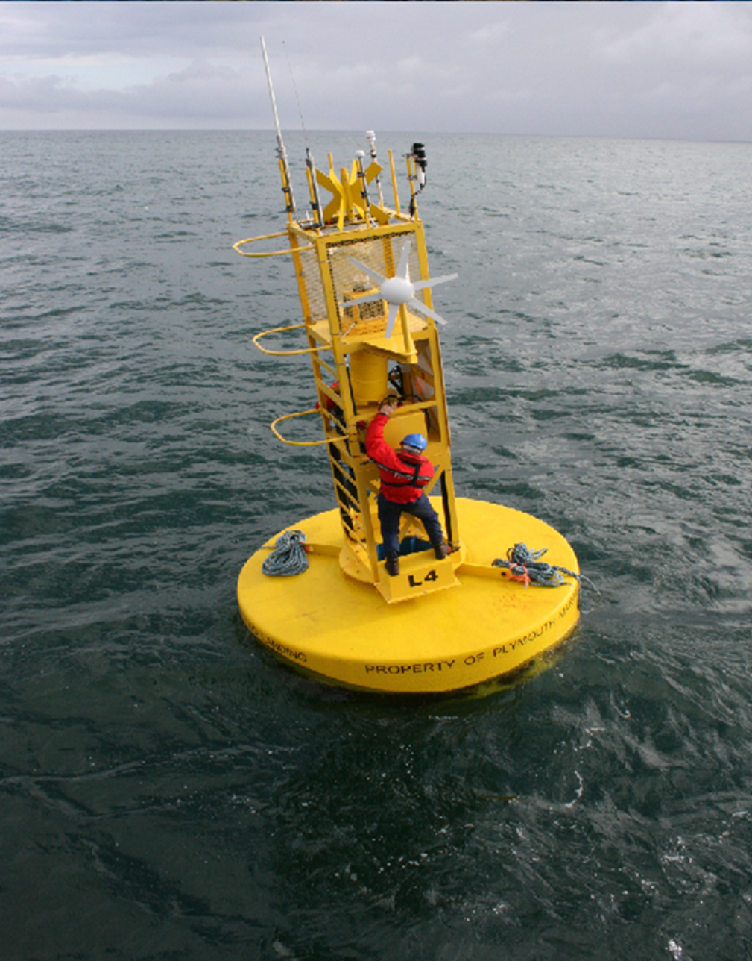
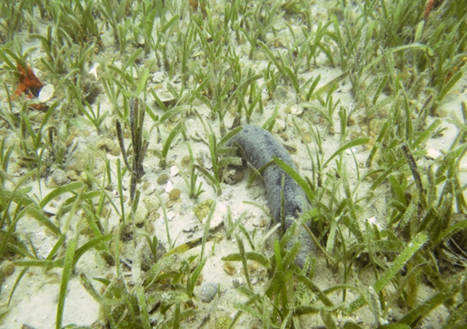


The evidence is in: So what do we need to do?
Nations need to take the ocean into account and to:
Recognise the very high risk of CO₂ emissions to ocean ecosystems and its dependent societies
Take unprecedented action on greenhouse gas emissions over next 10 years to achieve net-zero emissions by 2050
Include the ocean in the implementation of the Paris Agreement, ocean NDCs and funding ocean actions
Preserve ocean carbon sinks such as mangroves, sea grass meadows and salt marshes
Reduce local sources of acidification such as from land
Reduce other stressors such as pollution and poor management and through MPAs
Observe local ocean acidification conditions, but collaborate internationally, so societies’ are forewarned as it is a global condition with local effects
Network of 506 scientists from 83 countries.
All welcome: www.goa-on.org

Slide 11

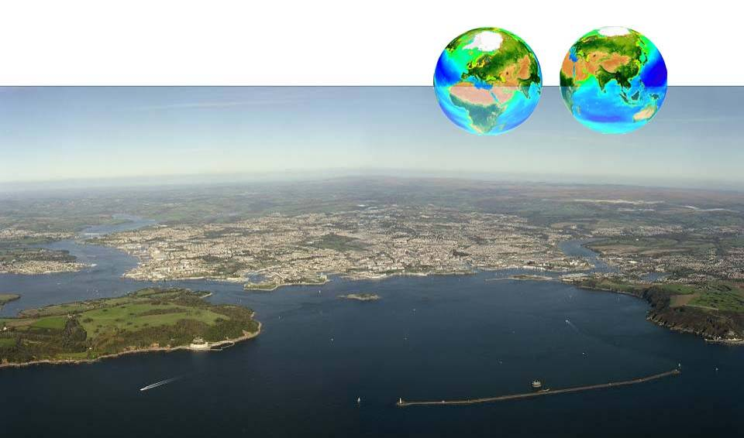



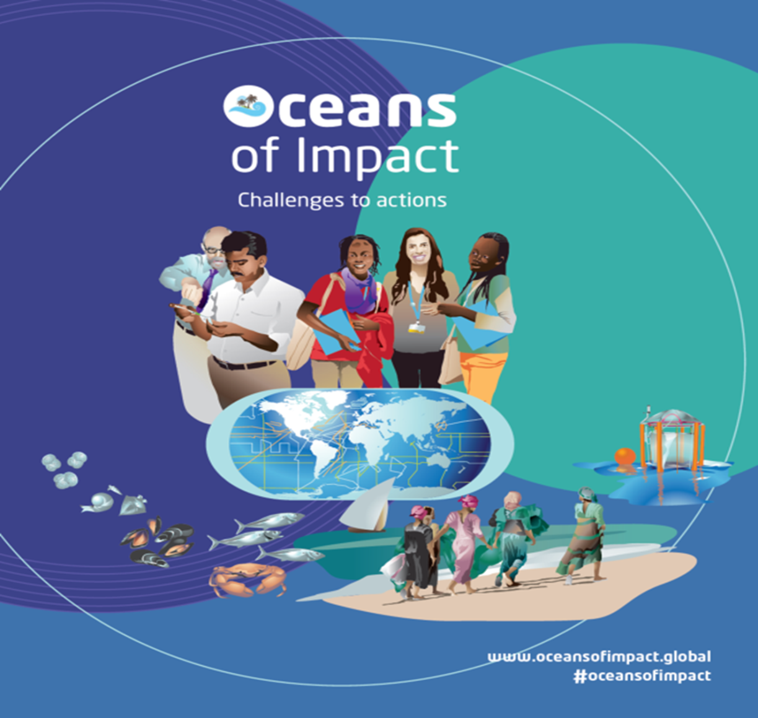
Thank you ct@pml.ac.uk
More information see: www.oceansofimpact.global

