Slide 1
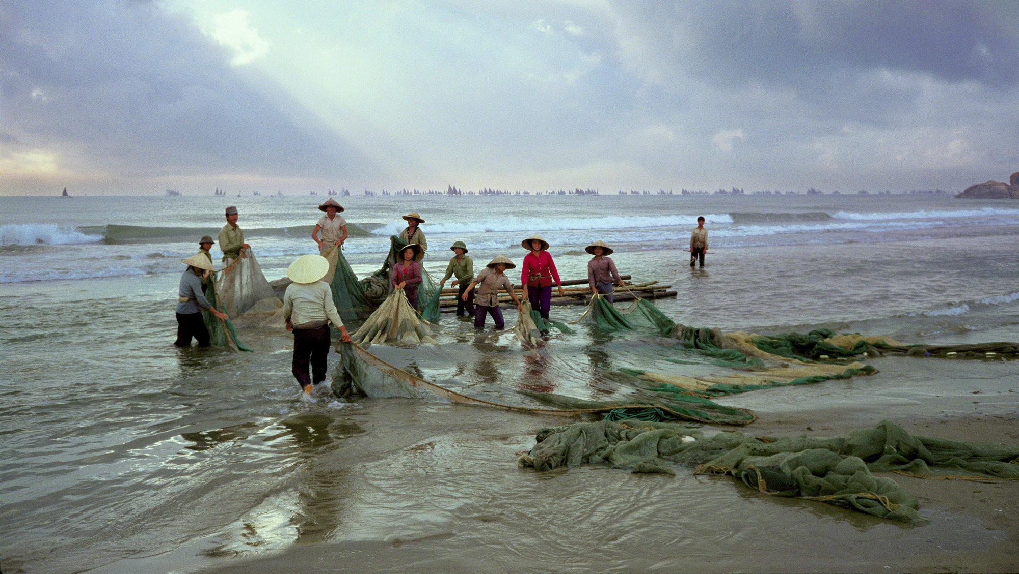
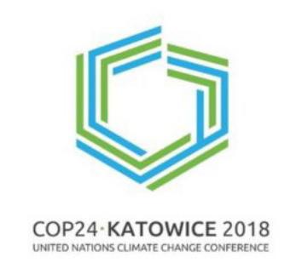

Food from the Oceans in the era of climate change (Part II)
Manuel Barange
Director Fisheries and Aquaculture Division
Food and Agriculture Organization of the UN, Rome, Italy (manuel.barange@fao.org)

Slide 2

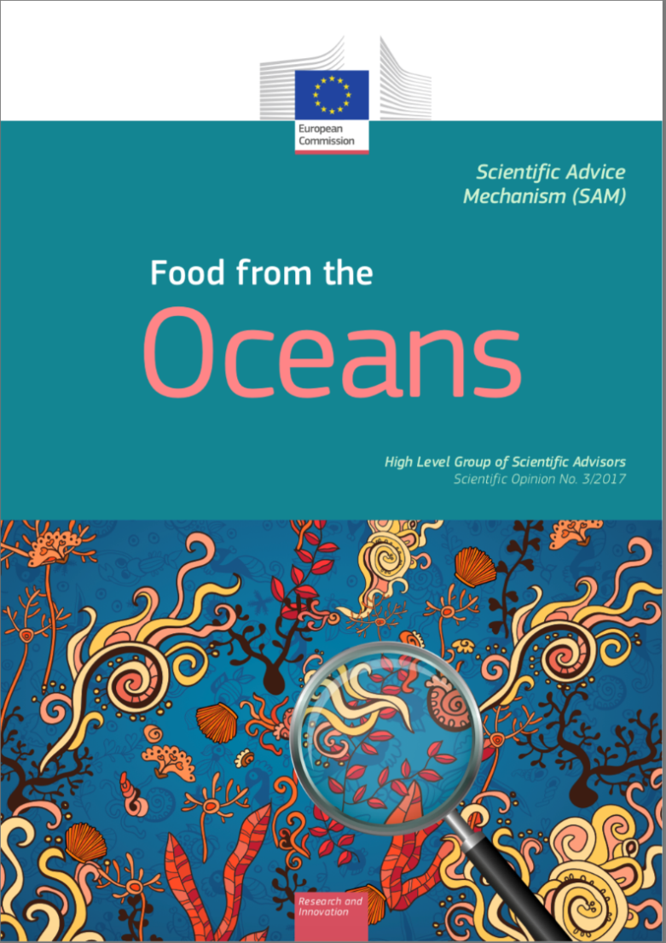
Increased calls to obtain more food from Oceans
How to do so in the era of climate change is less obvious
2016 FAO data – Marine systems
88.3 million t for food (32% from marine aquaculture)
19.7 million t non-food use
58% of all food fish is from Ocean sources
Marine Capture
Marine Aquaculture

Slide 3

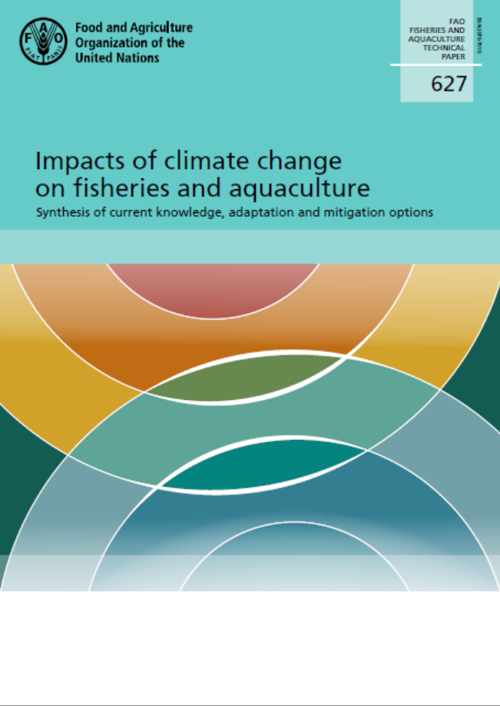
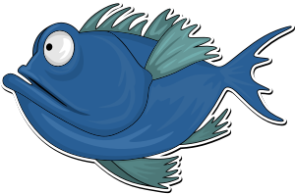

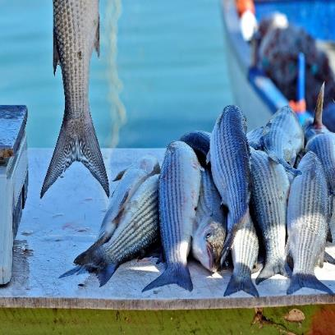



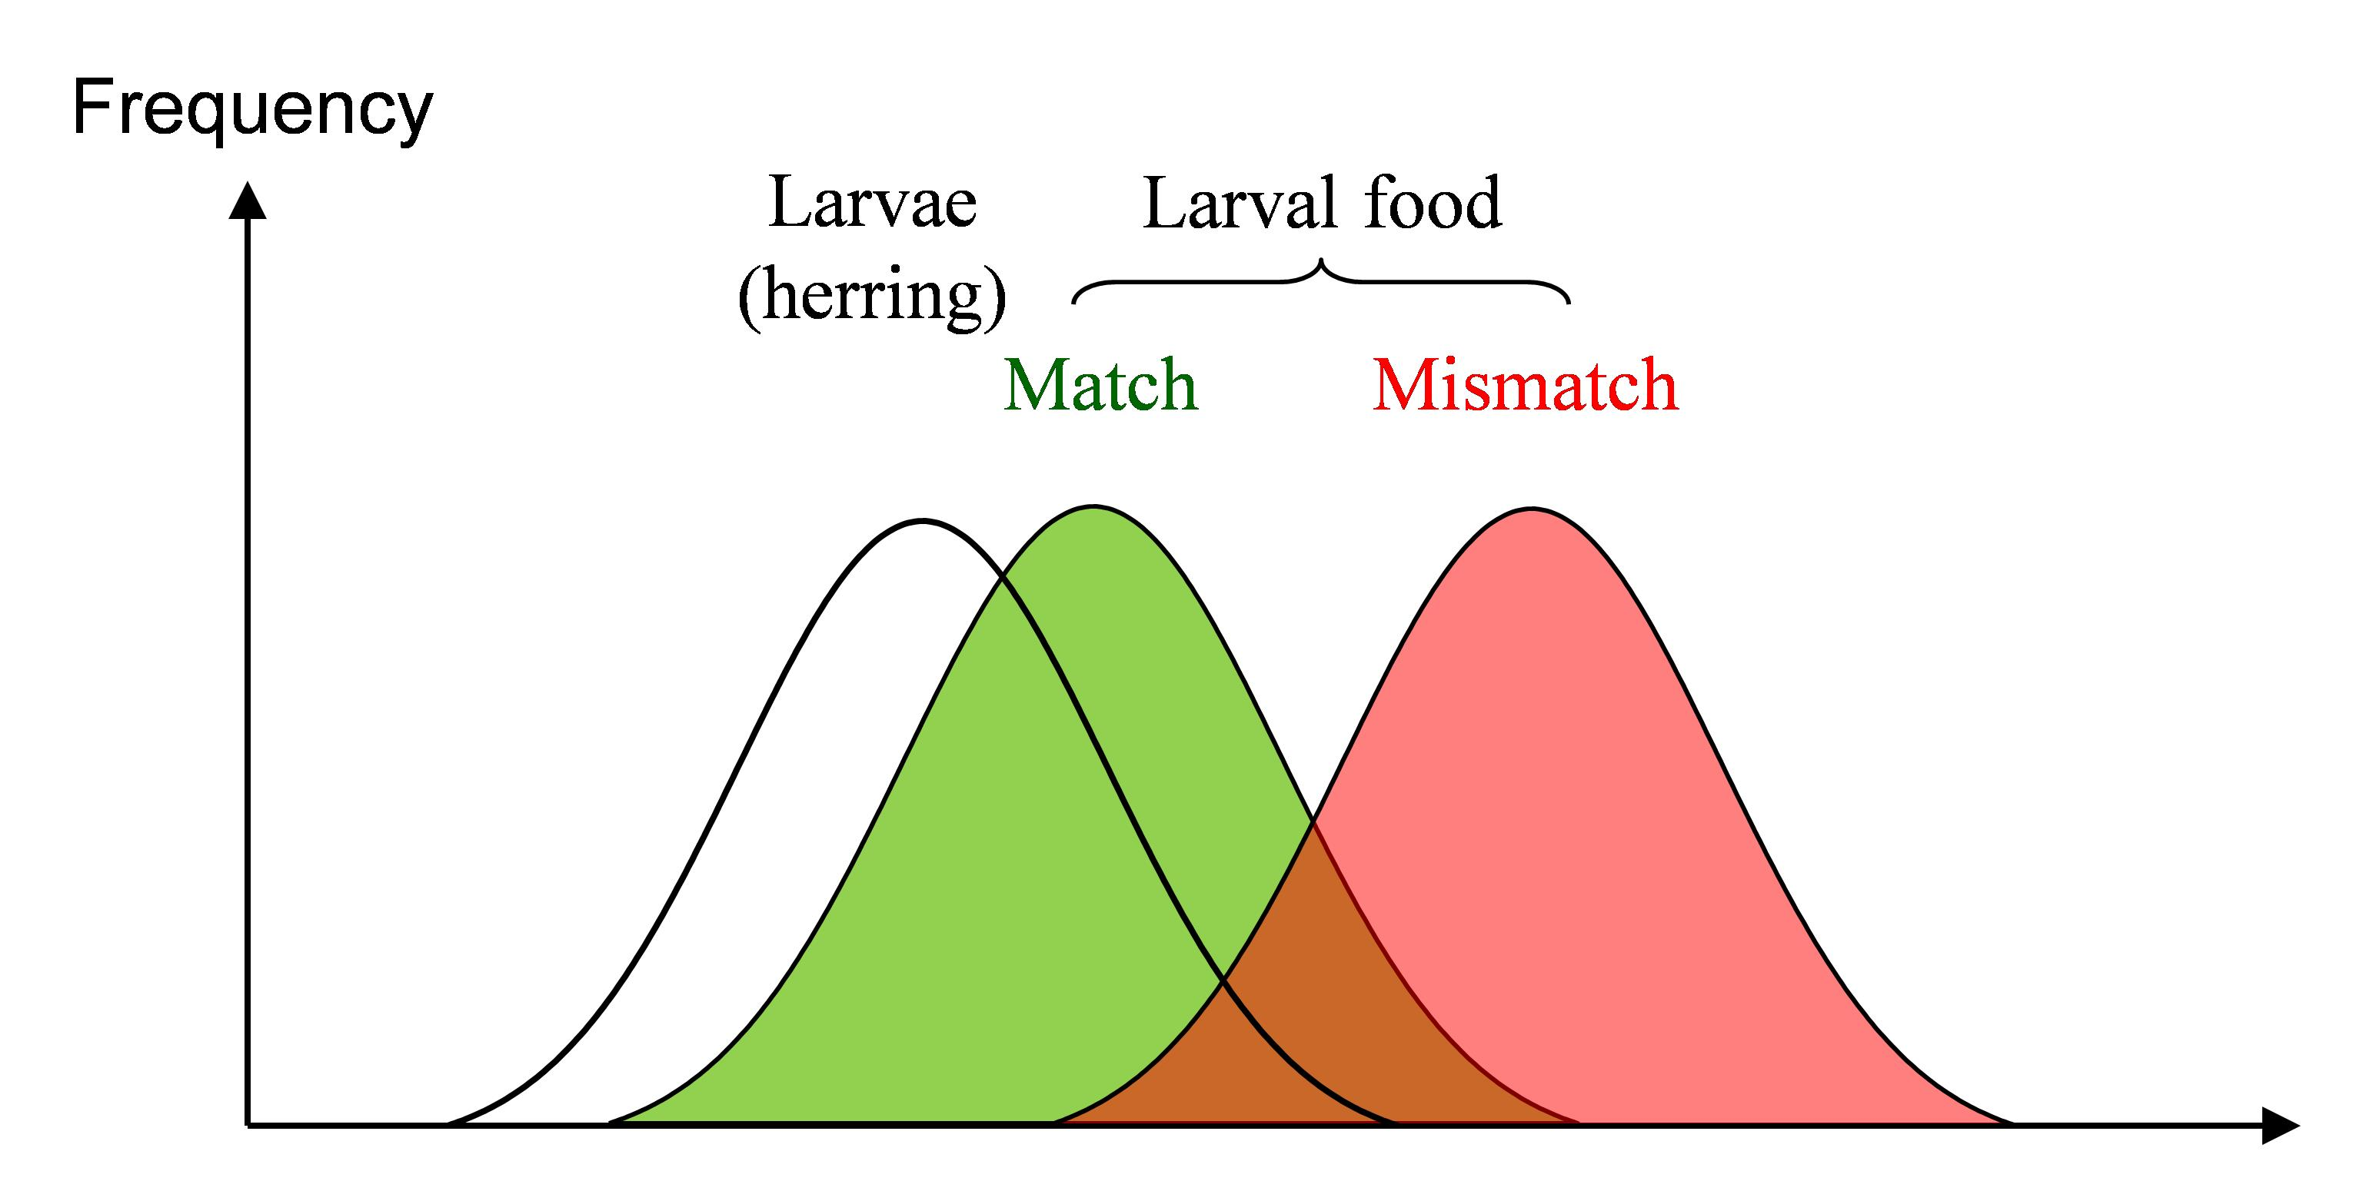
SQUARING THE CIRCLE: Here comes Climate Change
Productivity changes
Distributional changes
Seasonality changes
Marine Fisheries
>100 Authors / > 50 Reviewers
> 600 pages of country-by-country assessments

Slide 4

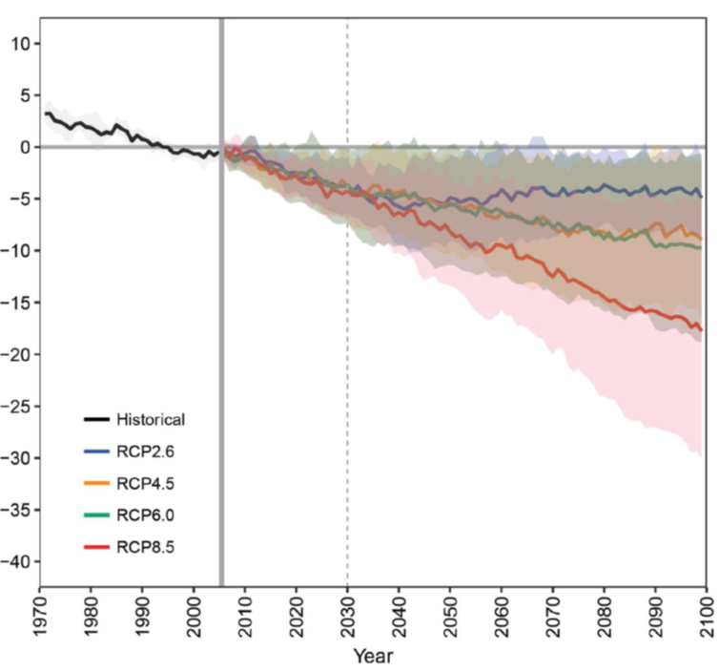

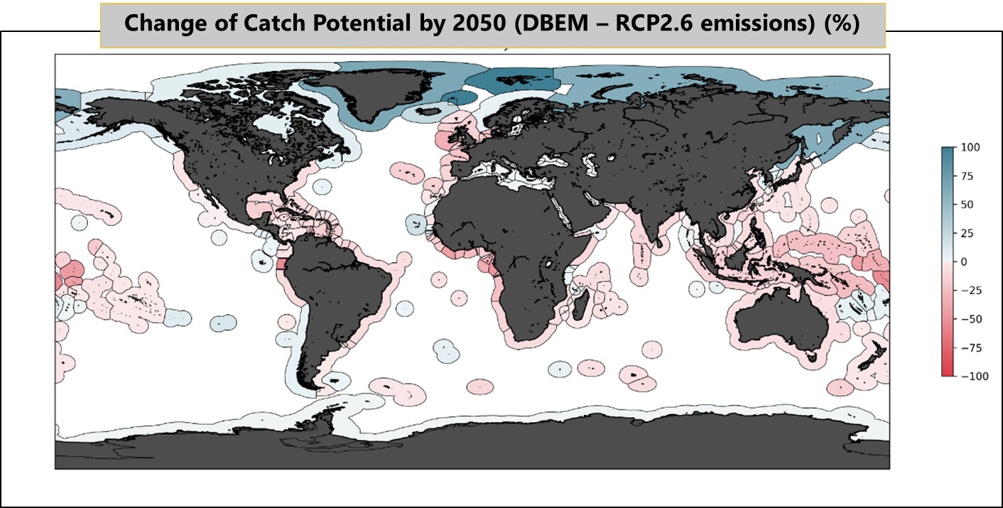

Climate Change Impacts – What are the issues?
1. Productivity changes
Lotze, H., et al. (in review) (https://doi.org/10.1101/467175)
Barange et al. 2018. FAO TP 629
Impacts on global fish catch potential < 12% by 2050 --- Catch Potential IS NOT THE SAME as Realized Catch
Tropical regions (particularly Pacific SIDS) are worse affected // High latitudes more positively affected

Slide 5
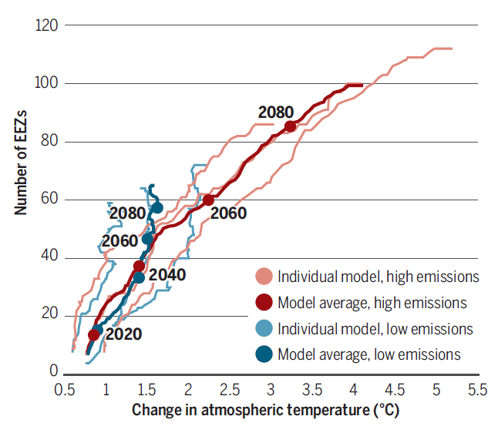
Climate Change Impacts – What are the issues
2. Distributional changes
A large number of EEZs will see new transboundary stocks requiring institutional and management changes, and adaptations across the value chain
Management response crucial to minimize threats and maximize opportunities
It does not have to be a zero-sum – but it will lead to winners and losers
ADAPTATION will be crucial
Pinsky et al. 2018. Science 360

Slide 6
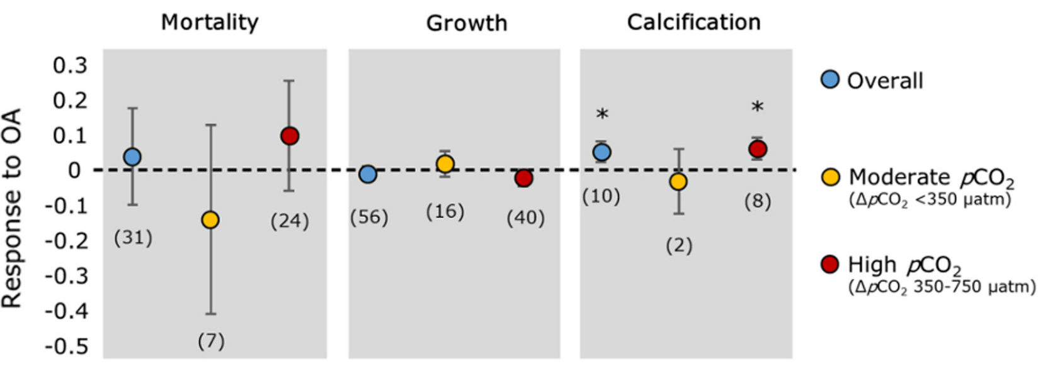
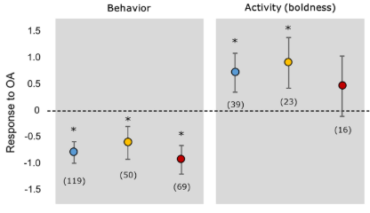


Climate Change Impacts – and the known unknowns
3 Ocean Acidification
Cattano et al. 2018. Ecol. Monogr.
OA impacts on fish undeniable, but complex and very uncertain (even in what direction)
Local adaptation and/or adaptive phenotypic plasticity to OA has been observed (e.g. Vargas et al. 2017)
OA impacts on the food web fish rely on even more complex – We plan for the possible, not for the probable.

Slide 7

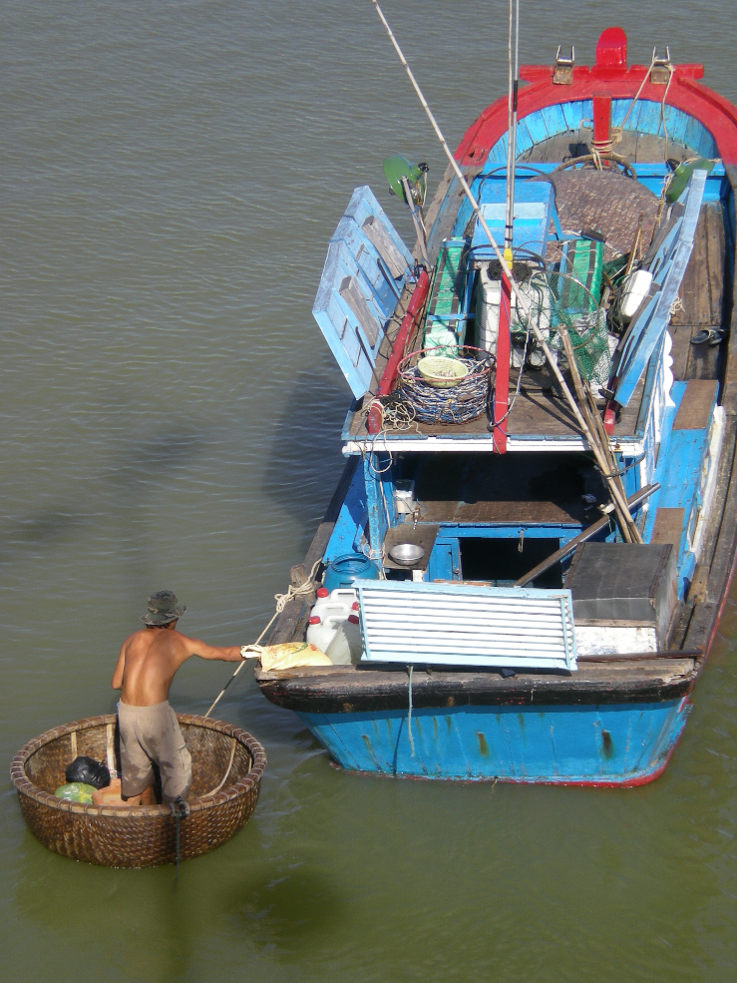
Adaptation is possible and necessary
International / National / Regional / Watershed / Management Area
Institutional Adaptation
Livelihoods Adaptation
Risk Reduction and Resilience
Adaptation is placed and context based
Adaptation should be viewed as an on-going and iterative process
We adapt to the possible rather than the probable – our predictive capability for most fisheries is in its infancy
Positive and timely Adaptation can have very positive results - Maladaptation can lead to terrible outcomes

Slide 8
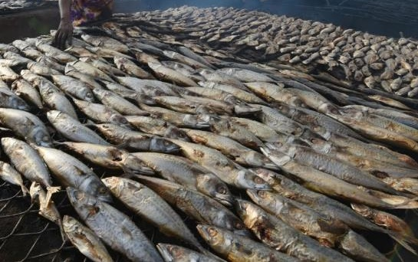

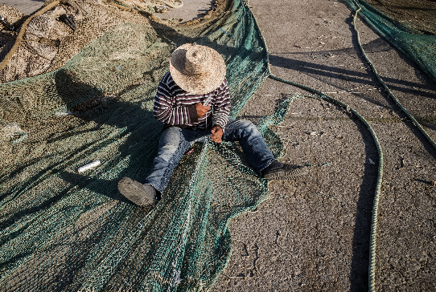
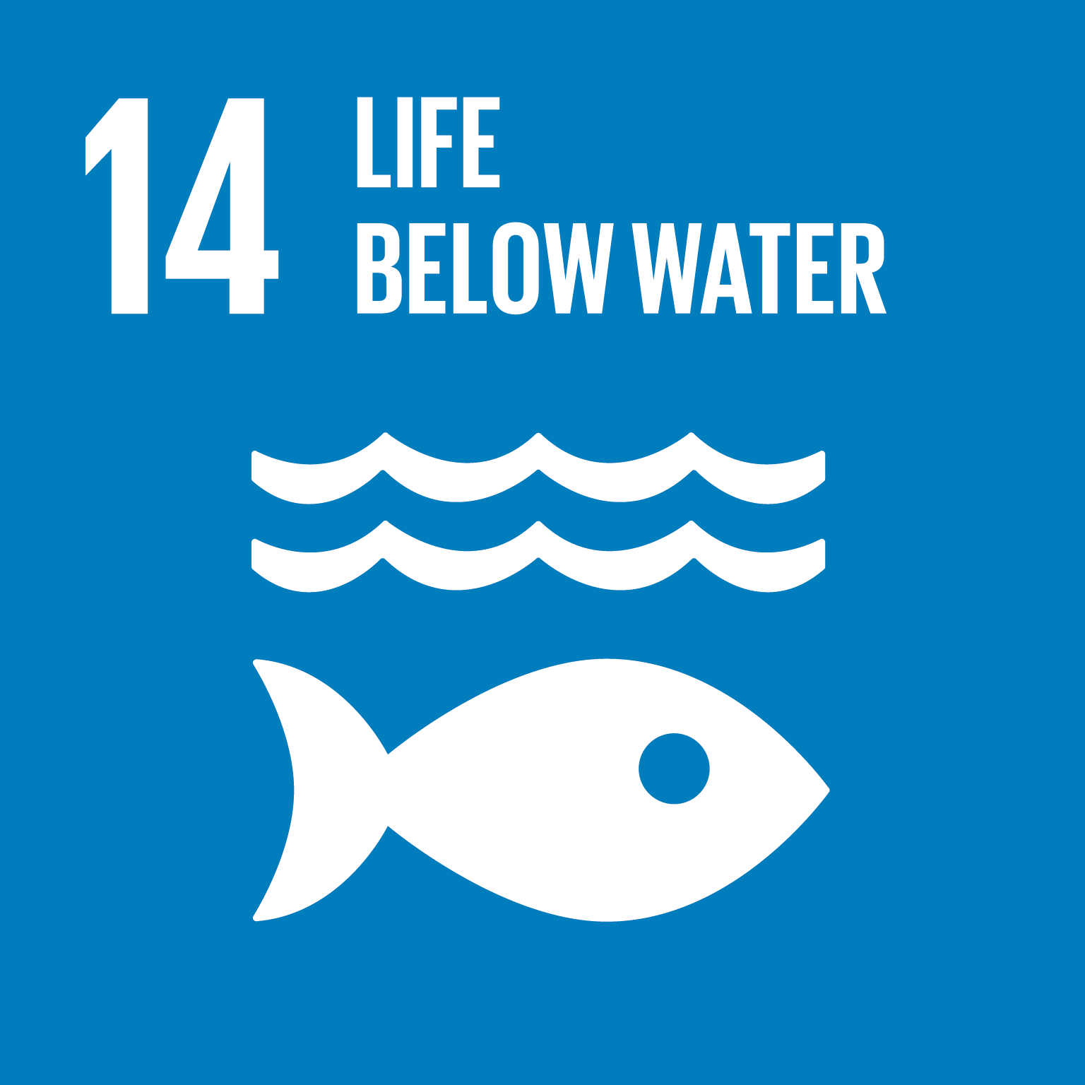
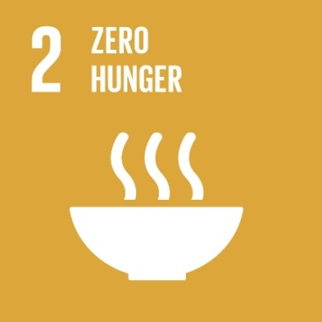
Adaptation to climate change in fisheries and aquaculture
Adaptation to Climate Change is NOT a zero-sum game, or a fight to maintain status quo, but there will be winners and losers.
Appropriate management response crucial to minimize threats and maximize opportunities – we need more knowledge but know enough to act
Effective and coordinated adaptation essential to avoid limiting the adaptation options of neighbours
We need political commitment and societal support – recent events show this is not simple

Slide 9
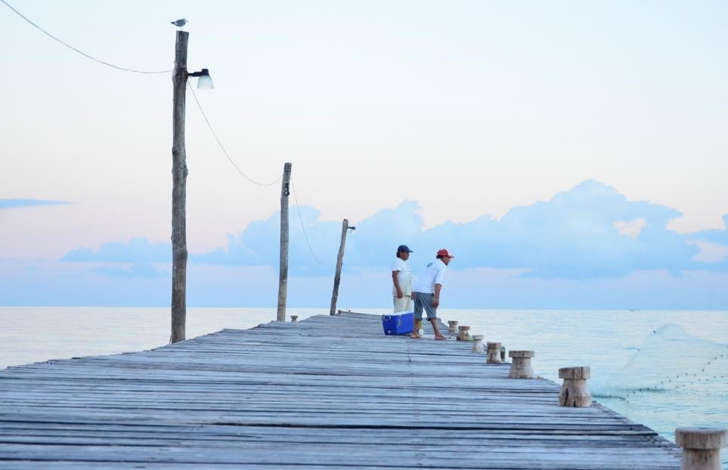
Thank you
A luta continua…

