Slide 1
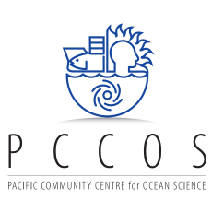
Impact of Climate Change and ocean acidification on tuna fisheries in the Pacific
UN Side event COP24, 8/12/2018
Notes:
Ocean temperatures are projected to rise by 1.4°C by 2050 and 2.5°C by 2100, and the water will become more acidic.
The acidity or pH of sea water has stayed steady for millions of years at about 8.2. Higher concentrations of carbon dioxide (CO2) in the atmosphere will result in more CO2 being absorbed by the ocean and sea water becoming more acidic. Ocean acidification reduces the amount of minerals in sea water needed by corals to build their skeletons, and will degrade coral reefs in the decades ahead.
The impacts of – and responses to – climate change will be different among the Pacific Islands; this will add to the challenges of regional adaptation and the identification and promotion of sustainable livelihood alternatives in the future.

Slide 2
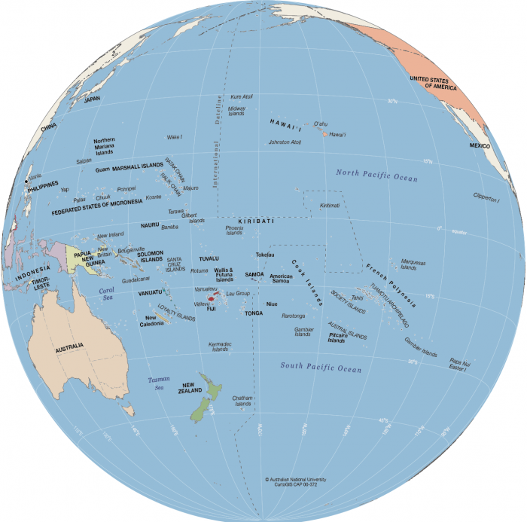
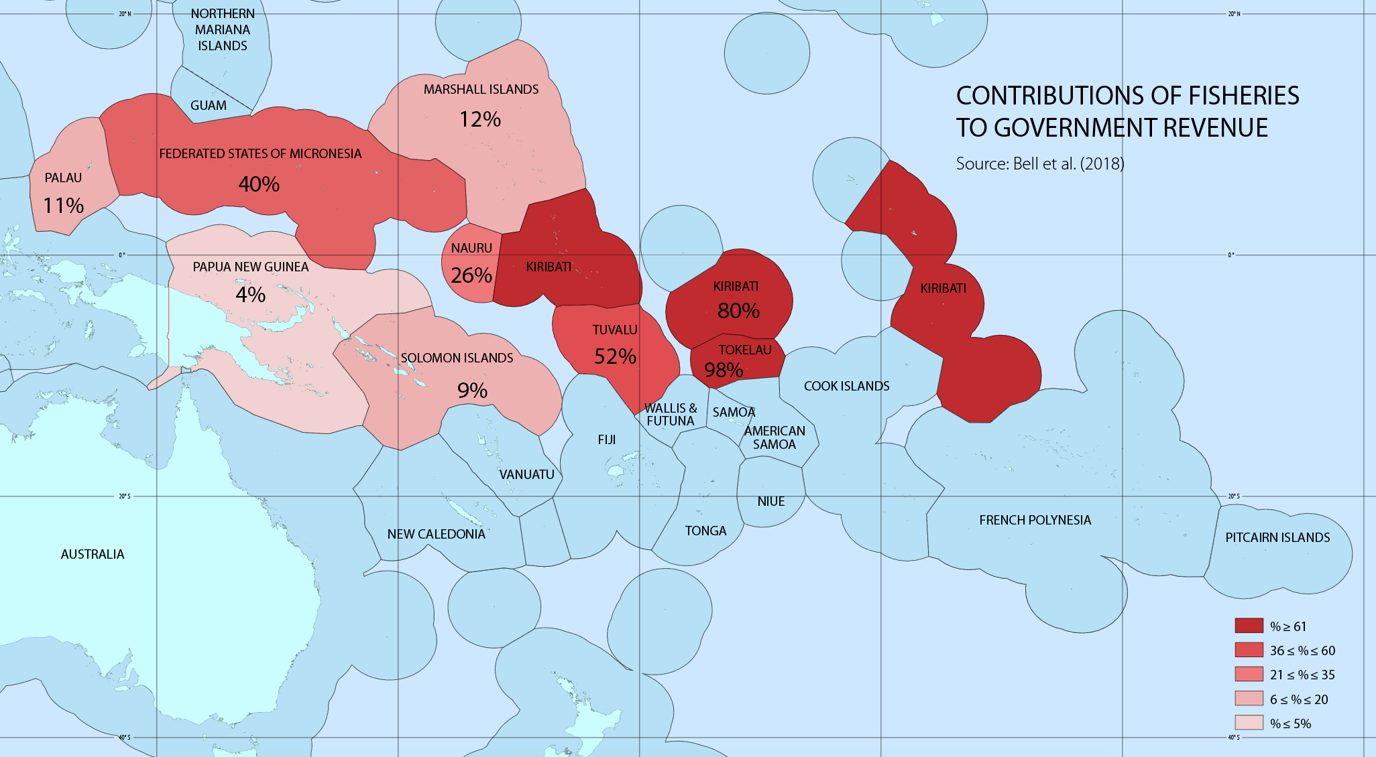
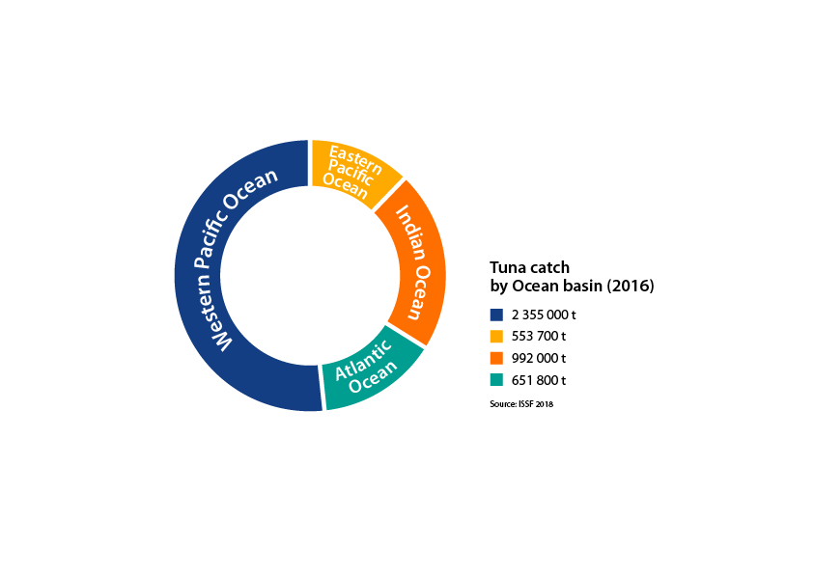
Tuna in the Western and Central Pacific Ocean
Illustration: SPC
Illustration: SPC
Notes:
Tuna fisheries are highly important for the Pacific islands and territories and can represent up to 98% of the government revenue of some of the countries.
Tuna resources from this region are also highly important globally as the 2 million tons of tuna caught in the western and central Pacific represent more than 50% of the global tuna catches, for an estimated value of more than 5 billion USD and are widely distributed on the global market
Tuna are top predators in the pelagic ecosystem along with sharks and marlins and their population growth depends on the food web they are feeding on.
Climate change is predicted to have an impact on the pelagic ecosystem and the tuna resources mainly through the temperature rise

Slide 3
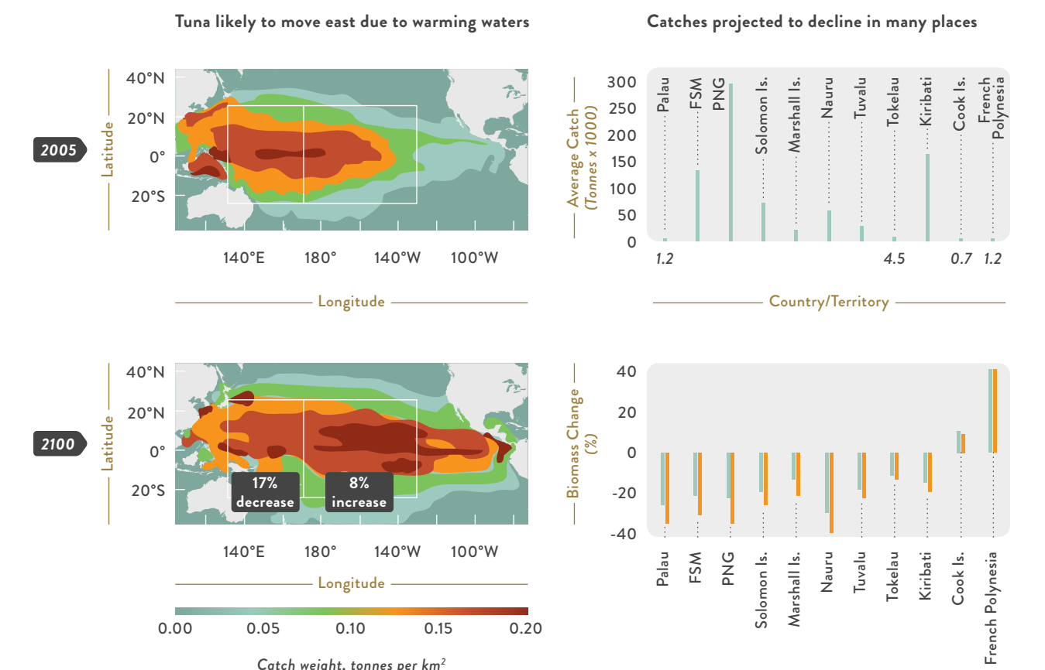
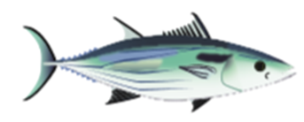
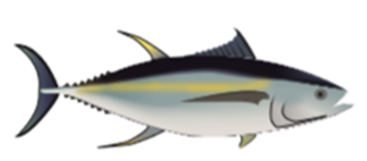
Effects of climate change on tuna?
Skipjack tuna
(Mt/km2)
(Mt/km2)
Yellowfin tuna
Source: Patrick Lehodey & Inna Senina
(Mt/km2)
(Mt/km2)
Notes:
Warmer waters in the tropical Pacific will impact the distribution of tropical tuna species such as skipjack, yellowfin, bigeye and albacore, causing them to progressively shift eastward. Eventually, their abundances are also expected to decrease as climate change reduces the supply of nutrients to the food web that supports tuna, lowers oxygen levels and increases ocean acidification. This will make it more difficult for local people in the western part of the Pacific Island region to catch tuna, and affect the profitability of some industrial fishing fleets.
The predicted impact of CC on tuna population and in particular yellowfin tuna is mainly driven by the change in the spawning habitat (temperature and productivity) and subsequent larval recruitment with a decrease in Western and Central Pacific Ocean and increase in the Eastern Pacific Ocean.
The additional impact of ocean acidification is minor. There is no discernible impact when considering the low sensitivity scenario, very small effects (5%) by the end of the century in the eastern equatorial Pacific Ocean with the immediate scenario S1 and a stronger negative impact reaching locally -10% in 2050 and -15% in 2100 with the high sensitivity scenario.

Slide 4
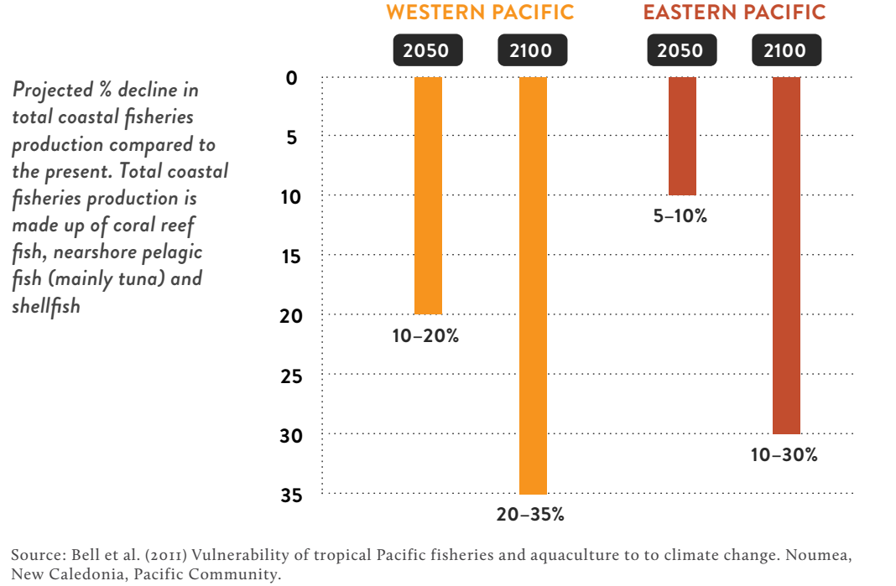
Effects of climate change on coastal fisheries?
Total coastal fisheries production is projected to decline at di erent rates in the
eastern and western Pacific
(Mt/km2)
(Mt/km2)
Notes:
Warmer waters in the tropical Pacific will impact the distribution of tropical tuna species such as skipjack, yellowfin, bigeye and albacore, causing them to progressively shift eastward. Eventually, their abundances are also expected to decrease as climate change reduces the supply of nutrients to the food web that supports tuna, lowers oxygen levels and increases ocean acidification. This will make it more difficult for local people in the western part of the Pacific Island region to catch tuna, and affect the profitability of some industrial fishing fleets.
The predicted impact of CC on tuna population and in particular yellowfin tuna is mainly driven by the change in the spawning habitat (temperature and productivity) and subsequent larval recruitment with a decrease in Western and Central Pacific Ocean and increase in the Eastern Pacific Ocean.
The additional impact of ocean acidification is minor. There is no discernible impact when considering the low sensitivity scenario, very small effects (5%) by the end of the century in the eastern equatorial Pacific Ocean with the immediate scenario S1 and a stronger negative impact reaching locally -10% in 2050 and -15% in 2100 with the high sensitivity scenario.

Slide 5
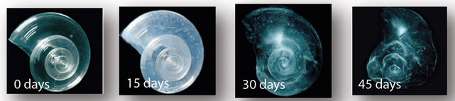
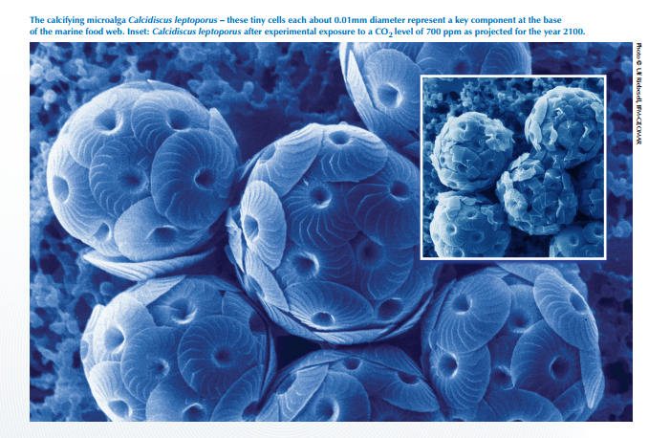
Indirect impact of ocean acidification on tuna
Impact of increasing acidification on the calcareous phytoplankton and zooplankton at the base of the food web is impacting indirectly tuna
Photo credit: David Liittschwager/National Geographic Stock. National Geographic Images.
http://www.epoca-project.eu/dmdocuments/OA.TF.English.pdf
http://www.pmel.noaa.gov/co2/story/What+is+Ocean+Acidification%3F
Notes:
The impact of ocean acidification on the tuna resources is yet insufficiently understood. It can have indirect impact through the food web and direct impact on the tuna themselves, particularly on the larvae.
Indirect impacts of ocean acidification in terms of CC impact on development of phytoplankton and zooplankton meaning less food in the ecosystem and consequently less resource for the tuna to feed on. It is complex to estimate.
A recent SPC trophic study was conducted which is, to our knowledge, the first that targets temporal variations in the diet of yellowfin tuna and tunas Obese West and Central Pacific.

Slide 6
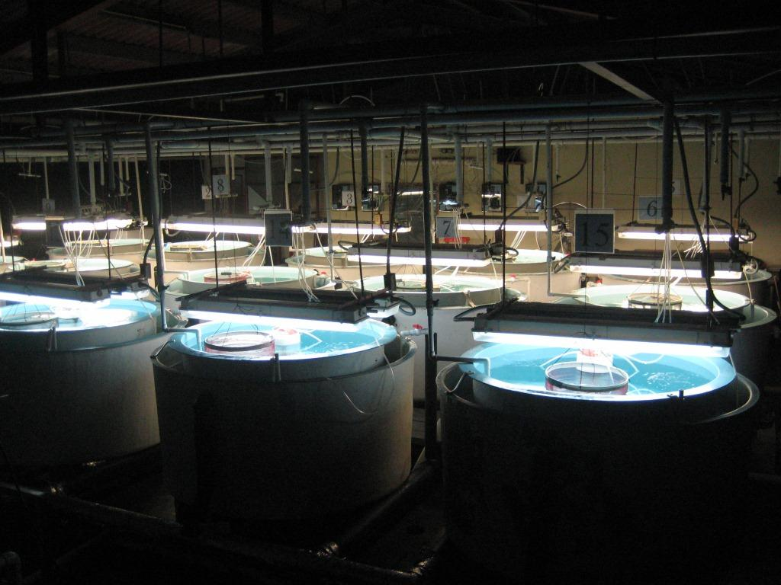
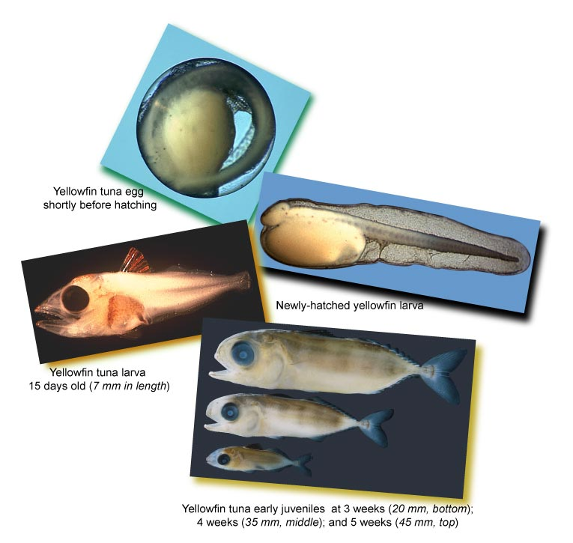
Testing the direct impact of ocean acidification on tuna larvae
Source: IATTC, Bromhead 2015, Frommel 2016, Watson 2018, Laubenstein 2018
Notes:
In collaboration with IATTC, experiments were conducted in tanks to determine the impact of pH on the survival and growth of larvae of yellowfin tuna (up to 7 days after hatching)
The decrease in pH level was found to reduce larval survival during the first 7 days by 64% at pH 7.3 which is the value expected in 2200 under the RCP 8.5 climate scenario (present value of pH being around 8.1).
[For pH levels higher than 7.3 (that is pH closer to the present value), there are statistically insignificant results]
Experiments conducted on yellowtail kingfish (Seriola lalandi), a pelagic coastal species, indicate the stronger impact of temperature compared to acidification but the combination of those 2 factors induce complex effects on survival and development of larvae and juveniles

Slide 7
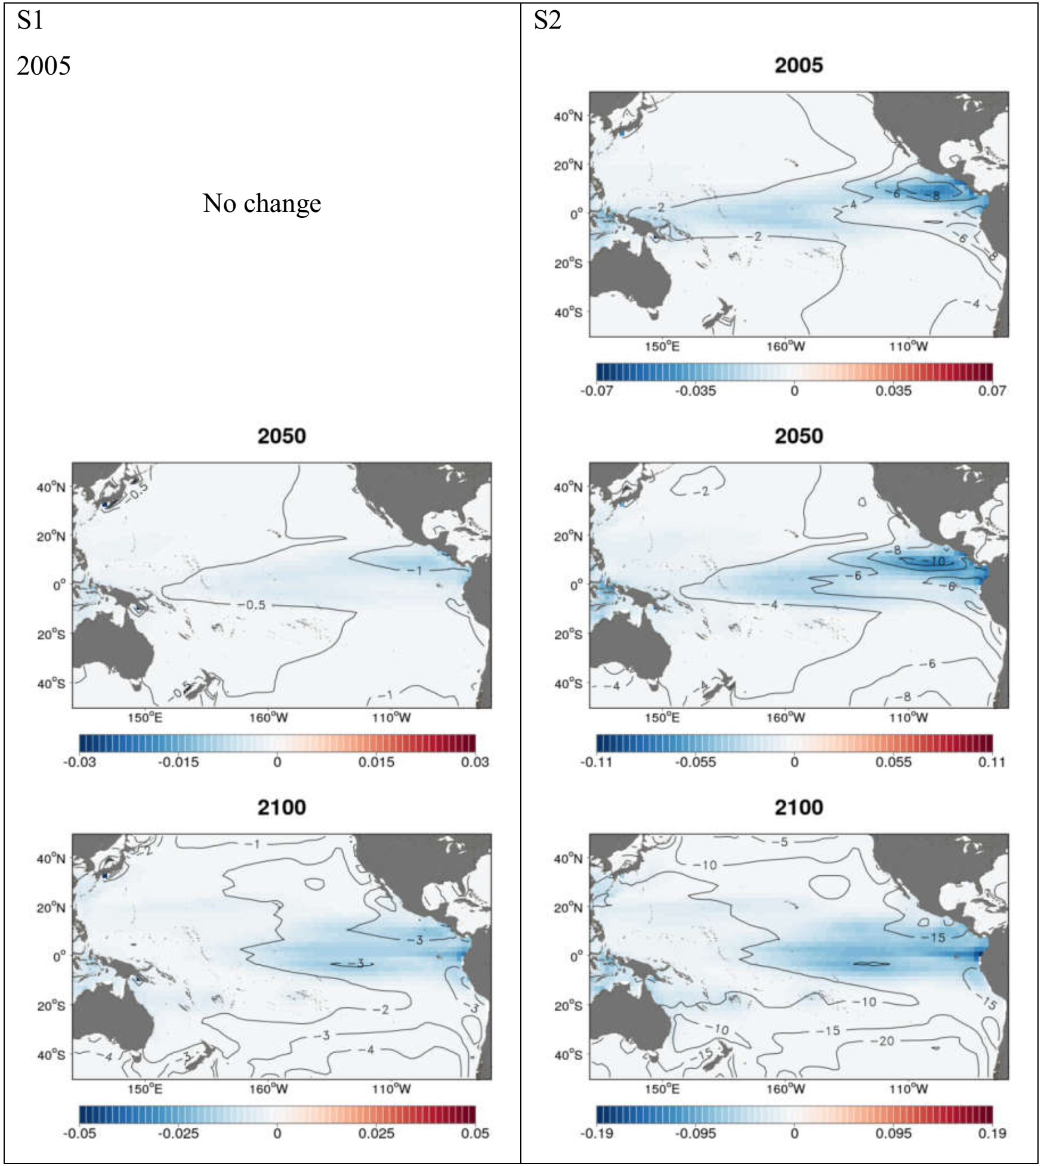
Modelling the impact of ocean acidification on tuna larvae
Source: Senina 2018
Notes:
Results from the experiments have been included into tuna modelling
The maps show in blue the decline in % of yellowfin tuna larvae biomass in 2050 and 2100 in comparison to 2005 under the RCP8.5 climate scenario.
The direct impact of ocean acidification on tuna larvae is stronger in the eastern pacific with decline of up to 3% in 2100 compare to present.
This is an average model and results vary according to the sensitivity to acidification included in the model

Slide 8
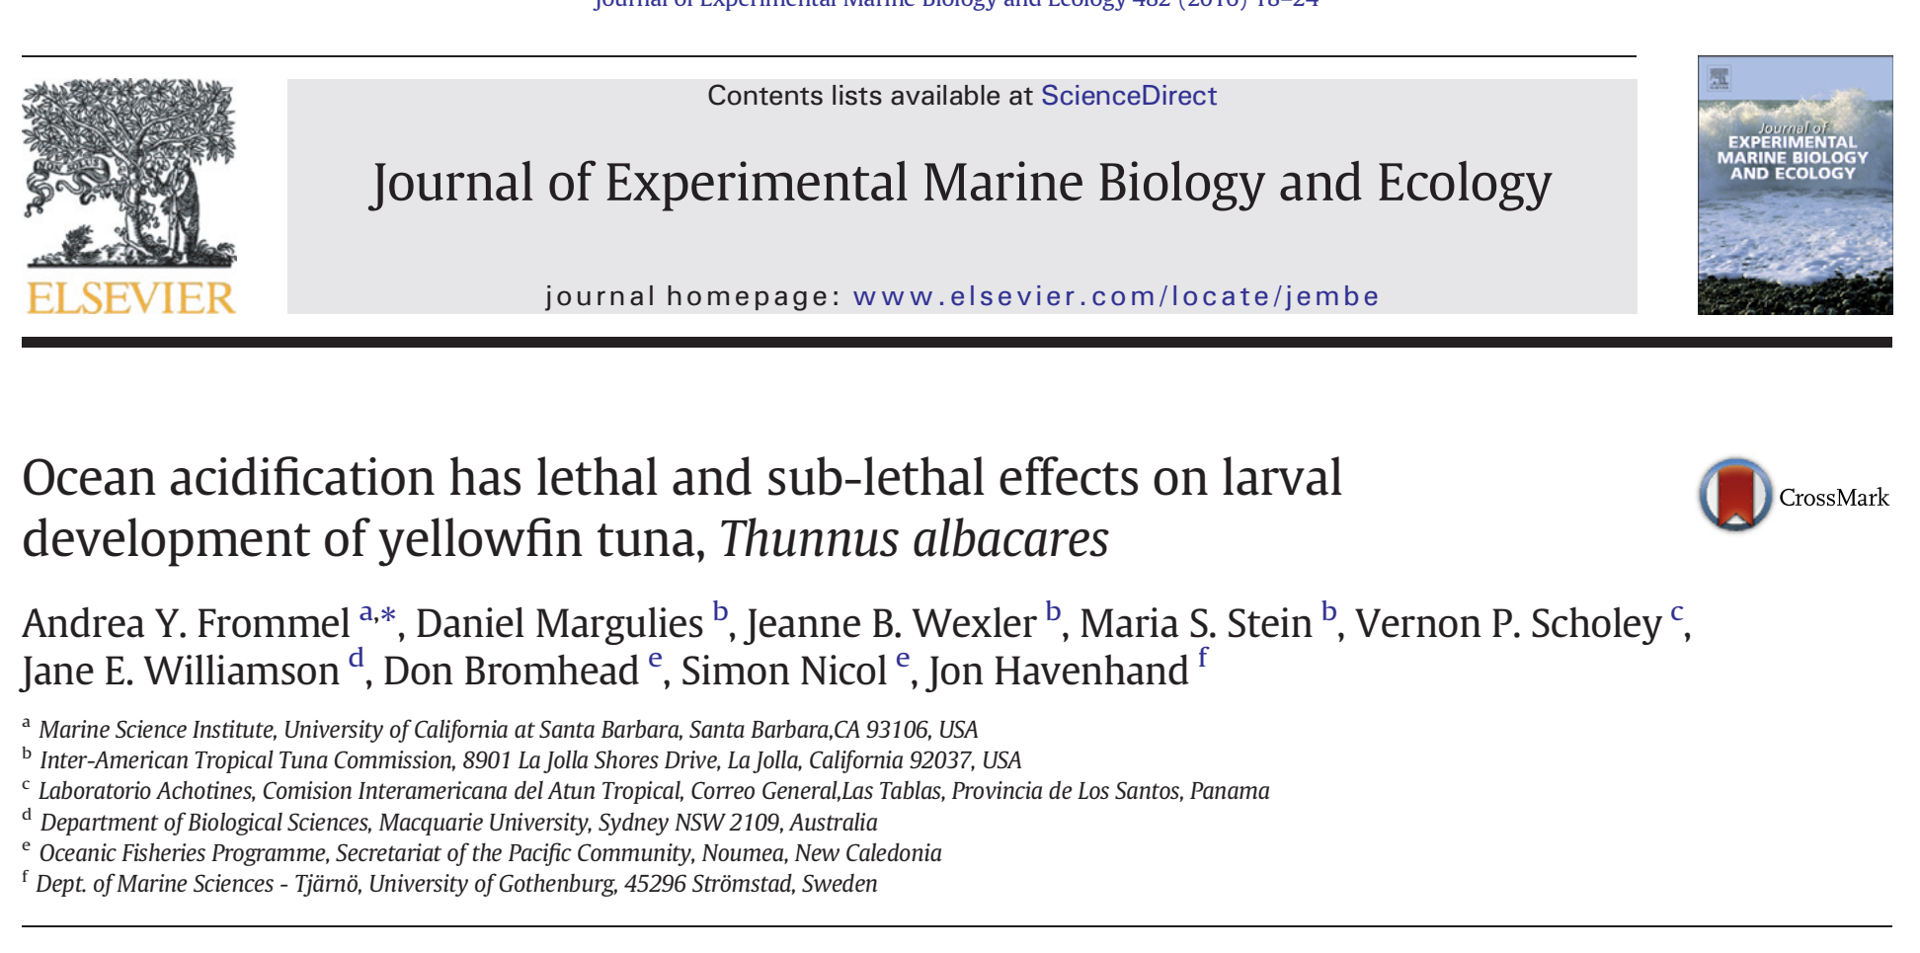
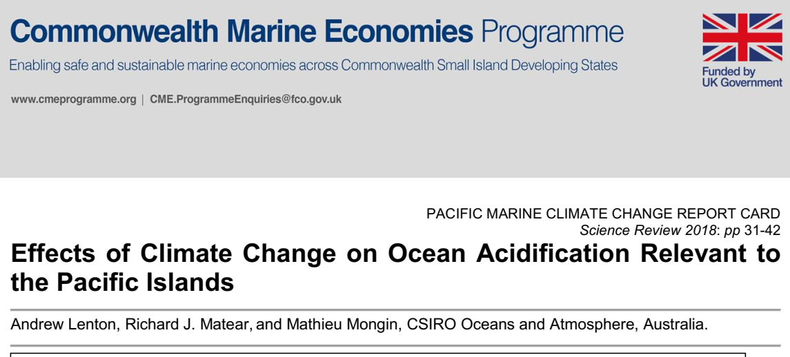
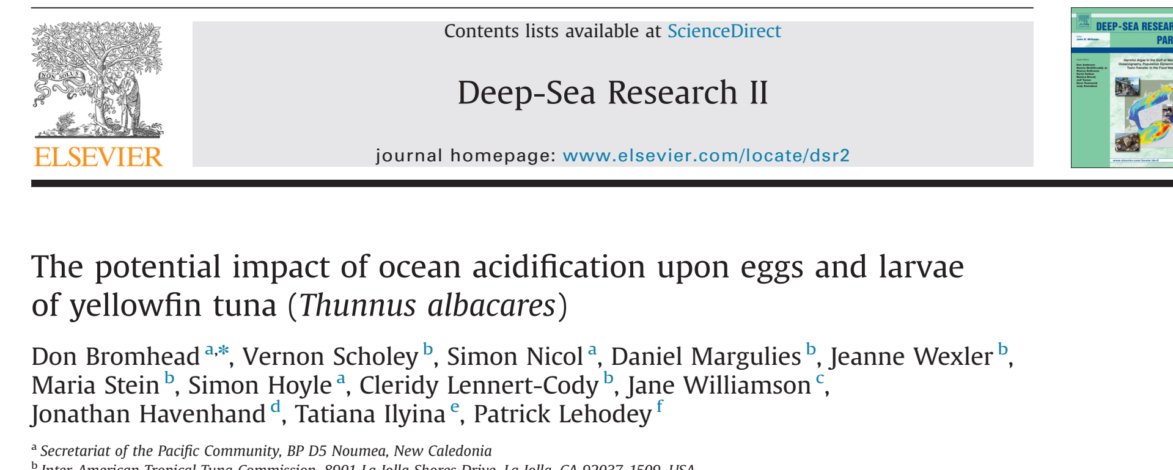
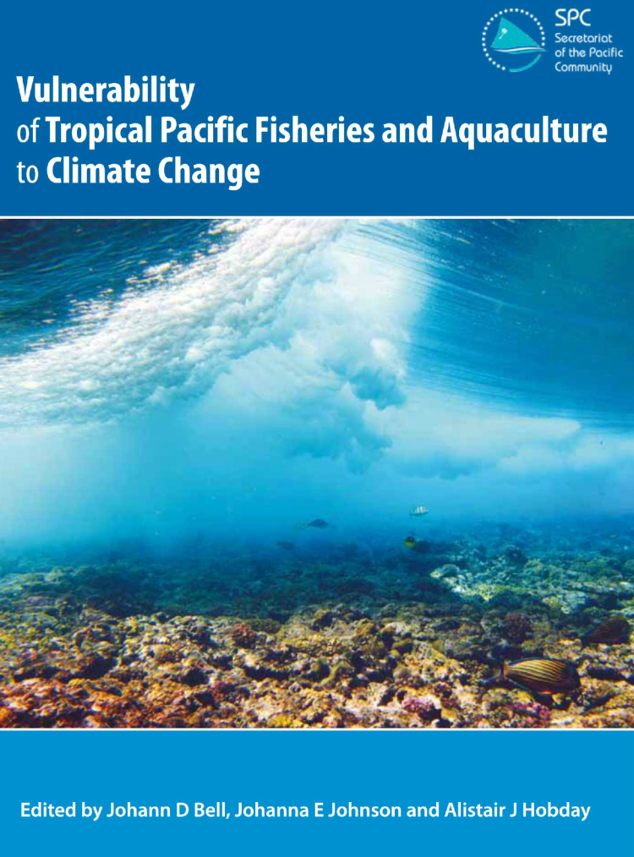
Notes:
Research work feeds into scientific papers, briefing notes, consolidated analysis

Slide 9
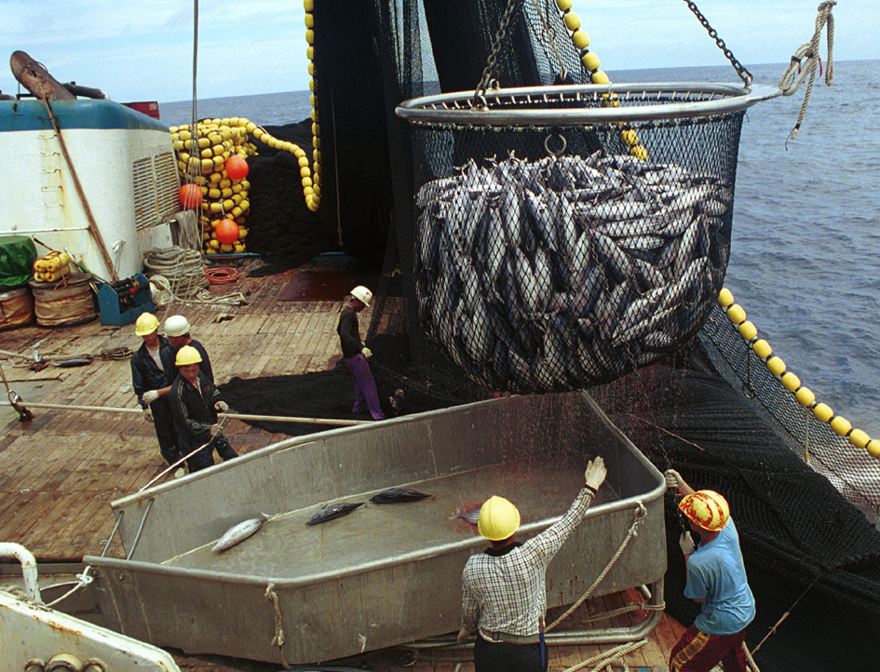
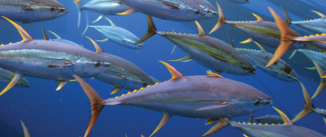
Conclusion
What we know:
Ocean acidification will: -increase mortality and decrease growth rate of tuna
        -induce changes in the food web
Temperature rise has a stronger impact on tuna than ocean acidification
Climate change will impact tuna resources, fisheries and associated human activities
What we don’t know:
What is the potential for genetic adaptation to future ocean acidification levels?
What are the combined effects of increasing temperature, lower oxygen and acidification?
How acidification will cascade through the marine food web and affect the whole ecosystem and tuna
What we should do
Continue to reduce uncertainties on the impact of ocean acidification
Continue monitoring the impacts on tuna and the whole marine ecosystem
Image: Valerie Allain, SPC
Image: Jeff Muir
Image: Valerie Allain, SPC
Notes:
To conclude, it has been demonstrated that acidification has potential negative impact on tuna larvae and on the whole food web.
It is important to note that temperature rise has a much stronger impact on tuna than ocean acidification and that climate change will impact tuna resources and consequently fisheries and associated human activities.
However there are still uncertainties as there is no information on the potential genetic adaptation of tuna and other marine organisms to ocean acidification. The combined effect of increased temperature, lower oxygen and acidification is poorly understood as well as how acidification will cascade through the marine food web.
It then appears important to continue to reduce uncertainties on the impact of ocean acidification in combination with other effects of climate change (temperature and oxygen) and to monitor the tuna resources and the whole marine ecosystem

