Slide 1
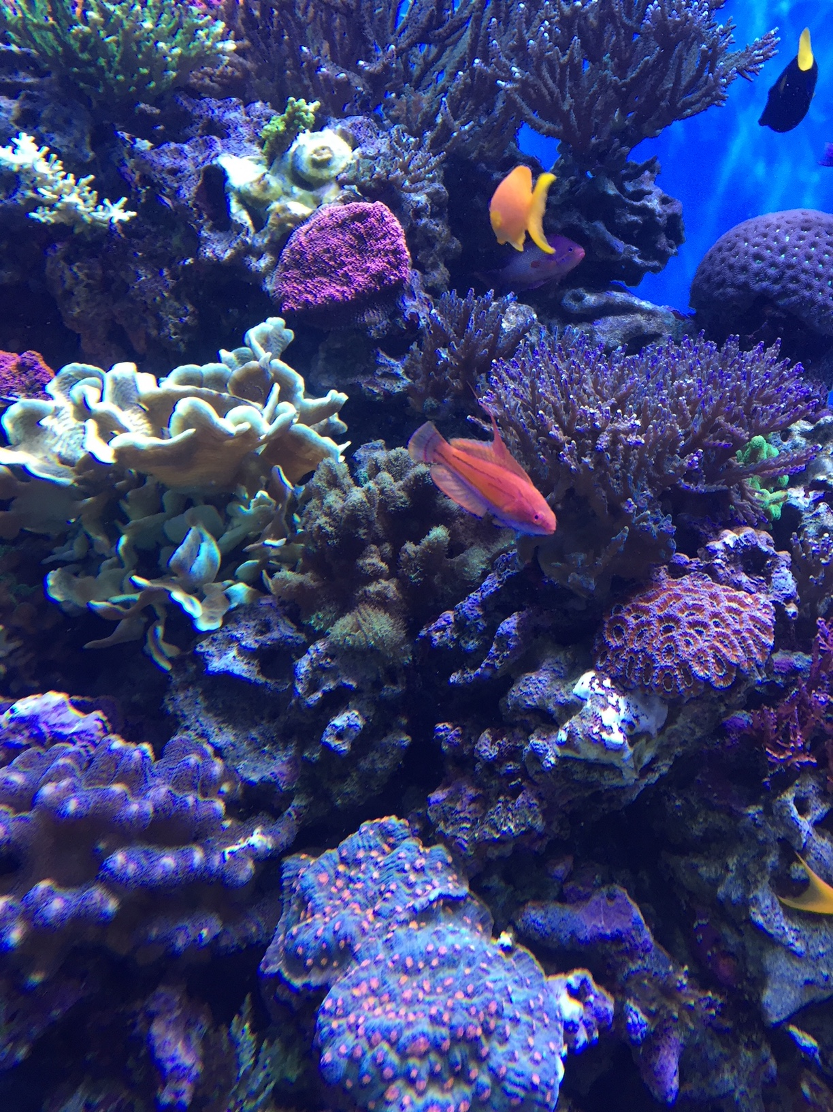
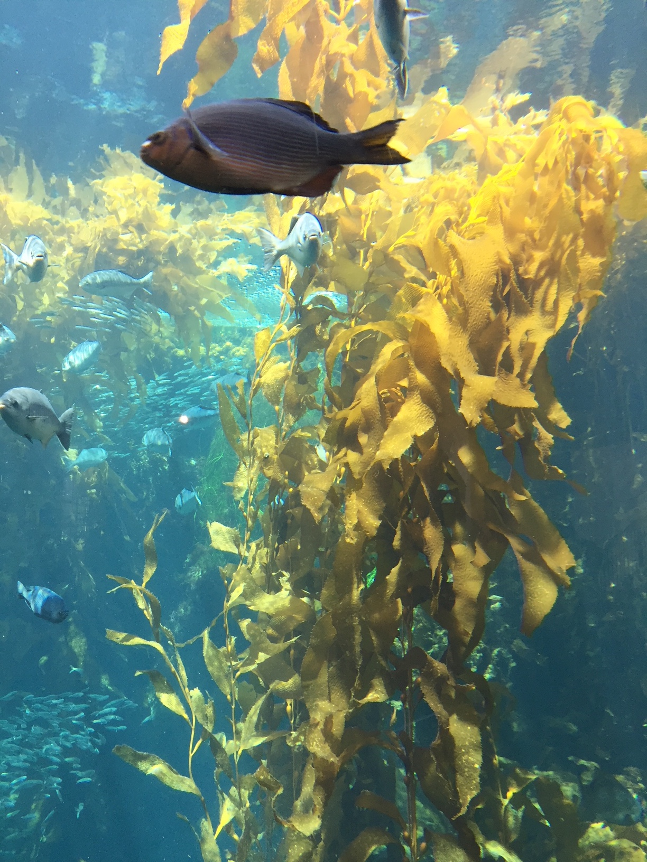
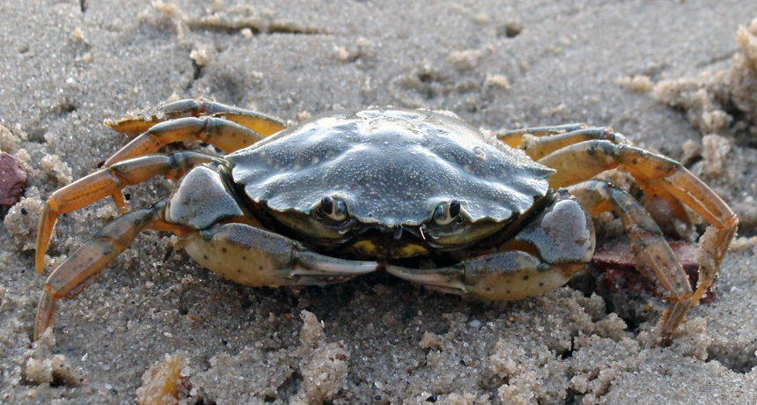
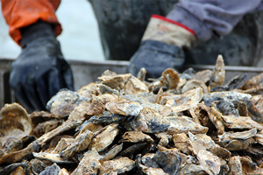
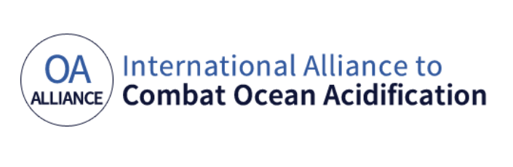
International Alliance to Combat Ocean Acidification:
Leadership to advance tangible actions that address ocean acidification
Notes:
What is the Alliance – Brings together governments and civil society such as research institutions, affected businesses, and NGOs across the globe to highlight ocean acidification as an immediate threat to coastal economies and ocean ecosystems in their region and to serves as a hub for advancing tangible actions to address this critical issue.
How the OA Alliance was formed – 10 years ago, the West Coast of the U.S. experiences widespread oyster hatchery failures, discovers ocean acidification was the root cause, Washington launches a panel to understand the scope of the problem and provide recommendations to address it. This lead to broader regional discussions, including a regional scientific convening, and, ultimately, decision in 2016 to launch the international alliance to combat ocean acidification.
In just two years, our membership has grown to over 70 members with a growing global footprint with national governments, states and provinces, tribes, cities, as well as scientific institutions, affected businesses, and NGOs. The OA Alliance welcomes all members, whether they are just beginning to work on these daunting issues or are well into implementing mitigation, adaptation and resiliency strategies that address ocean acidification.

Slide 2

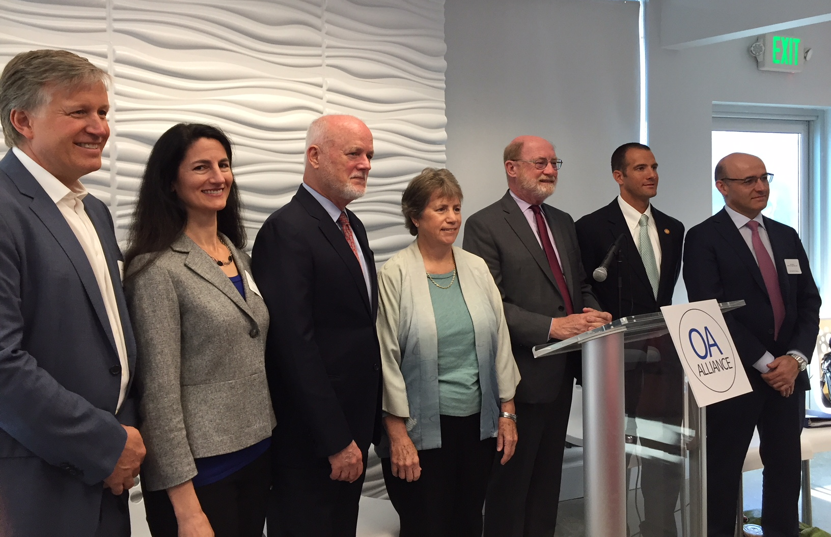
Global Call to Action
Advance scientific understanding
Reduce causes of ocean acidification and changing ocean conditions
Build adaptation capacity and resilience
Expand public awareness
Build sustained international support for addressing ocean acidification through climate frameworks
OA Alliance members and partners at the Global Climate Action Summit in California
Notes:
Five central goals in the OA Alliance Call to Action

Slide 3
OA Alliance
Objectives
Advance OA Action Plans
Elevate OA in Climate Agreements and Frameworks
Build the Coalition
Notes:
For the international alliance….main objectives are:
Advance OA Action Plans that describe the actions Alliance members will take to combat OA in their region and address Alliance goals
West Coast support to members through exchange of recent and relevant science, best practices to mitigate and adapt, sharing examples of existing action plans, and convening of members at international ocean and climate meetings
OA Action Toolkit
Webinars and Additional Support/ Resources
One on One Member Calls
Sharing draft of developed OA Action Plans
Elevate OA in Climate Agreements and Frameworks
Collaborating with partners
Engaging in Ocean Pathway Partnership through UNFCCC
Support countries in developing strong ocean protections in Nationally Determined Contributes (NDCs) per COP21
Helping to implement targets of of SDG 14
Build coalition –
Attend International ocean and climate conferences
Collaborate with partner efforts and initiatives
Engage OA Alliance members in ways that best fit their interests, needs and experiences
Engage Alliance members at events and scheduled programs, culminating in COP23 where the Alliance will participate in efforts for the inclusion of ocean health language in the implementation of the Paris Agreement

Slide 4
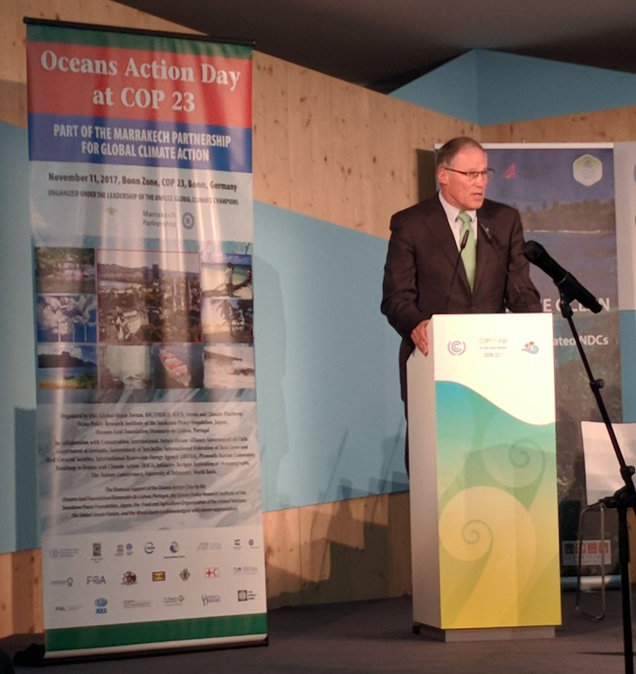
A Commitment to Action
  “Individual Alliance members…commit to taking meaningful actions where they are located by crafting their own jurisdictional
  Ocean Acidification Action Plan.”
-- Governor Jay Inslee
Washington State
Notes:
Members pledge to take action - Whether this be a stand-alone action plan, or incorporated into climate action plans, including part of NDCs – where appropriate, these action plans form the basis for taking meaningful actions to address ocean acidification. Affiliate members leverage their expertise and resources to strategically assist the Alliance in meeting it’s goals.

Slide 5
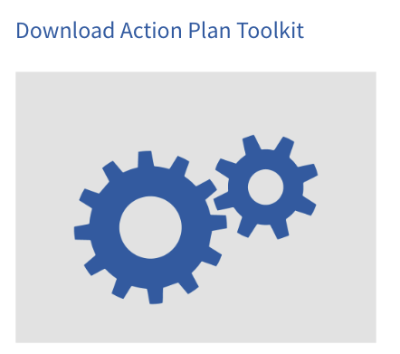
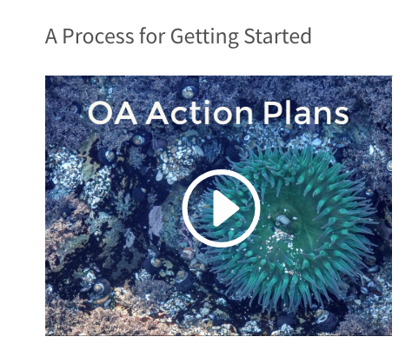
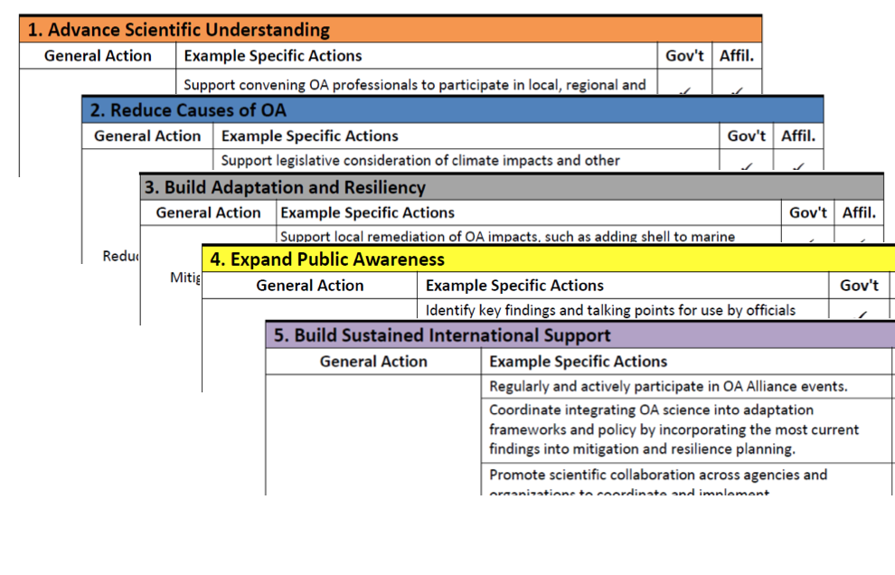
Notes:
The OA Alliance provides support for governments and non-governments building an OA Action Plan, including online resources such as the Action Plan toolkit and videos.
Document and leverage existing actions that mitigate or adapt
Share ideas and pilots about existing or potential actions
Inspire future actions and investments
Toolkit meant to be a living compendium, a way to inspire inspiration, a set of resources, and is by no way comprehensive…

Slide 6
Making Progress –
Delivering on Commitments
Members Create OA Action Plans
(e.g. NDCs)
International Commitments (SDG 14.3, Our Oceans)
Showcase Individual Action Plans
Meet OA Alliance Objectives:
20 Action Plans by Dec. 2019
Completed OA Action Plans
New Zealand
Washington
California
Notes:
New Zealand, Washington, and California have unveiled finalized OA Action Plans and many more are under development.
OA Action Plans are being created by national, subnational, tribal/ first nation and affiliate (non-government) members of the OA Alliance.
Registered international commitments with the United Nations through Sustainable Development Goal 14.3 and at the 2017 and 2018 Our Ocean Conferences to support the development of 20 OA Action Plans by end of 2019.
Showcasing OA Action Plans as they are developed on a rolling basis in 2019 and 2020 to spur the creation of plans by our member governments and affiliate members, including at COP24 and COP25.
Mobilize and accelerate tangible actions that address OA

Slide 7


Jennifer Hennessey, Senior Policy Ocean Advisor
Washington State Governor Jay Inslee
Jennifer.Hennessey@gov.wa.gov
Jessie Turner, Secretariat for the OA Alliance
Jessie@OAAlliance.org

