Slide 1
Advancing the Oceans and Climate Agenda in the Next Phase
Dr. Biliana Cicin-Sain
Mr. Richard Delaney
COP 24, Katowice, Poland
Saturday, 8 December 13:15-14:45 PM
Room Narew (Area G)

Slide 2
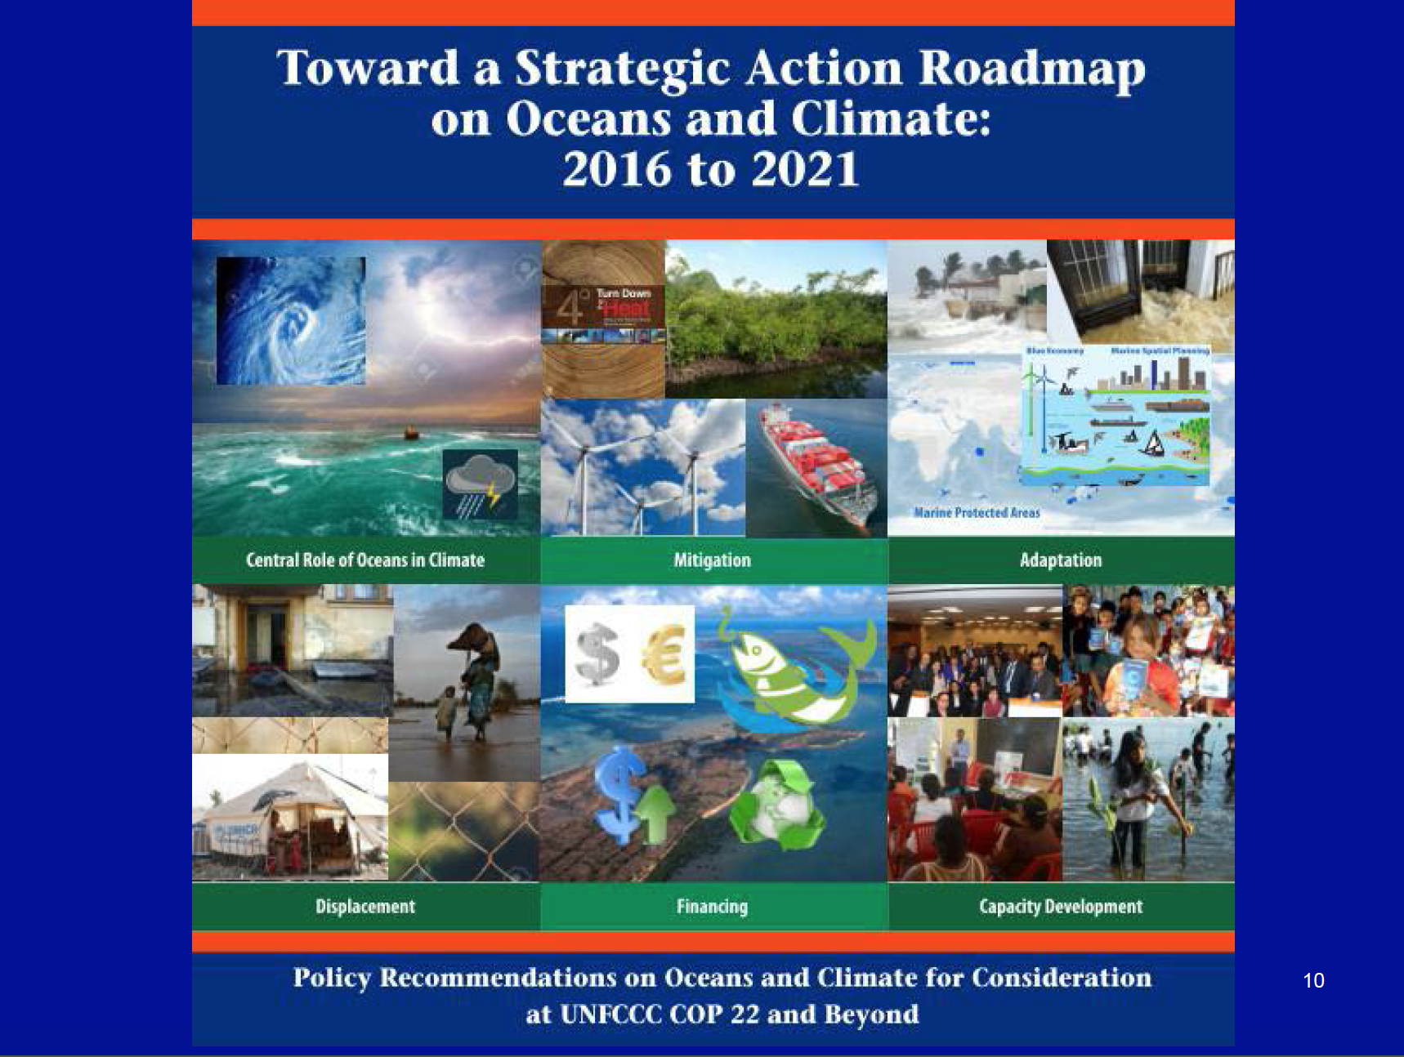

Slide 3
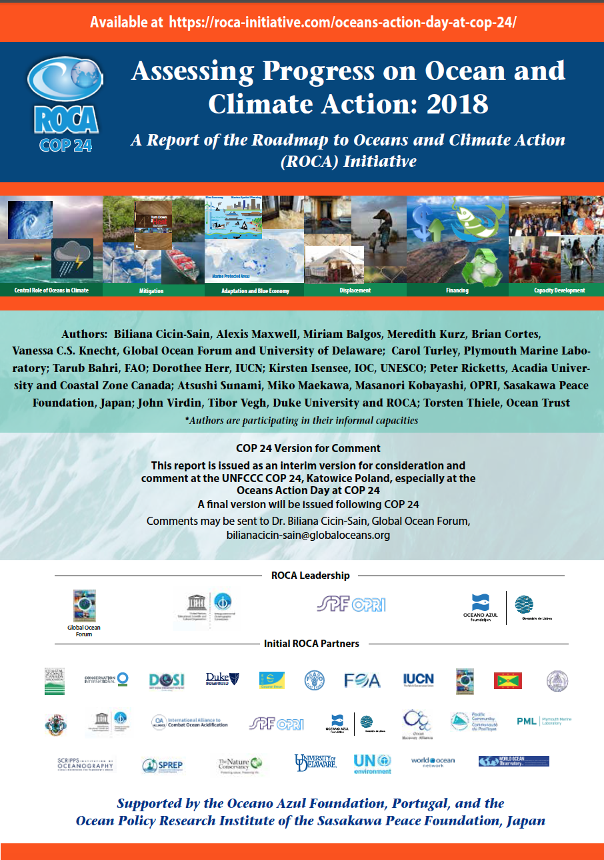

Slide 4
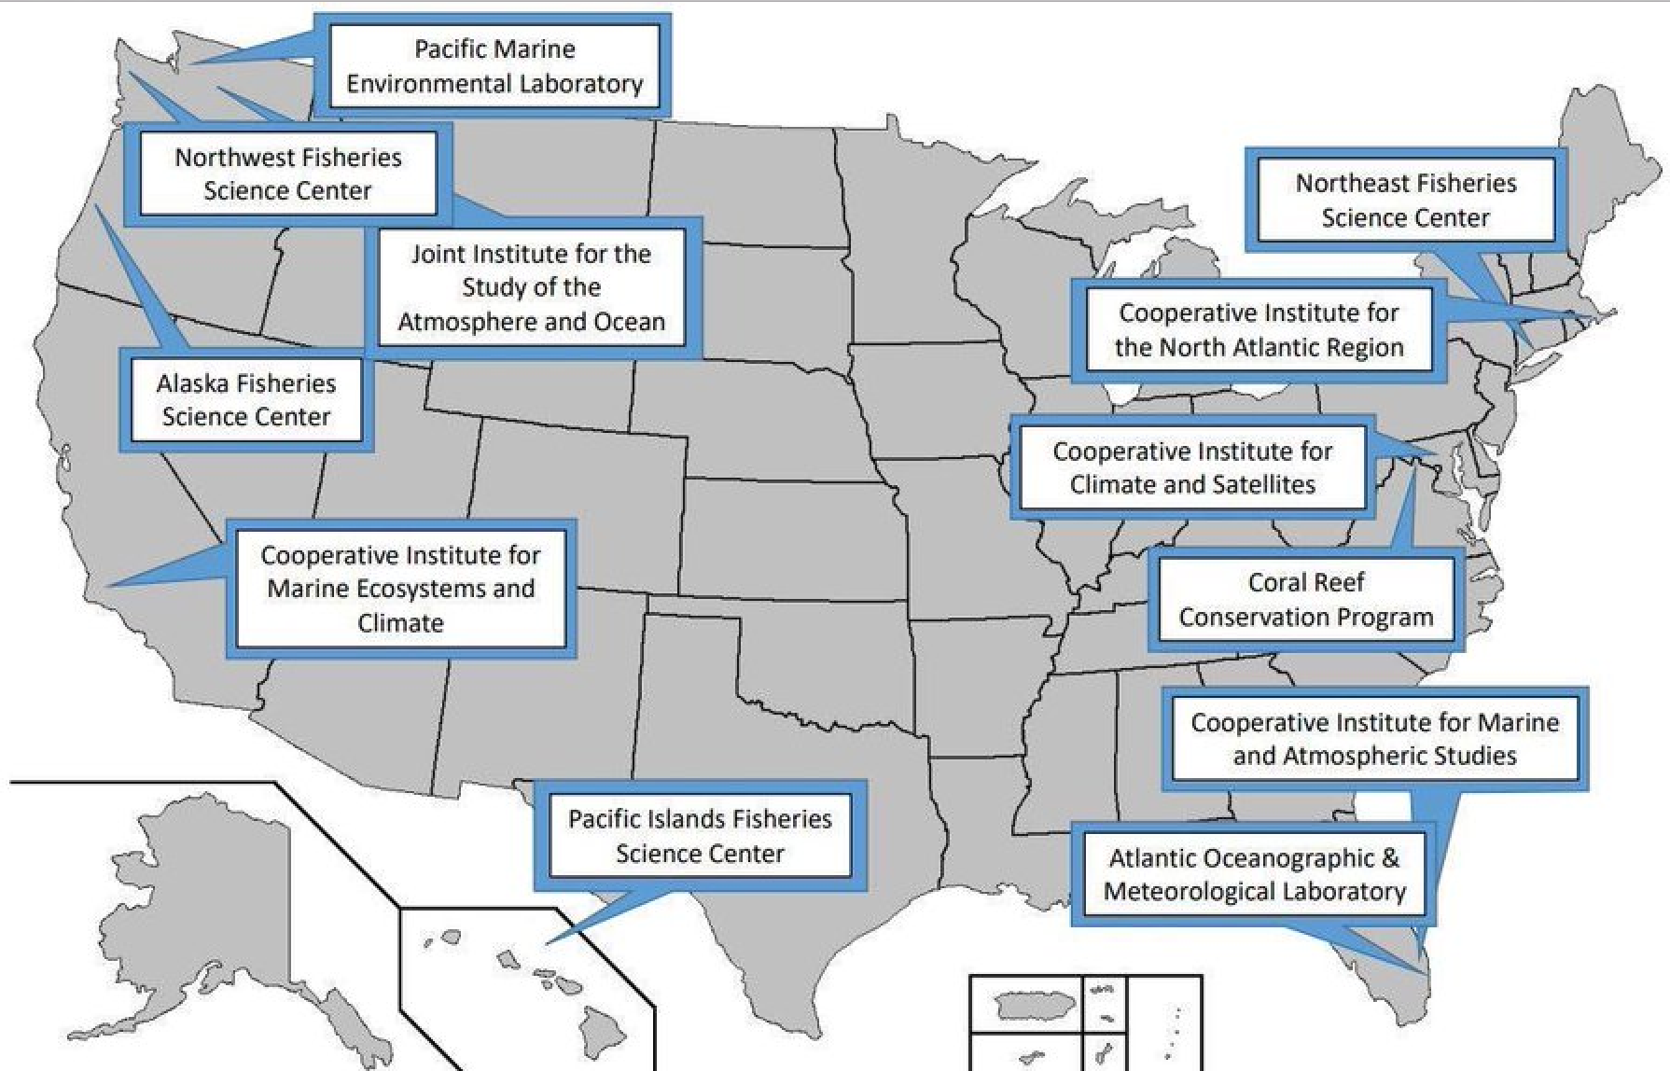

Slide 5
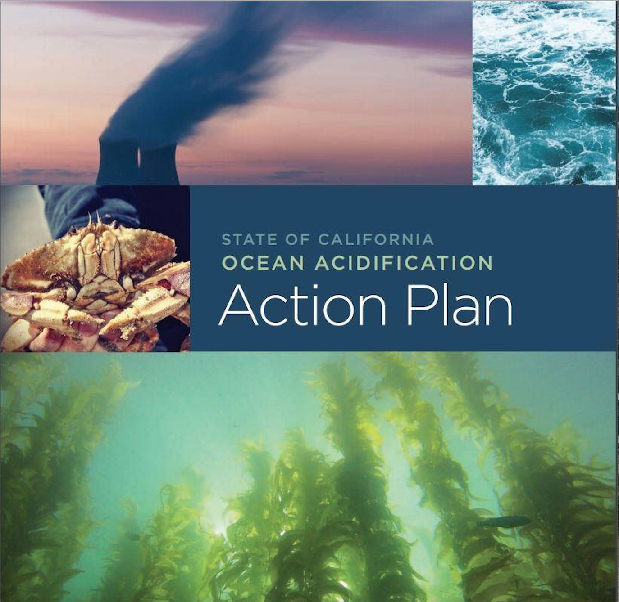

Slide 6
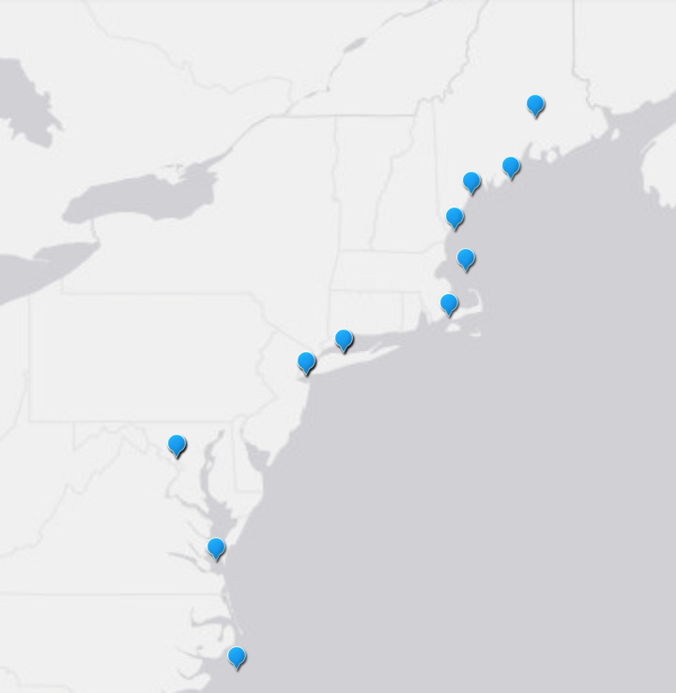
Northeast U.S. OA Research Projects

Slide 7
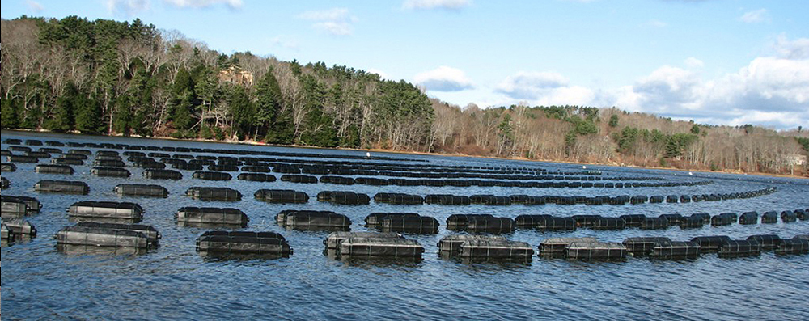
Coastal Acidification
Ocean and Coastal Acidification Thresholds from Long Island Sound to the Nova Scotian Shelf

