Slide 1


Current research questions being addressed in the ongoing IPCC Special Report on the Ocean and Cryosphere in a Changing Climate (SROCC)
Changing Ocean, Marine Ecosystems and Dependent Communities
William W. L. Cheung
Associate Professor and Canada Research Chair, Institute for the Oceans and Fisheries, University of British Columbia

Slide 2
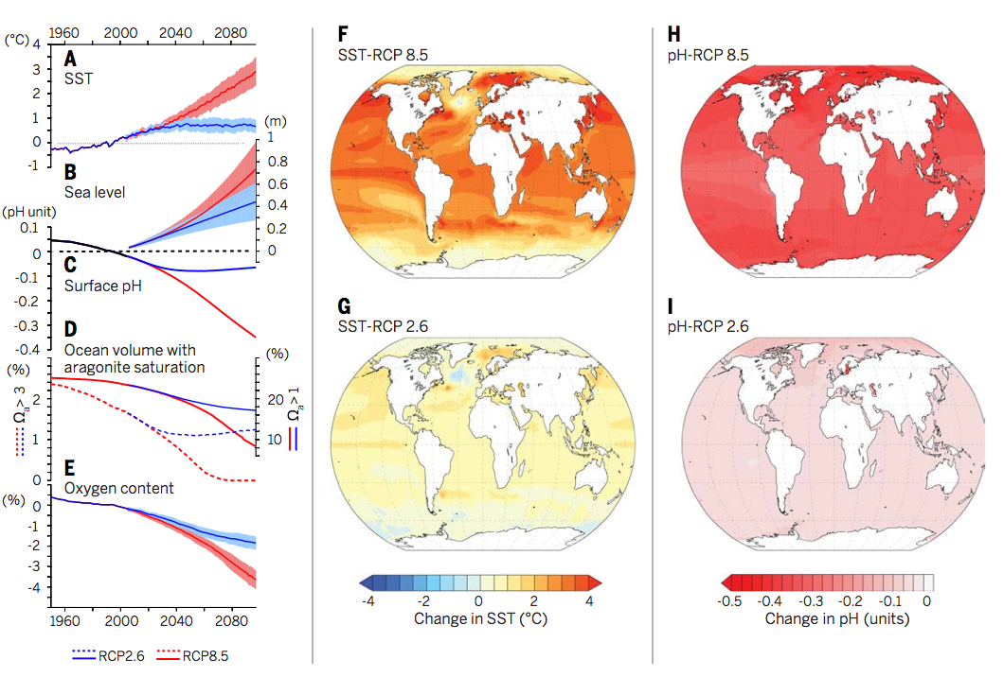
Established understanding from IPCC Fifth Assessment
Temperature
Gattuso, Magnan, Billé, Cheung, Howes, Joos, et al. 2015 Science.

Slide 3
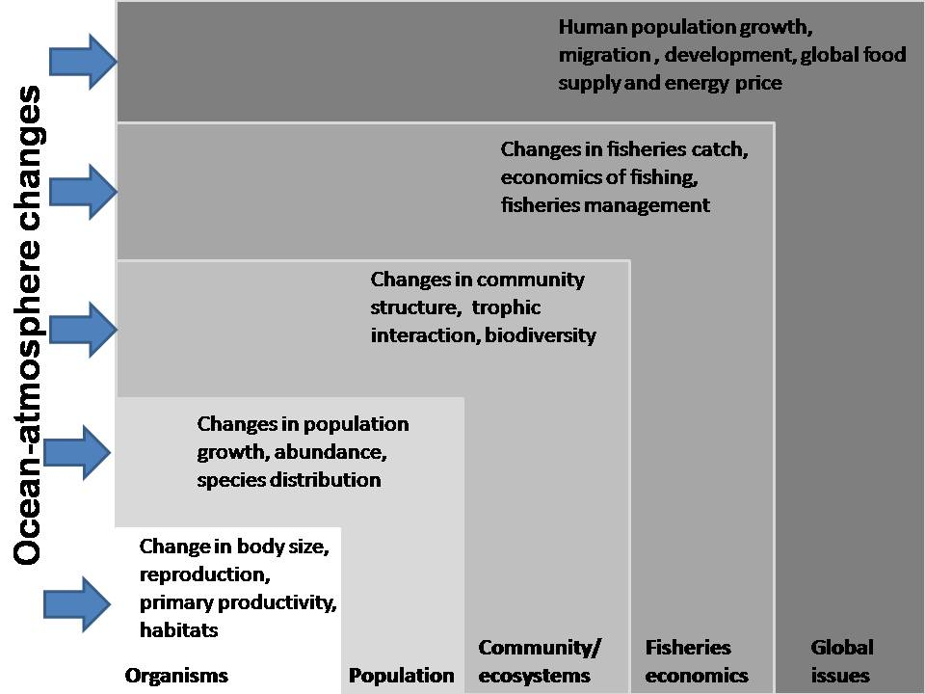
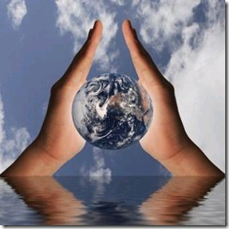

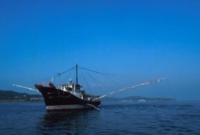


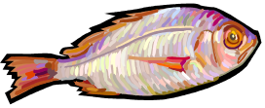
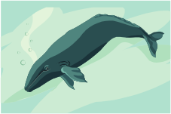

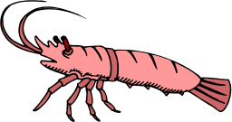
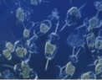
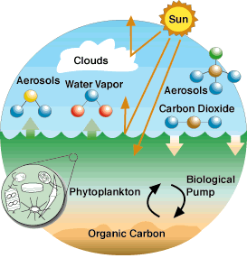
Linking climate effects on ocean, ecosystems and human communities
Physical
Biological
Social/Economics
From: Sumaila, Cheung, Lam, Pauly, Herrick (2011) Nature Climate Change

Slide 4
Research questions being addressed in SROCC
What are the key changes in the physical and biogeochemical properties of the oceans as a result of human climate influences?
How does these affect marine biodiversity and ecosystem functions, particularly under multiple climatic and other non-climatic human stressors?
How does these ocean and ecosystem changes affect ecosystem services and human wellbeing?
How effective are different nature-based climate solutions e.g., coastal blue carbon and open/deep ocean initiative?
What are the pathways for adaptation for marine dependent human communities?

Slide 5
Expected contributions of SROCC
Providing the latest assessment on the past, current and future changes of the ocean properties that are most relevant to marine ecosystems and human communities;
Highlighting the effects of climate change on different aspects of human-wellbeing, from economics/livelihood, food provision, social security to culture;
Pointing out the biggest opportunities and challenges to address these risks and impacts through adaptation and mitigation from the ocean perspectives.

Slide 6
Thank you
William Cheung
w.cheung@oceans.ubc.ca
Twitter: @coru_ubc

