Slide 1
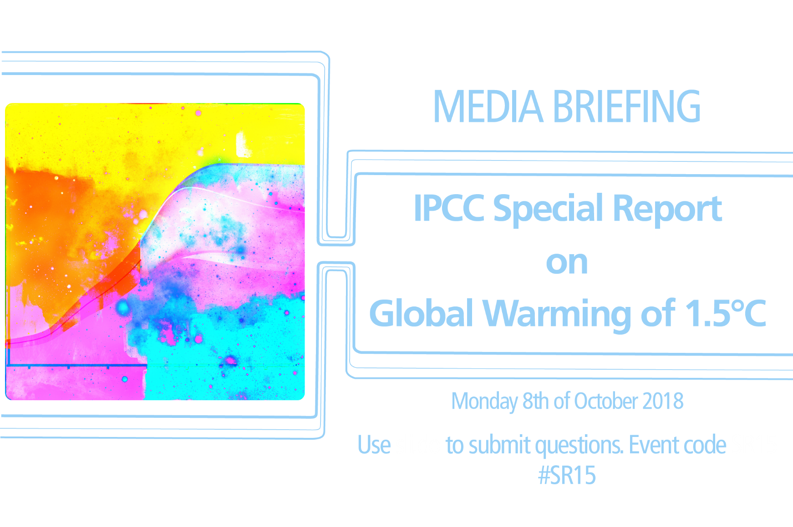
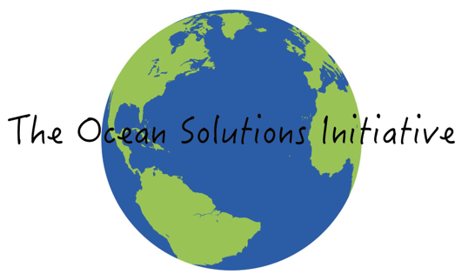
Implications of the
for Oceans and Peoples
Hans-O. Pörtner
IPCC Working Group II Co-Chair
Avoided Impacts:
Guiding AMBITION in mitigation and adaptation

Slide 2

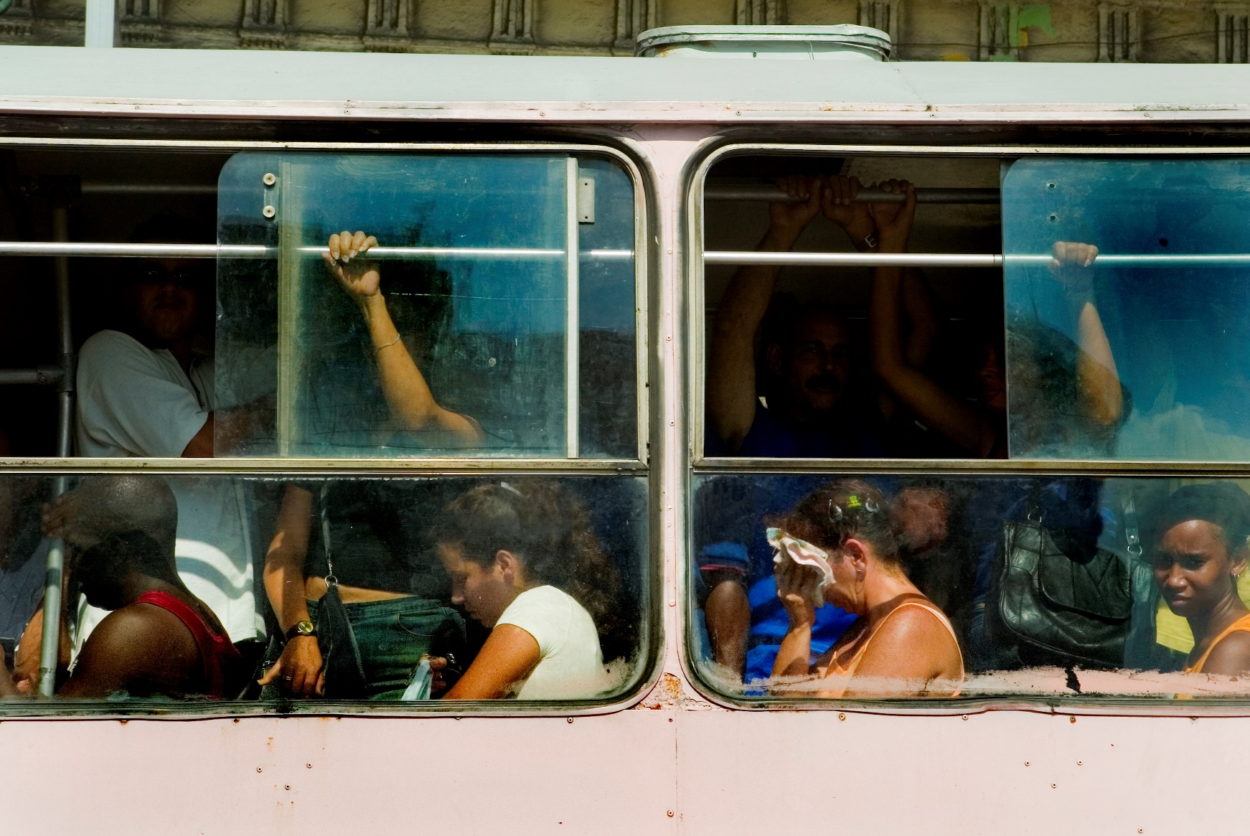

Impacts of global warming:
Where do we want to go?
At 1.5°C compared to 2°C:
Clear differences in climate and extremes between today, a 1.5°C and a 2°C warmer world
Less impacts from extreme weather where people live
By 2100, global mean sea level rise will be around 10 cm lower …. but will continue for centuries
10 million fewer people exposed to risk of rising seas, …less coastal ecosystems exposed
Jason Florio / Aurora Photos

Slide 3
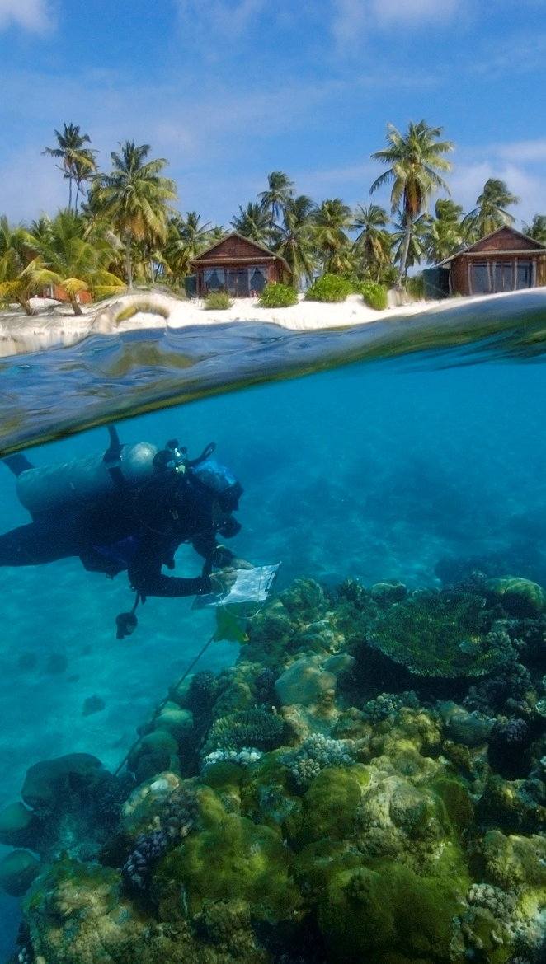
Where do we want to go?
At 1.5°C compared to 2°C:
Up to several hundred million fewer people exposed to climate-related risk and susceptible to poverty by 2050
Lower impact on biodiversity and species
Lower risk to fisheries & the livelihoods that depend on them
Andre Seale / Aurora Photos

Slide 4
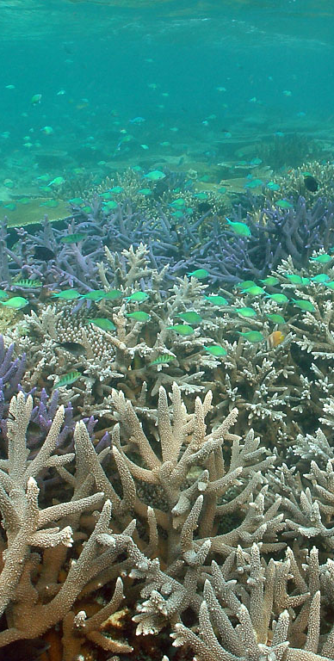
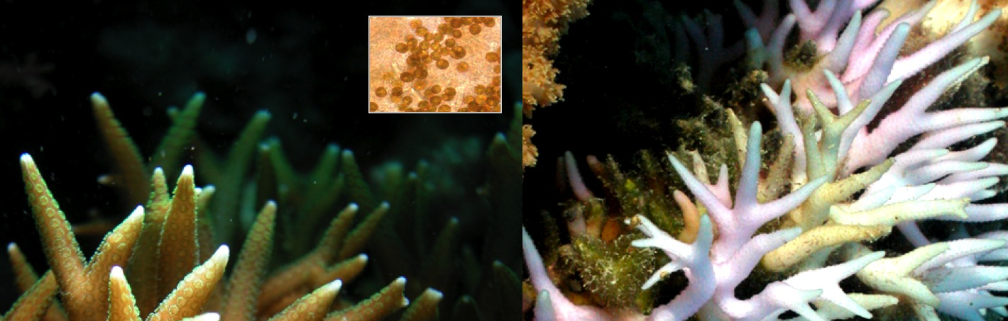
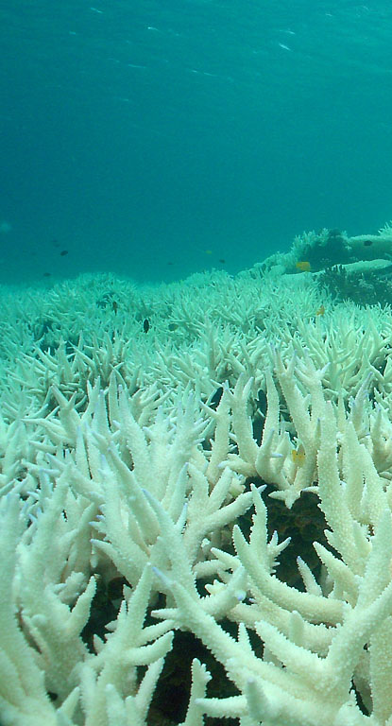
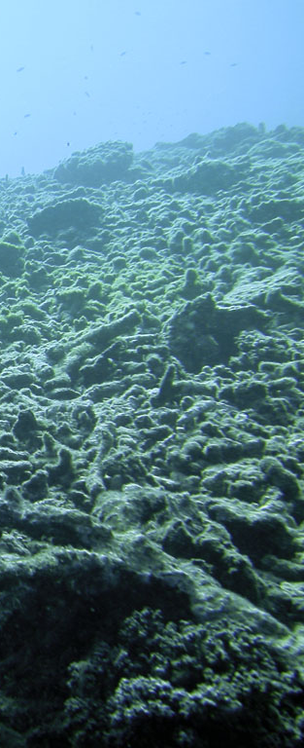
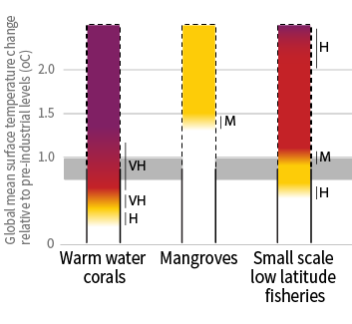
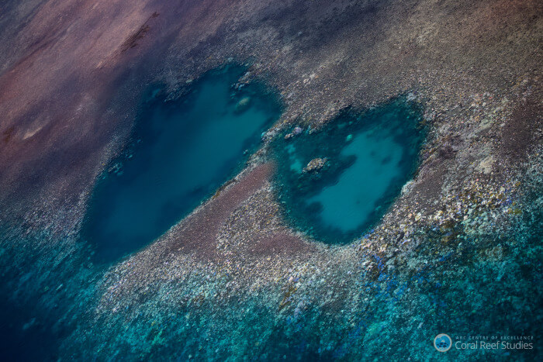
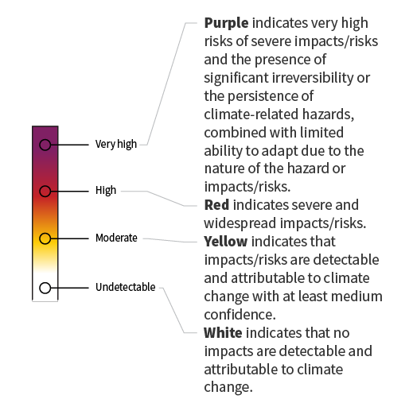
OBSERVATIONS
0.8 to 1.0°C
Vulnerable ecosystem identified in AR5 and SR1.5
Warm water coral reefs under various pressures
Assessing risk of global warming
Even in a 1.5°C warmer world.... high risk of losing 70 to 90% of coral reefs and their services to humankind; … even higher losses at 2°C
2.0°C
1.5°C
2006-
2015
2016
low
mod.
high
very high
Risk level
Verons 2009

Slide 5
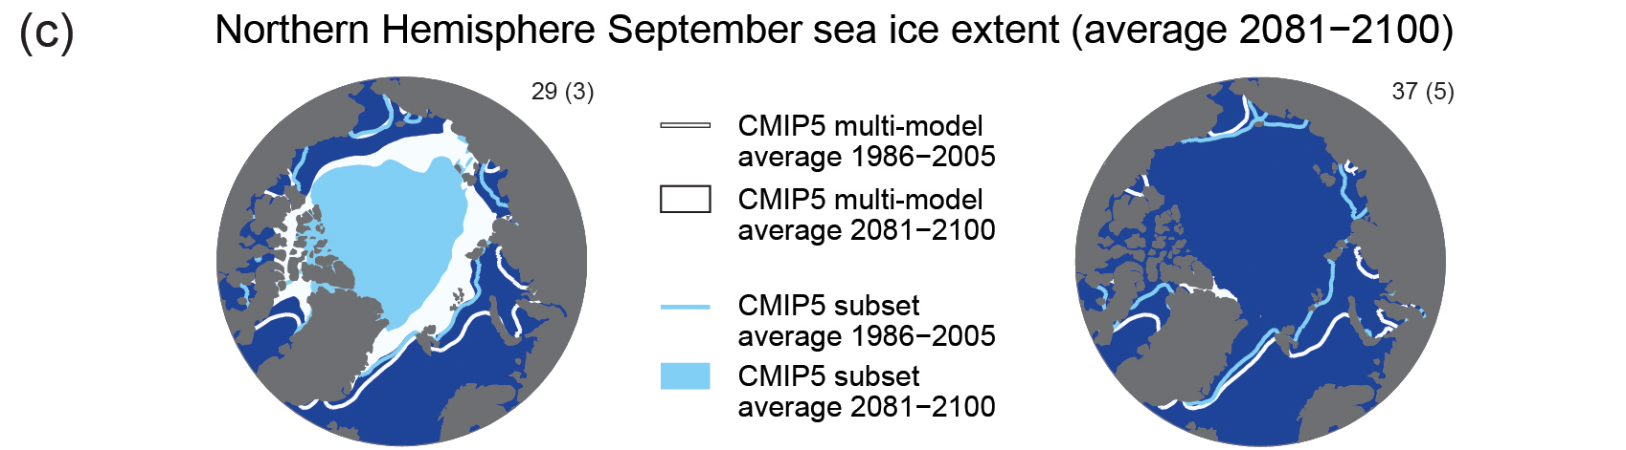
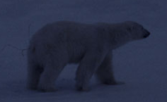
Vulnerable ecosystems identified in AR5 and SR1.5:
Arctic summer sea ice systems
1.5°C
≥2°C
RCP 2.6
RCP 8.5
ambitious mitigation
business as usual
1 in 100 years ice-free
at 1.5°C
> 1 in 10 years ice-free at 2°C
A warmer Arctic:
Implications for climate extremes and impacts (Northern hemisphere summer and winter extremes)
©H.O. Pörtner
AR5 WGI SPM.7b, 8c
Notes:
Figure SPM.7, Panel b
Complete caption of Figure SPM.7:
Figure SPM.7 | CMIP5 multi-model simulated time series from 1950 to 2100 for Northern Hemisphere September sea ice extent (5-year running mean). Time series of projections and a measure of uncertainty (shading) are shown for scenarios RCP2.6 (blue) and RCP8.5 (red). Black (grey shading) is the modelled historical evolution using historical reconstructed forcings. The mean and associated uncertainties averaged over 2081−2100 are given for all RCP scenarios as colored vertical bars. The numbers of CMIP5 models used to calculate the multi-model mean is indicated. For sea ice extent (b), the projected mean and uncertainty (minimum-maximum range) of the subset of models that most closely reproduce the climatological mean state and 1979 to 2012 trend of the Arctic sea ice is given (number of models given in brackets). For completeness, the CMIP5 multi-model mean is also indicated with dotted lines. The dashed line represents nearly ice-free conditions (i.e., when sea ice extent is less than 106 km2 for at least five consecutive years). For further technical details see the Technical Summary Supplementary Material {Figures 6.28, 12.5, and 12.28–12.31; Figures TS.15, TS.17, and TS.20}

Slide 6
Where do we want to go?
At 1.5 and even more so at 2°C, there is disproportionately high risk for Arctic, small island developing states and least developed countries
At 1.5°C compared to 2°C:
Lower risks for health, livelihoods, food security, water supply, human security and economic growth
A wide range of adaptation options can reduce climate risks; less adaptation needs at 1.5°C
Jason Florio / Aurora Photos

Slide 7
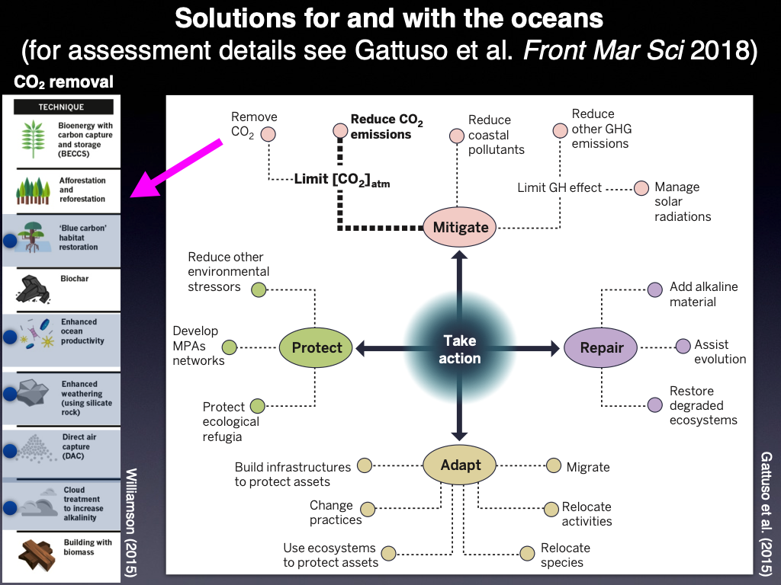

Slide 8
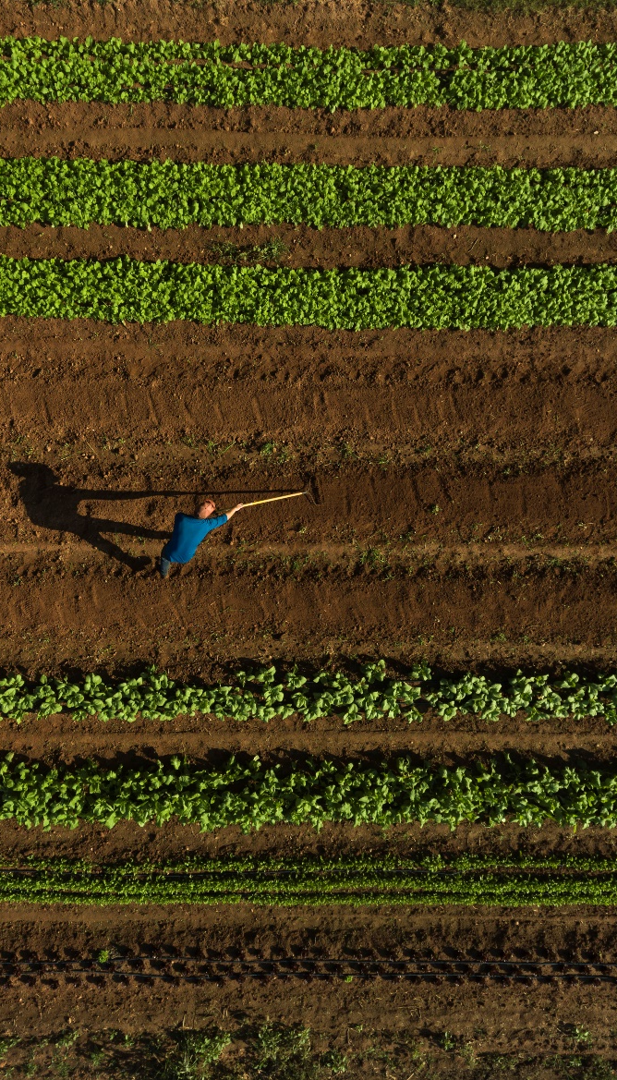
Ambitious emissions reductions would have…
Co-benefits for
Human health
  Biodiversity and ecosystem conservation
  Food security for humankind
  Ecosystem restoration and carbon storage (mangroves, seagrasses, kelp biomass)
Peter Essick / Aurora Photos

Slide 9
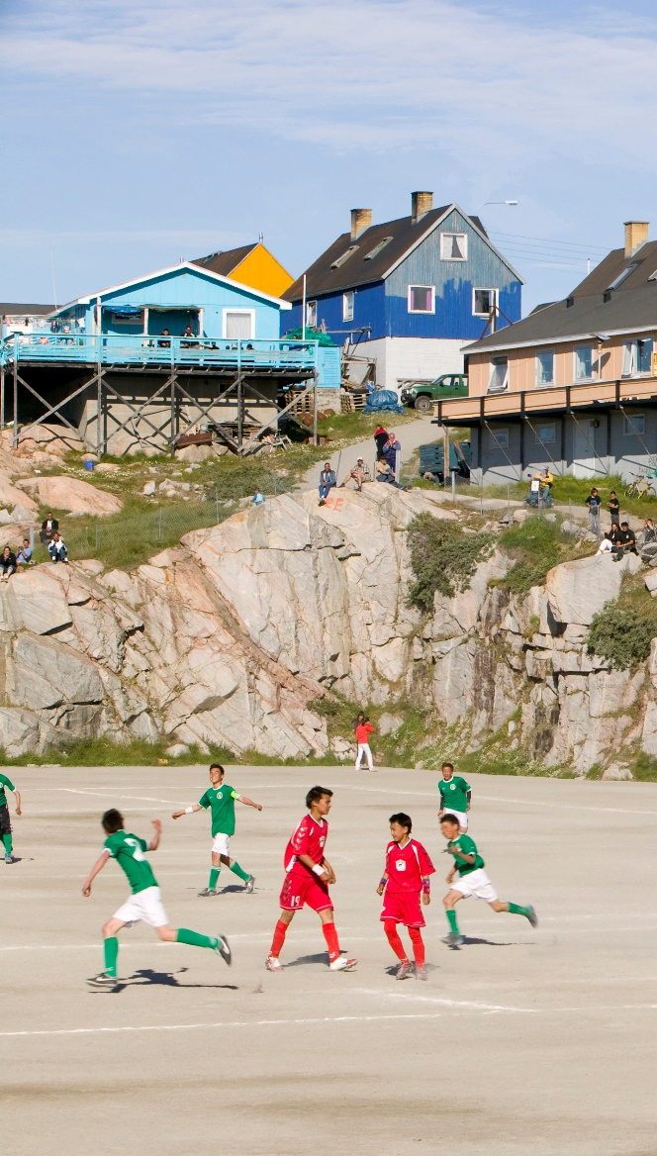
For minimizing impacts and associated risks….
Half a degree…,
…every bit of warming matters
Each year matters
Each choice matters
Ashley Cooper/ Aurora Photos

Slide 10
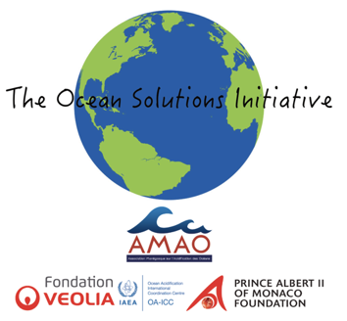
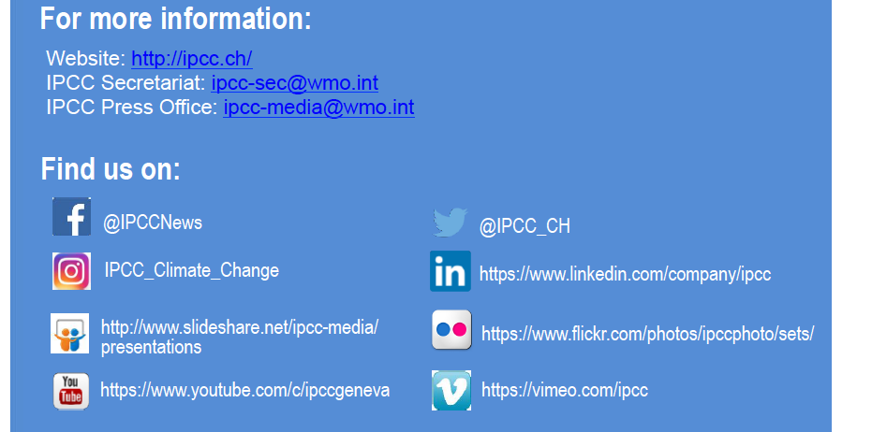
Thank you for your attention

