Slide 1
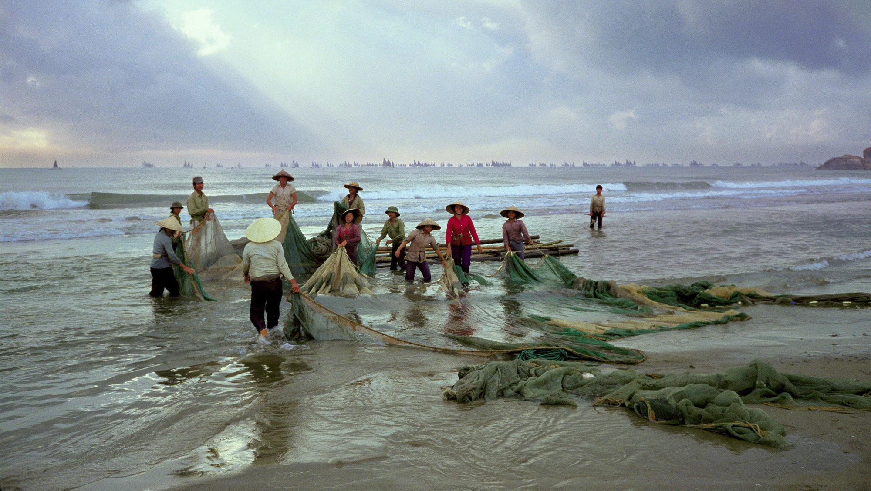
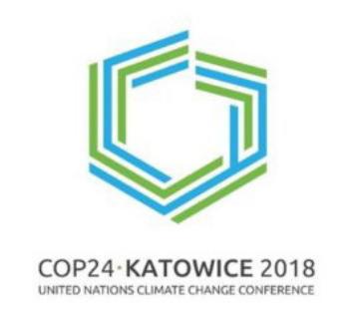

Fisheries and Aquaculture Sustainability in a Changing Climate
Manuel Barange
Director Fisheries and Aquaculture Division
Food and Agriculture Organization of the UN, Rome, Italy (manuel.barange@fao.org)

Slide 2

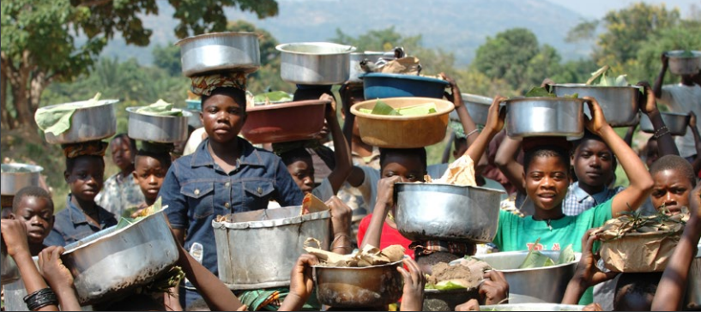
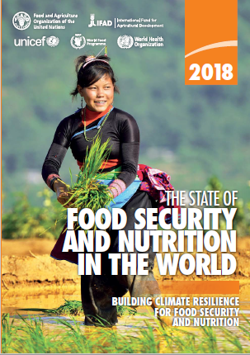
State of Food Security and Nutrition – Regressing
AGRICULTURE
50% of habitable land
70% of all water use
25% of GHG emissions

Slide 3
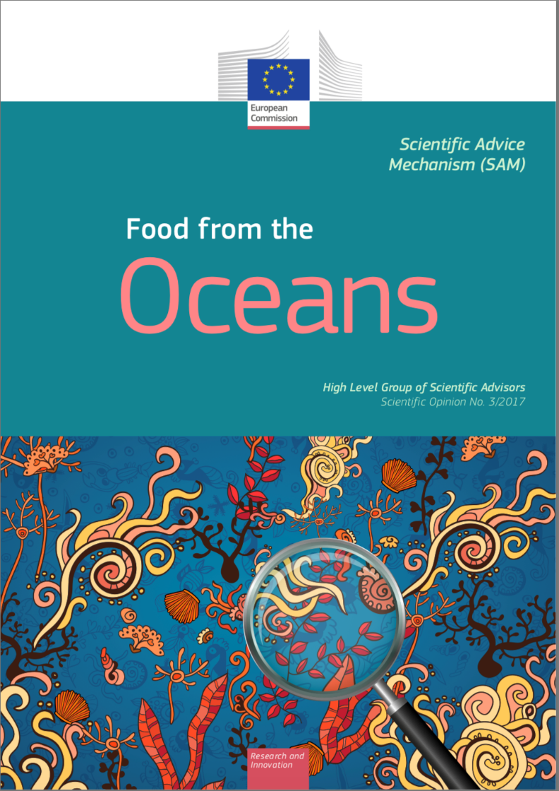
Increased calls to obtain more food from Oceans
How to do so in the era of climate change is less obvious
2016 FAO data – Marine systems
88.3 million t for food (32% from marine aquaculture)
19.7 million t non-food use
58% of all food fish is from Ocean sources
32% of all Ocean food fish
Marine Capture
Marine Aquaculture

Slide 4

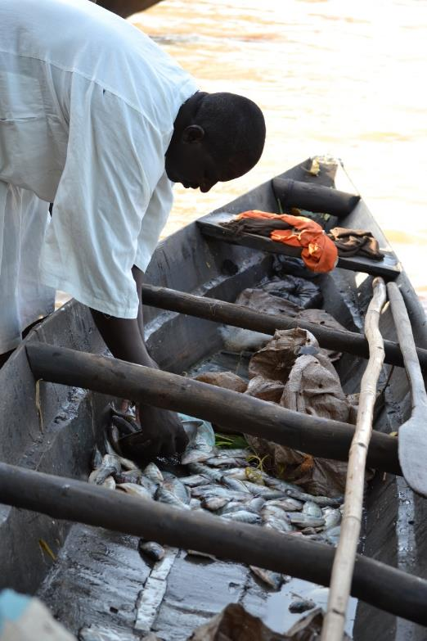
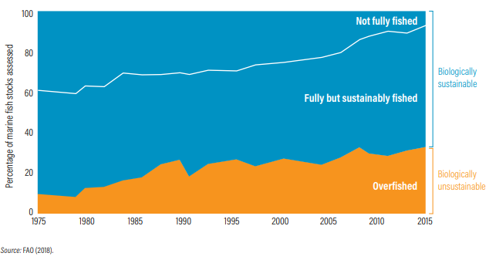
To achieve SDG14.4, all commercial fish stocks should be in GREEN

Slide 5
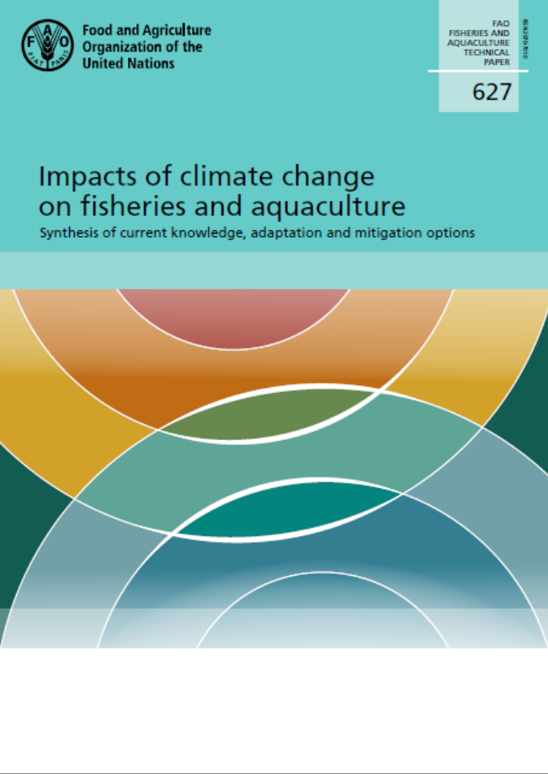
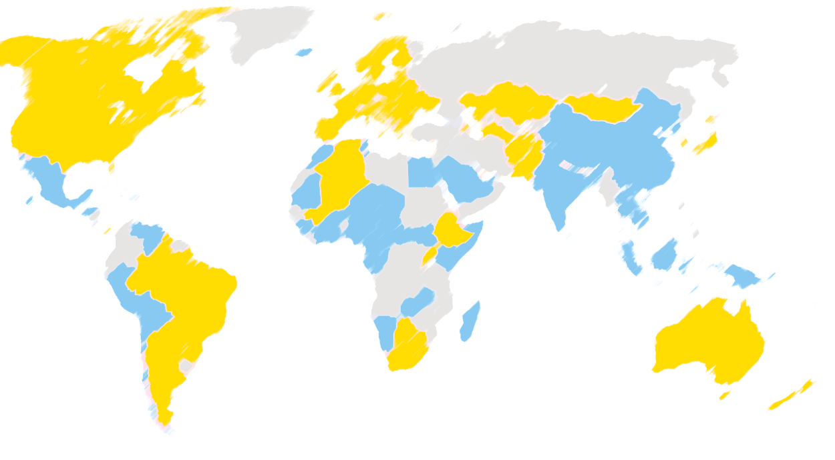


SQUARING THE CIRCLE: Here comes Climate Change
Fisheries and aquaculture reported in the NDCs (78 countries)
>100 Authors / > 50 Reviewers
> 600 pages of country-by-country assessments
Disaggregated information on F&A impacts and responses
Fisheries and aquaculture not reported in the NDCs

Slide 6
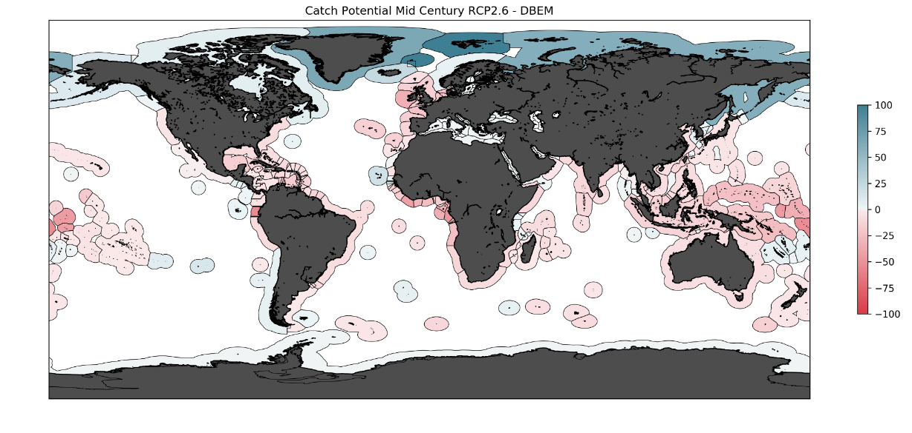
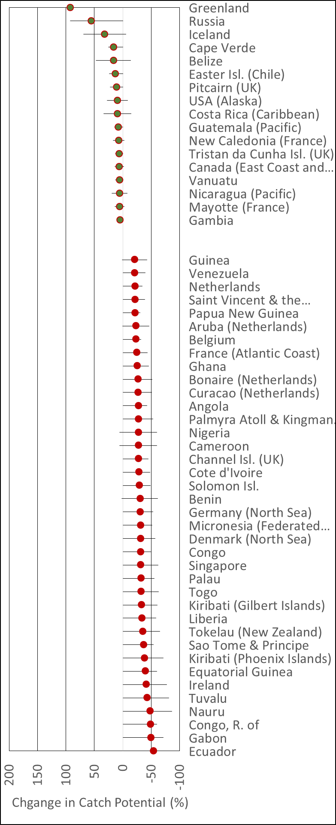
Climate Change will affect all industries : Fisheries included
Change of Catch Potential by 2050 (model – RCP2.6 emissions)
(>5% Growth)
…/…
(>20% Decline)
Global fish catch potential = (-) 2.8-5.3% (RCP2.6) or (-) 7.0-12.1 (RCP8.5) by 2050
Impacts largely negative but with large geographical differences
Tropical regions (particularly Pacific SIDS) are worse affected
A large number of EEZs will see new transboundary stocks
Change in Catch Potential (%) 2050

Slide 7

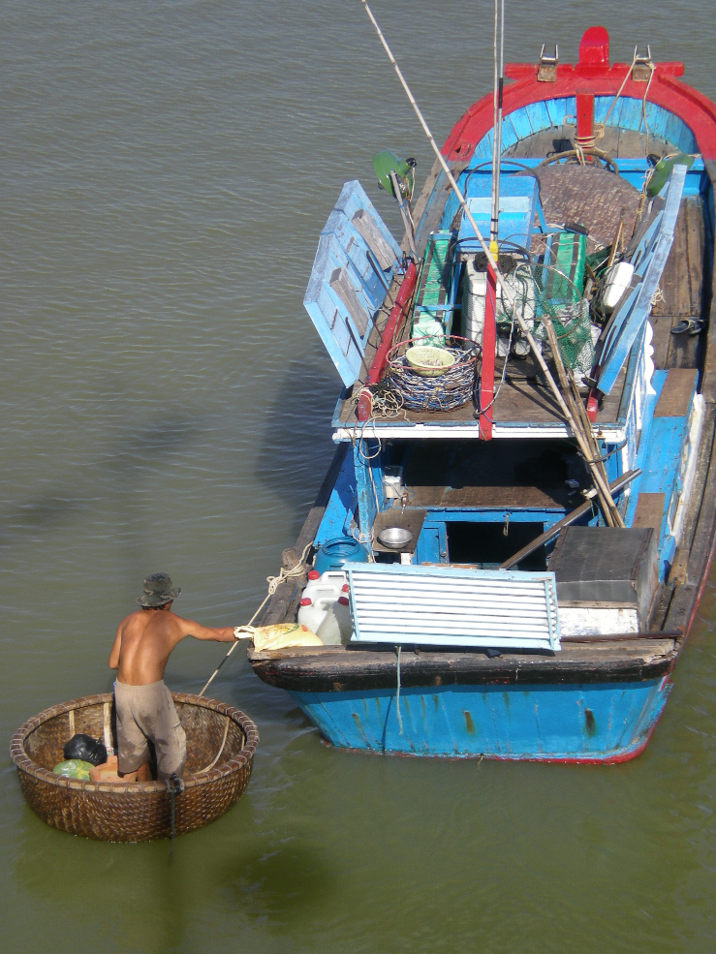
Adaptation is possible, necessary and urgent
International / National / Regional / Watershed / Management Area
Institutional Adaptation
Livelihoods Adaptation
Risk Reduction and Resilience
Public Policies
Institutional Frameworks
Within Sector
Between Sectors
Risk Pooling and Transfer
Early Warning
Legal Frameworks
Management and Planning
_______...
_______...
_______...
Risk Reduction
Preparedness and Response
_______...
_______...
_______...
_______...
_______...
_______...
Adaptation is placed and context based
Adaptation should be viewed as an on-going and iterative process
We adapt to the possible rather than the probable – our predictive capability for most fisheries is in its infancy
Positive and timely Adaptation can have very positive results - Maladaptation can lead to terrible outcomes

Slide 8
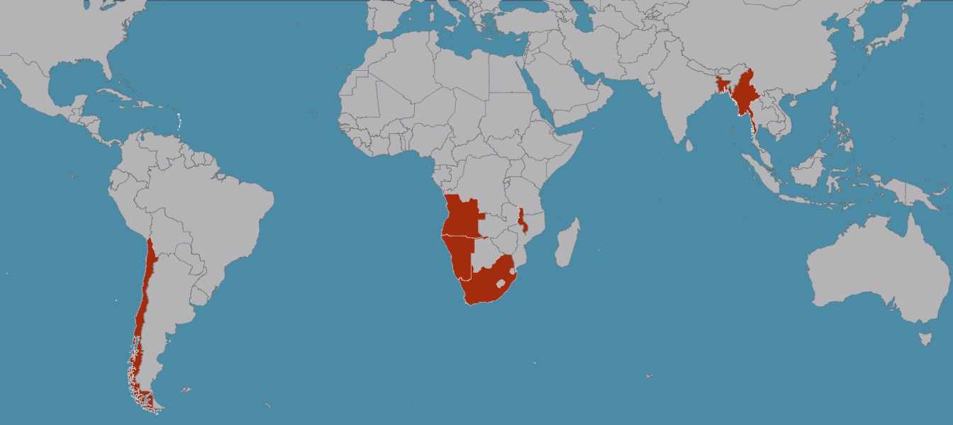
FAO- GEF Adaptation programme
Eastern Caribbean 2016-19; $5.4 m
Myanmar 2017-20
Malawi 2017-21
$5.4m
Chile 2016-18
$2.5m
Benguela Current 2017-20, $4.7m
  New resources mobilized for 2019 projects to implement the FAO toolbox in: St Kits and Nevis, St Vincent and the Grenadines, St Lucia, Angola, Namibia, Chile and the Philippines.

Slide 9

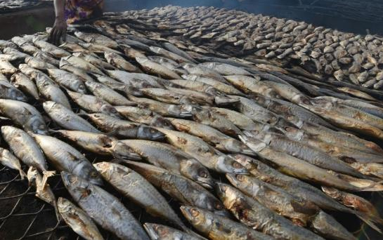
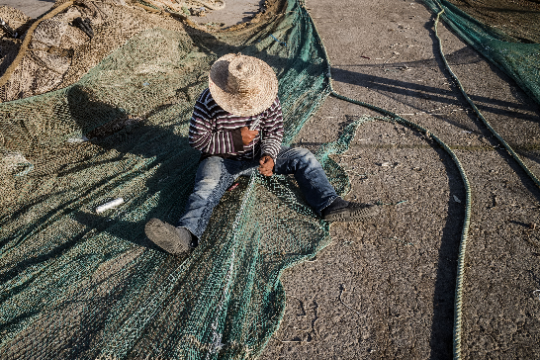
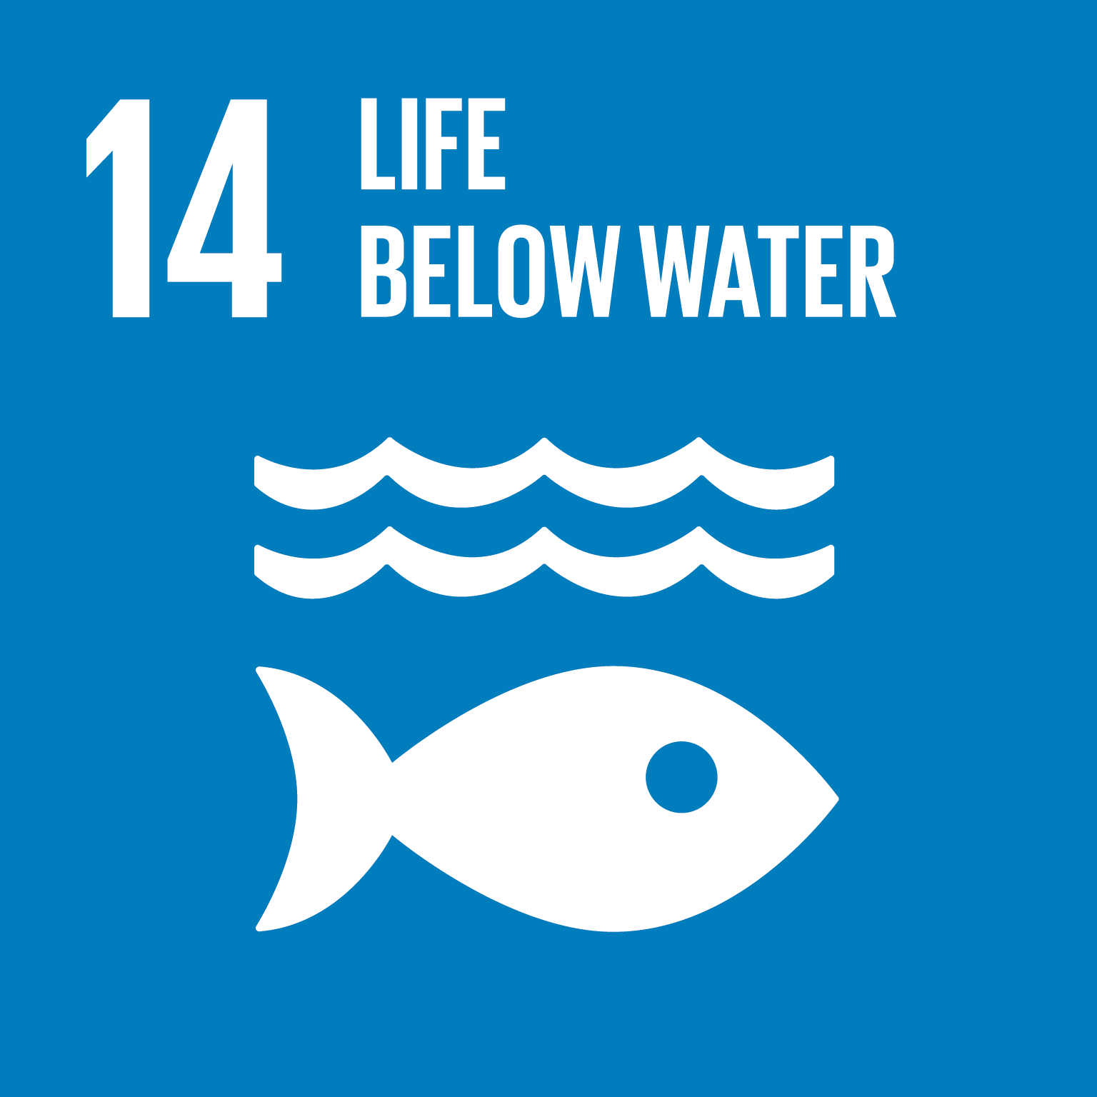
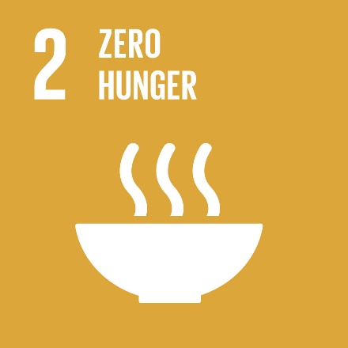
Adaptation to climate change – Key messages
Not a zero-sum game, or a fight to maintain status quo, but there will be winners and losers.
Appropriate management response crucial to minimize threats and maximize opportunities – we know what to do!
Effective and coordinated adaptation essential to avoid limiting the adaptation options of neighbours
We need political commitment and societal support – recent events show this is not simple

Slide 10
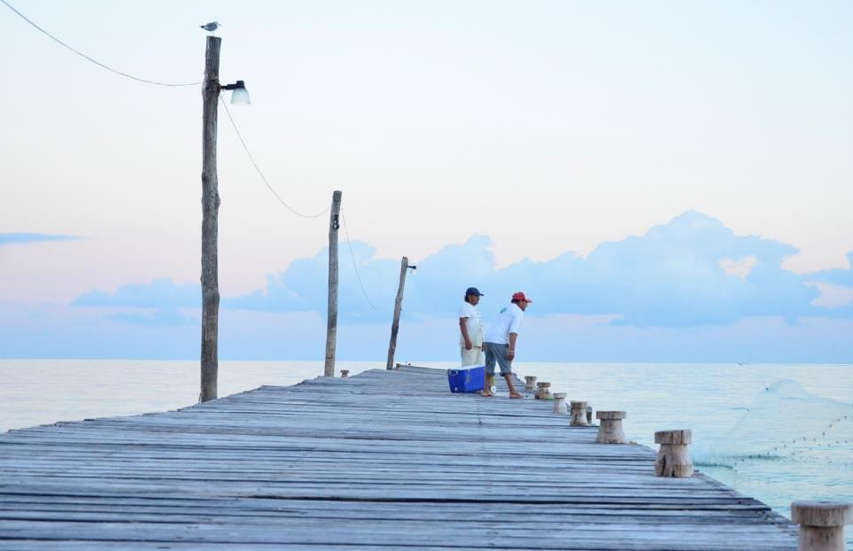
For more details on how to respond:
Part II of this talk:
Food from the Oceans in the era of climate change
UN Side event COP24:
Actions on Ocean Acidification - the Other CO₂ Problem – towards realising sustainable development
Saturday 8th December 13:15-14:45
Room Narew

