Slide 1

Update on Tracking Finance for Ocean Conservation and Climate Action
Dr. Biliana Cicin-Sain, Global Ocean Forum, Dr. John Virdin and Mr. Tibor Vegh, Duke University and ROCA
COP 24, Katowice, Poland
1

Slide 2
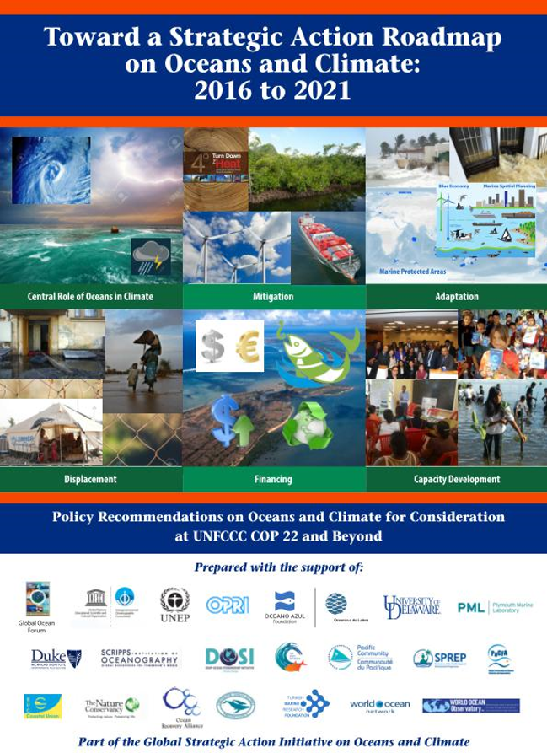
Why track financing of Ocean Conservation and Climate Action together?
ROCA emphasized feedback loops between climate change and other human-related drivers of change in the ocean–impacts are cumulative
Need to consider climate action (i.e. mitigation and/or adaptation efforts) and ocean conservation together.
Drivers
Nested
Nested Ocean
Social
Ecosystems
Governance
(Policy Instruments + Delivery Mechanisms)
Systems
Ecosystem Services
Source: Adapted from Ommer et al. (2011)

Slide 3
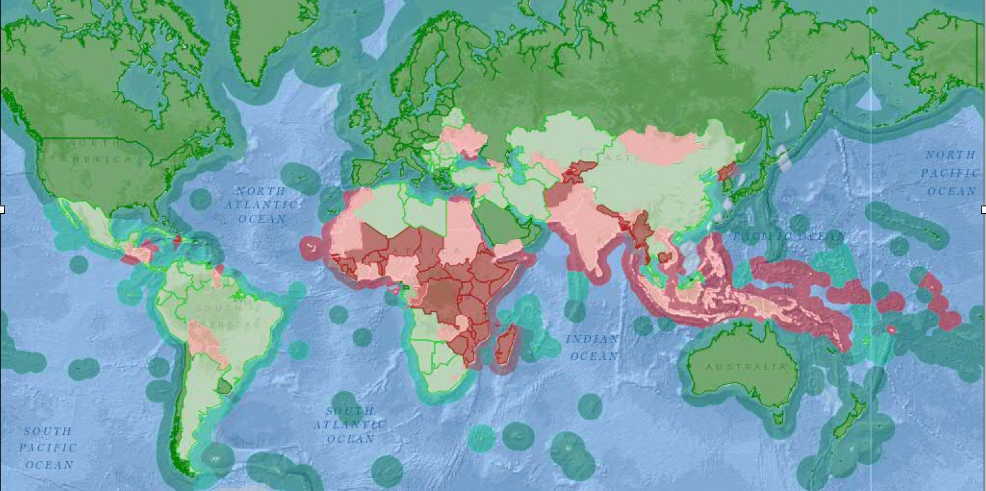

Types of Finance for Ocean Conservation and Climate Action
The need for financing costs of ocean conservation and climate action: 54 lower and lower-middle income are coastal or small island states, where in aggregate almost 2/3rds of the national territory is ocean.
Public Financing
3 Common Types of Finance:
Grants
Concessional Investments
Mature Debt & Equity Investments
        Low income (GNI/cap < $1,035)
        Lower-Middle Income (GNI/cap $1,036 - $4,085)
        Upper-Middle Income (GNI/cap $4,086 - $12,615)
        High Income (GNI/cap > $12,616)
Countries
incl. ocean area
Source: Blue Ribbon Panel to the Global Partnership for Oceans, 2013

Slide 4
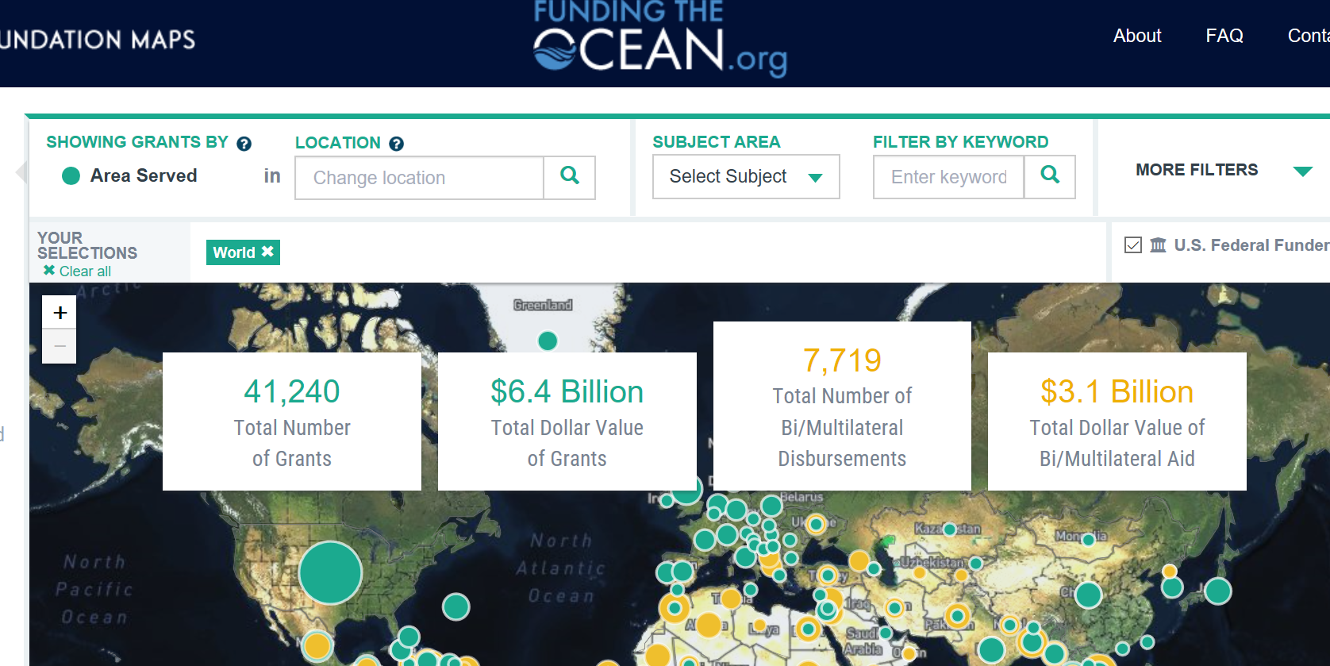
Scope of Initial Tracking Efforts
Objective: to track public financing of ocean conservation and climate action in lower and lower-middle income states – starting at the international level
Aims to build upon (but not duplicate) existing tools like Funding the Ocean.Org:
How does this add to existing efforts?
Looks at climate action and financing together with ocean conservation
Additional international financiers
Maps financing to relevant SDG targets

Slide 5

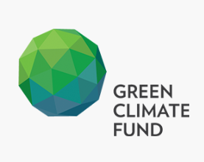

Scope of Initial Tracking Efforts: International Level
Tracking public finance at the international level, from:
  Global Environment Facility (GEF)–including Special Climate Change Fund, Least Developed Countries Fund, etc.
  Green Climate Fund
  World Bank
  Regional development banks: e.g. the African Development Bank, the Asian Development Bank, and the Inter-American Development Bank
  NOTE: This tracking (i.e. the following analytical framework) could form the basis for additional codes to be used by these organizations, in order to report financing based on SDG targets for ocean conservation and climate action.

Slide 6
Analytical Framework
Track international public financing over time, by type of intervention and SDG target, as well as ROCA actions if applicable (also by geography of recipients, SIDS, etc.):
Type of Intervention Financed | SDG 14 target supported | Other targets supported (SDGs, ROCA)
Ocean pollution reduction measures | 14.1
Coastal and ocean ecosystem management and protection measures | 14.2, 14.3, 14.5 | 13.1; ROCA actions
Ocean fisheries management measures Measures targeted to support small-scale fisheries | 14.4 14.7
Measures to help coastal populations adapt to climate-related impacts |  | 13.1; ROCA actions
Coastal and SIDS population displacement |  | ROCA actions
Measures to reduce ocean-linked anthropogenic sources of greenhouse gases |  | ROCA actions
Measures to increase ocean-based sources of renewable energy |  | 7.2; ROCA actions

Slide 7
Analytical Framework cont.
For interventions to support ‘coastal and ocean ecosystem management and protection measures’, more specificity can be provided, linked to targets:
Sub-Category of ecosystem management & protection measures | SDG 14 target supported | Other targets supported (SDGs, ROCA)
Coastal and ocean protected area measures | 14.5
Measures explicitly targeted to help ocean ecosystems adapt to climate-related impacts, including: Ocean temperature increases Sea level rise and storm surge Acidification | 14.3 | 13.1; ROCA actions
Measures explicitly aiming to enhance coastal sinks of greenhouse gases |  | ROCA actions
All other coastal and ocean ecosystem management and protection measures | 14.2

Slide 8
Initial Results–Green Climate Fund (GCF)
Search strings of terms linked to analytical framework found:
From 2015–2018: a total of 24 projects (out of 96 GCF projects in total) (25 %) supporting ocean conservation and climate action in some form, for a total of US$741.2 million
87% aimed to help coastal populations adapt to climate-related impacts: total of US$636.3 million
Average total project cost (GCF + co-financing): US$ 76.8 million
Average GCF financing per project: US$ 30.9 million
Average estimated project duration: 5.6 years

Slide 9
Initial Results–Green Climate Fund Projects
Distribution of projects and funding by type of intervention and relevant targets: 2015-2018
Type of Intervention* | # of Projects Supporting the Type of Intervention | Total Financing (US$ m) | Relevant Targets
Ocean pollution reduction measures | 0 | 0 | SDG 14.1
Coastal and ocean ecosystem management and protection measures Coastal and ocean protected area measures Measures to help ocean ecosystems adapt Measures to enhance coastal GHG sinks All other ecosystem management | 0 6 0 0 | 0 91.4 0 0 | SDG 14.5 SDG 14.3; 13.1 SDG 14.2 SDG 14.2
Ocean fisheries management measures | 1 | 6.0 | SDG 14.4; 14.7
Measures to help coastal populations adapt to climate-related impacts | 24 | 636.3 | SDG 13.1
Coastal and SIDS population displacement | 0 | 0
Measures to reduce ocean-linked anthropogenic sources of greenhouse gases | 0 | 0
Measures to increase ocean-based sources of renewable energy | 0 | 0 | SDG 7.2
TOTAL | 31 | 741.2
87%
Notes:
The definition of coastal displacement is based on the following from the ROCA (2016):
A refugee is “any person who is outside their country of origin and unable or unwilling to return there, on account of a well-founded fear of persecution for reasons of race, religion, nationality, membership of a group, or political opinion.”
An environmental refugee is defined as “a person displaced owing to environmental causes, notably land loss and degradation, and natural disaster.”
Migrants are people who leave or flee their home to seek better or safer surroundings. Migration can be voluntary or forced, but generally a combination of choices and constraints are involved.
Climate-induced displacement falls within a “protection gap” between the definition of a migrant and a refugee.

Slide 10
Initial Results–Regional Distribution of GCF Projects Supporting Ocean Conservation and Climate Action
Distribution of the Number of Projects
Distribution of Funding

Slide 11
Initial Results–SIDS
Distribution of GCF financing supporting Ocean Conservation & Climate Action
12 projects targeted to SIDS
Total funding of US$ 376.5 million
95% of funding aimed to help coastal populations adapt to climate-related impacts

Slide 12
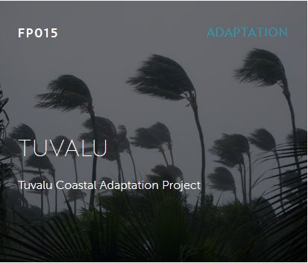
Initial Results–Example of GCF-financed Interventions
Tuvalu Coastal Adaptation Project, 2016-2024
Total Project cost: US$ 38.9 million, 93% financed by GCF
Type of intervention: Measures to help coastal populations adapt to climate-related impacts
Specific interventions to be financed
  Beach nourishment
  Concrete and rock revetments
  Sea walls
  Developing national capacity for resilient coastal management
Summary of targeted outcomes
  Livelihoods of people and communities
  Infrastructure and built environment
  Gender-responsive development

Slide 13
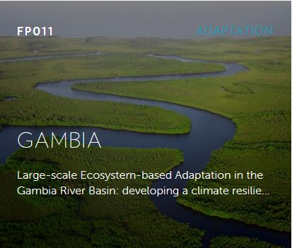
Initial Results–Example of GCF-financed Interventions
Large-scale Ecosystem-based Adaptation in the Gambia River Basin: Developing a climate resilient, natural resource based economy, 2016-2023
Total Project cost: US$ 25.5 million, 80% financed by GCF
Type of intervention
  Measures to help coastal populations adapt to climate-related impacts
  Measures explicitly targeted to help ocean ecosystems adapt to climate-related impacts
Specific interventions to be financed
  Restoration of degraded forests and agricultural landscapes
  Establishment of natural resource-based businesses
  Strengthening capacity and policies to implement ecosystem-based adaptation systems
Short list of targeted outcomes
  Health, food and water security
  Livelihoods of people and communities
  Ecosystems and ecosystem services

Slide 14
Next Steps
Review of GEF project database begun: 2,041 projects since the year 2000 were returned in initial review
Review of World Bank project database begun: As many as 2,220 projects since the year 2000 were returned in initial review
Upon completion of GEF and World Bank review, begin review of regional development banks: African Development Bank, Asian Development Bank, Inter-American Development Bank
Review conducted for all projects approved in 2000 or after
Initial output: Baseline trends in international public financing for ocean conservation and climate action, linked to specific SDG targets
This baseline would then be compared to NDC commitments/requests for ocean conservation and climate action, to assess any financing gaps

