Slide 1

Synthesis and Implications of Major Reports and
Analyses of the Oceans and Climate Nexus 2018
Dr Vladimir Ryabinin, IOC

Slide 2
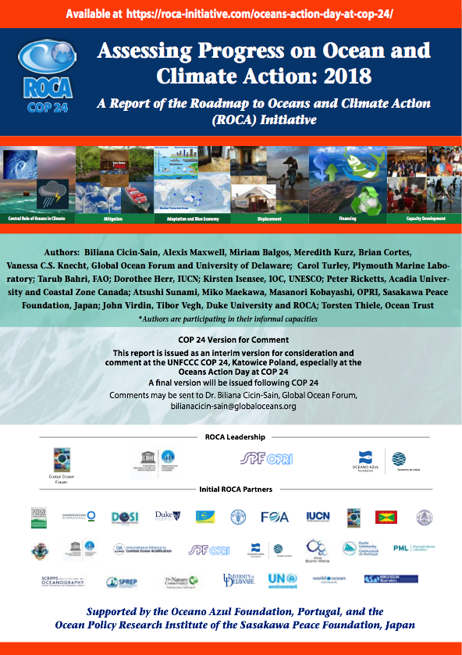
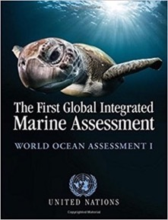
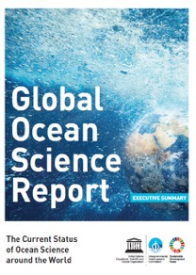
ROCA + Various Assessment Reports
Science and Policy
Nationally Determined Contributions
Mitigation
Adaptation
Blue Economy
Population Displacement
Financing
Capacity Development
AR5, SRCCL, SROCC, AR6

Slide 3

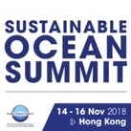

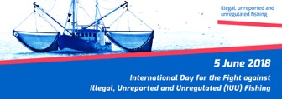
Growing Awareness: Conferences, Groups, Days
9 Communities
of Ocean Action
Friends of Ocean Action
UN Global Compact Sustainable Ocean Business Action Platform
High-Level Panel
on Sustainable
Blue Economy

Slide 4
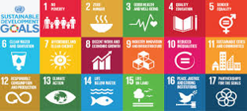
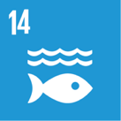




Frameworks
+ Paris
+ Ocean Pathway
+ BBNJ

Slide 5
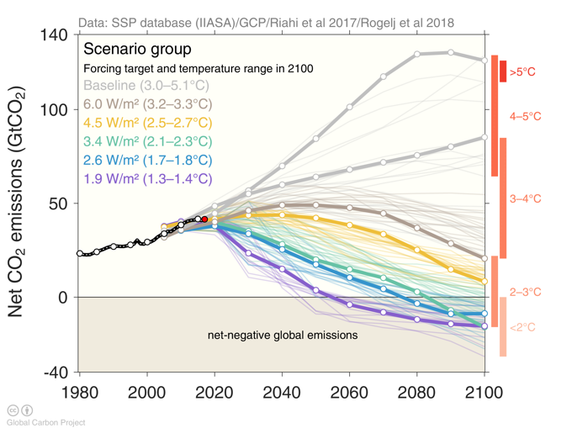
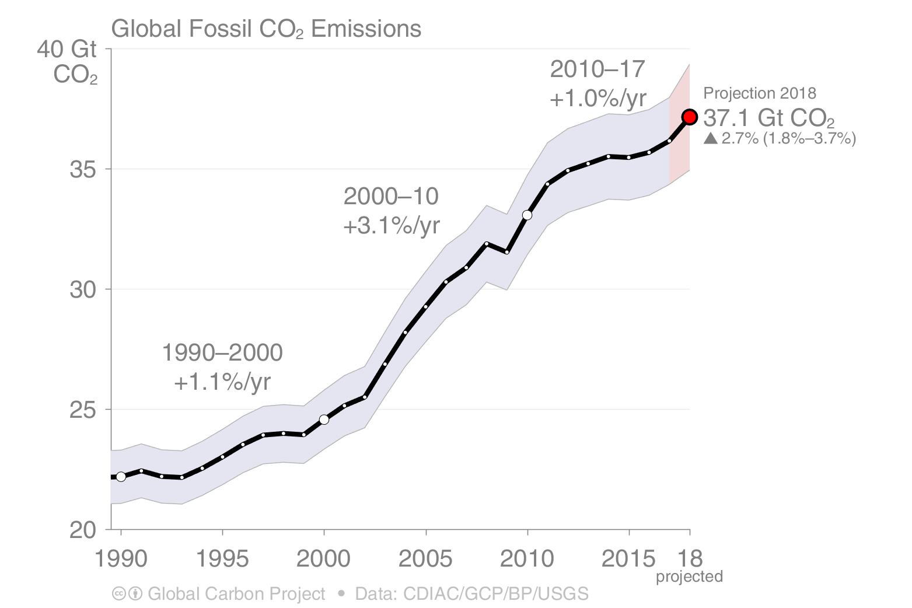
Reality Check: We Are We?
Carbon Emissions and the Shared Socioeconomic Pathways
Source: CDIAC; Le Quéré et al 2018;
Global Carbon Budget 2018
Source: Riahi et al. 2016; Rogelj et al. 2018; IIASA SSP Database; IAMC; Global Carbon Budget 2018

Slide 6

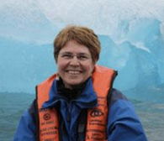
We Do We Want to Go?
The Shared Socioeconomic Pathways
New Social Contract
for Climate
Science
Now
we need one for Ocean Science
Source: Riahi et al. 2016; Rogelj et al. 2018; IIASA SSP Database; IAMC; Global Carbon Budget 2018

Slide 7
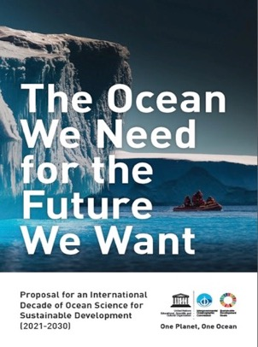
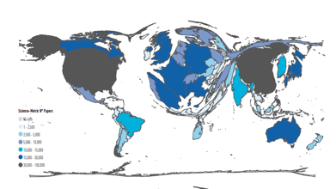
We Do We Want to Go?
Ocean science,
its level of development and potential social contract
Basis: ocean as common heritage of humanity
Can the ocean science offer a platform for leadership?
Motivation: existential issue of sustainable development
Level of science being fit for purpose:
now it is fit for highlighting problems and evaluating the state of the ocean, but is only starting to provide solutions
There are already many good examples of excellent applications. Can this potential be uncovered and how?
2-prong approach:
both cutting edge research & capacity development

Slide 8

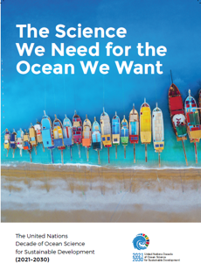
UN Decade of Ocean Science for Sustainable Development (2021- 2030): inclusive & transformative, focused on solutions; once in a life-time opportunity to mainstream and enable ocean science
Science breakthroughs –> top-down designed
Solutions
Mapping
Observations
Eco-system knowledge
Data and Information
Multi-Hazard Warning Systems
Ocean in Earth System Science
CD, Education, Ocean Literacy
Communication
Pickup by practice –> stimulated bottom-up
Aquaculture /
Implementation
Resources

Slide 9


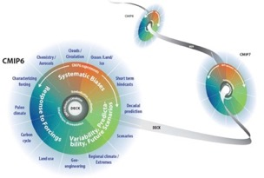

Ocean Prediction Project
Predict the Ocean in Climate using Integrated Assessment Models
Data revolution
Ocean
=
Climate
Knowing Future Ocean
Ocean Literacy
Policy Action
CD
Data
Big
Ocean
Predictive Ecosystem Management
- > towards more ambitious mitigation and adaptation to likely future conditions
Complete the Observing System

Slide 10

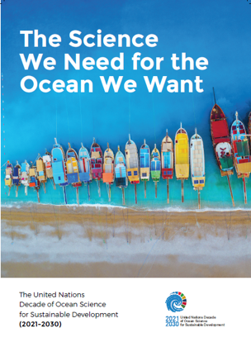



Thank You !
For more information, please contact: j.barbiere@unesco.org
Get involved
Write to us:
oceandecade@unesco.org
Follow all Decade news:
http://oceandecade.org
IocUnesco
IocUnesco
ioc_unesco

